Slide 1
A Game-Theoretic Method to Efficiently Assess the Vulnerability of a Dynamic Transportation Network
Venkateswaran Shekar and Lance Fiondella
Department of Electrical and Computer Engineering
University of Massachusetts Dartmouth

Slide 2
Outline
Motivation
Game Theoretic Vulnerability Assessment
Deterministic Vulnerability Assessment
Example scenario
Conclusion
Future Work

Slide 3
Motivation
Continuing increase in city populations
Expect criticality of transportation infrastructure to increase
Disaster planning, response, and recovery decision support systems
Often assume transportation network completely available
Unrealistic assumption may lead to suboptimal strategy

Slide 4
Static Traffic Assignment
Previous transportation network vulnerability research performed in context of static traffic models
Simplified Assumptions
Travel times of each link on route are added together to determine route travel time
Inflow and Outflow of link equal
Congestion occurs if Volume-to-Capacity ratio (V/C) > 1.0

Slide 5
Dynamic Traffic Assignment
Explicit modeling of traffic flow dynamics
Ensures direct linkage between travel time and congestion
Applications of dynamic transportation models
Congestion and vulnerability assessment
Travel demand function of time

Slide 6
Framework

Slide 7
Deterministic Method
For every edge e in network G
For every time interval $Δt_{i}$ in $ΔT$
Disable edge e during interval $Δt_{i}$
Record travel times of vehicles
Calculate ratio of disrupted travel time with undisrupted travel time
Problem: Method is not scalable

Slide 8
Game Theory
The analysis of competitive situations (or situations of conflicts) using mathematical models
Involves one or more players
Actions taken by players called moves
A set of outcomes for each move
An amount received for each outcome called payoff

Slide 9
Approach
2-player mixed strategy stochastic game
Router vs Tester
Router – Identifies a strategy to distribute traffic over roads to minimize risk
Tester – Develops an attack strategy that maximally disrupts the smooth flow of traffic
Perfect knowledge – Strategy of adversary is immediately known

Slide 10
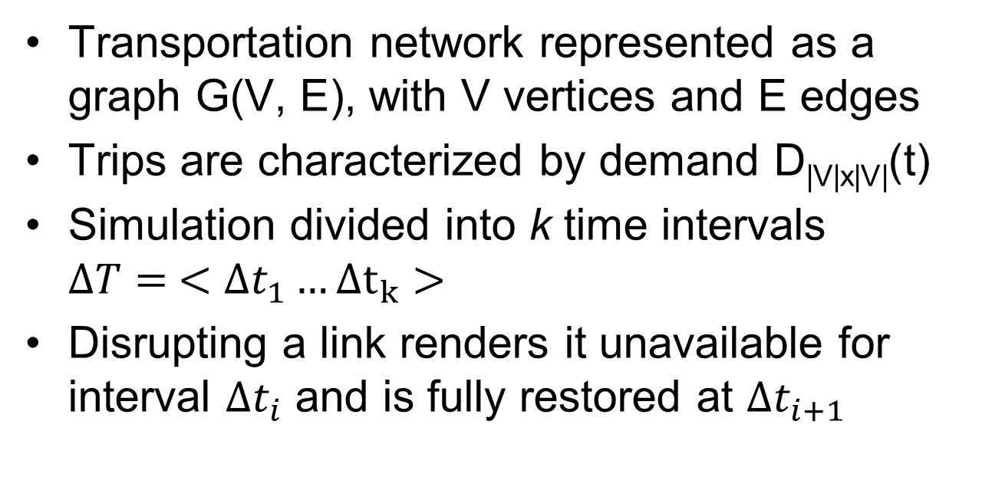
Simulation setup
Transportation network represented as a graph G(V, E), with V vertices and E edges
Trips are characterized by demand D_{|V|x|V|}(t)
Simulation divided into k time intervals $ΔT= <∆t_{1}…Δt_{k}>$
Disrupting a link renders it unavailable for interval $Δt_{i}$ and is fully restored at $Δt_{i+1}$

Slide 11
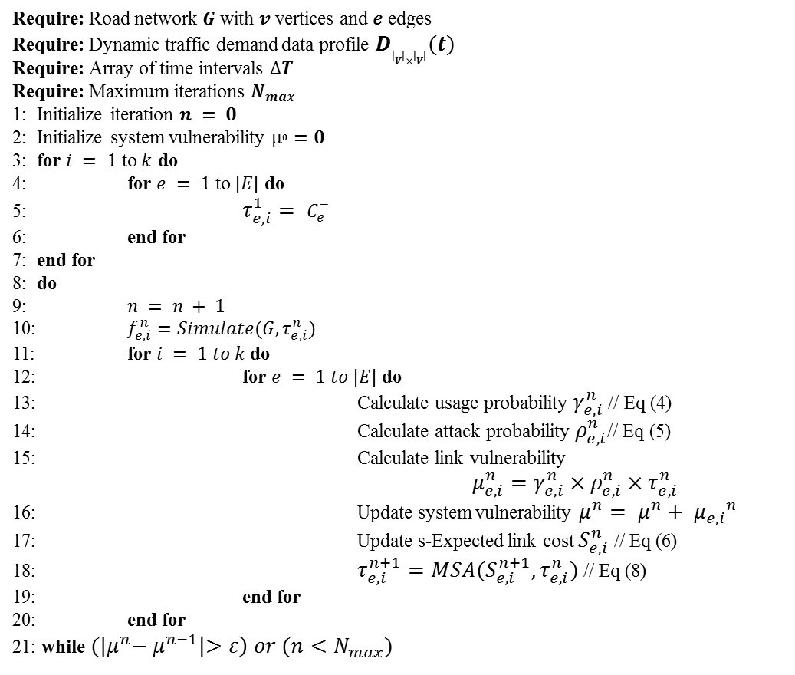
Algorithm
Require: Road network $G$ with $v$ vertices and $e$ edges
Require: Dynamic traffic demand data profile $D_{\left|V\right|×\left|V\right|}(t)$
Require: Array of time intervals $∆T$
Require: Maximum iterations $N_{max}$
1: Initialize iteration $n = 0$
2: Initialize system vulnerability $µ^{0}=0$
3: for $i = 1$ to $k$ do
4: for $e = 1$ to $|E|$ do
5: $τ_{e,i}^{1}= C_{e}^{−}$
6: end for
7: end for
8: do
9: $n = n + 1$
10: $f_{e,i}^{n}=Simulate(G, τ_{e,i}^{n})$
11: for $i = 1 to k$ do
12: for $e = 1 to |E|$ do
13: Calculate usage probability $γ_{e,i}^{n}$ // Eq (4)
14: Calculate attack probability $ρ_{e,i}^{n}$// Eq (5)
15: Calculate link vulnerability
$μ_{e,i}^{n}=γ_{e,i}^{n}×ρ_{e,i}^{n}×τ_{e,i}^{n}$
16: Update system vulnerability $μ^{n}= μ^{n}+ {μ_{e,i}}^{n}$
17: Update s-Expected link cost $S_{e,i}^{n}$ // Eq (6)
18: $τ_{e,i}^{n+1}=MSA(S_{e,i}^{n+1}, τ_{e,i}^{n})$// Eq (8)
19: end for
20: end for
21: while ${(|μ}^{n}− μ^{n−1}\left|>ε\right) or (n<N_{max})$

Slide 12
Illustration
Network Structure
6 Nodes
13 Links
Speed Limit
30 miles/hour
Time intervals
Δt₁ = 0 – 500 sec
Δt₂ = 500 – 1000 sec
Δt₃ = 1000 – 1500 sec
500 vehicles depart node zero
Destination is node five
Simulator: SUMO

Slide 13
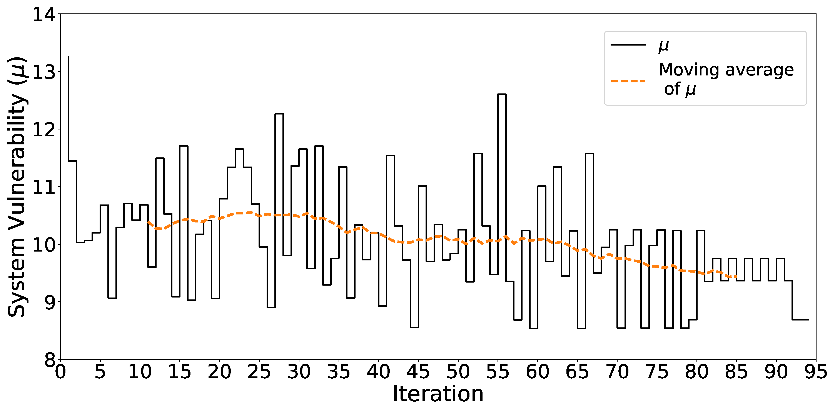
Network Vulnerability
Large variations in vulnerability until the 80th iteration

Slide 14
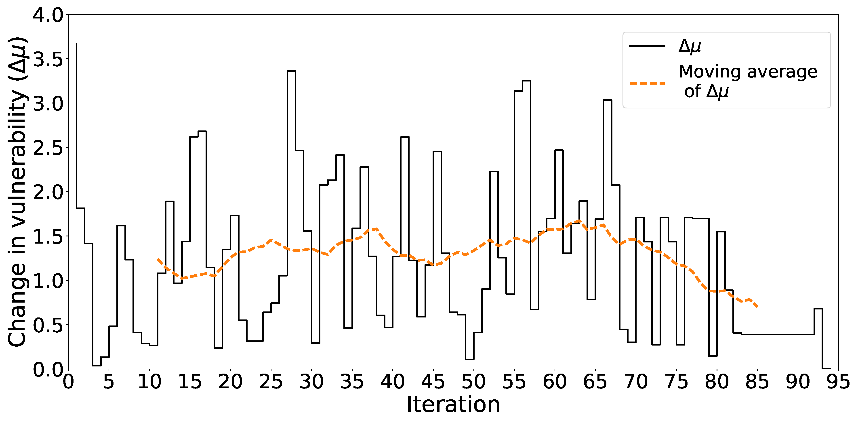
Change in vulnerability
MSA places less emphasis on later strategies forcing convergence

Slide 15
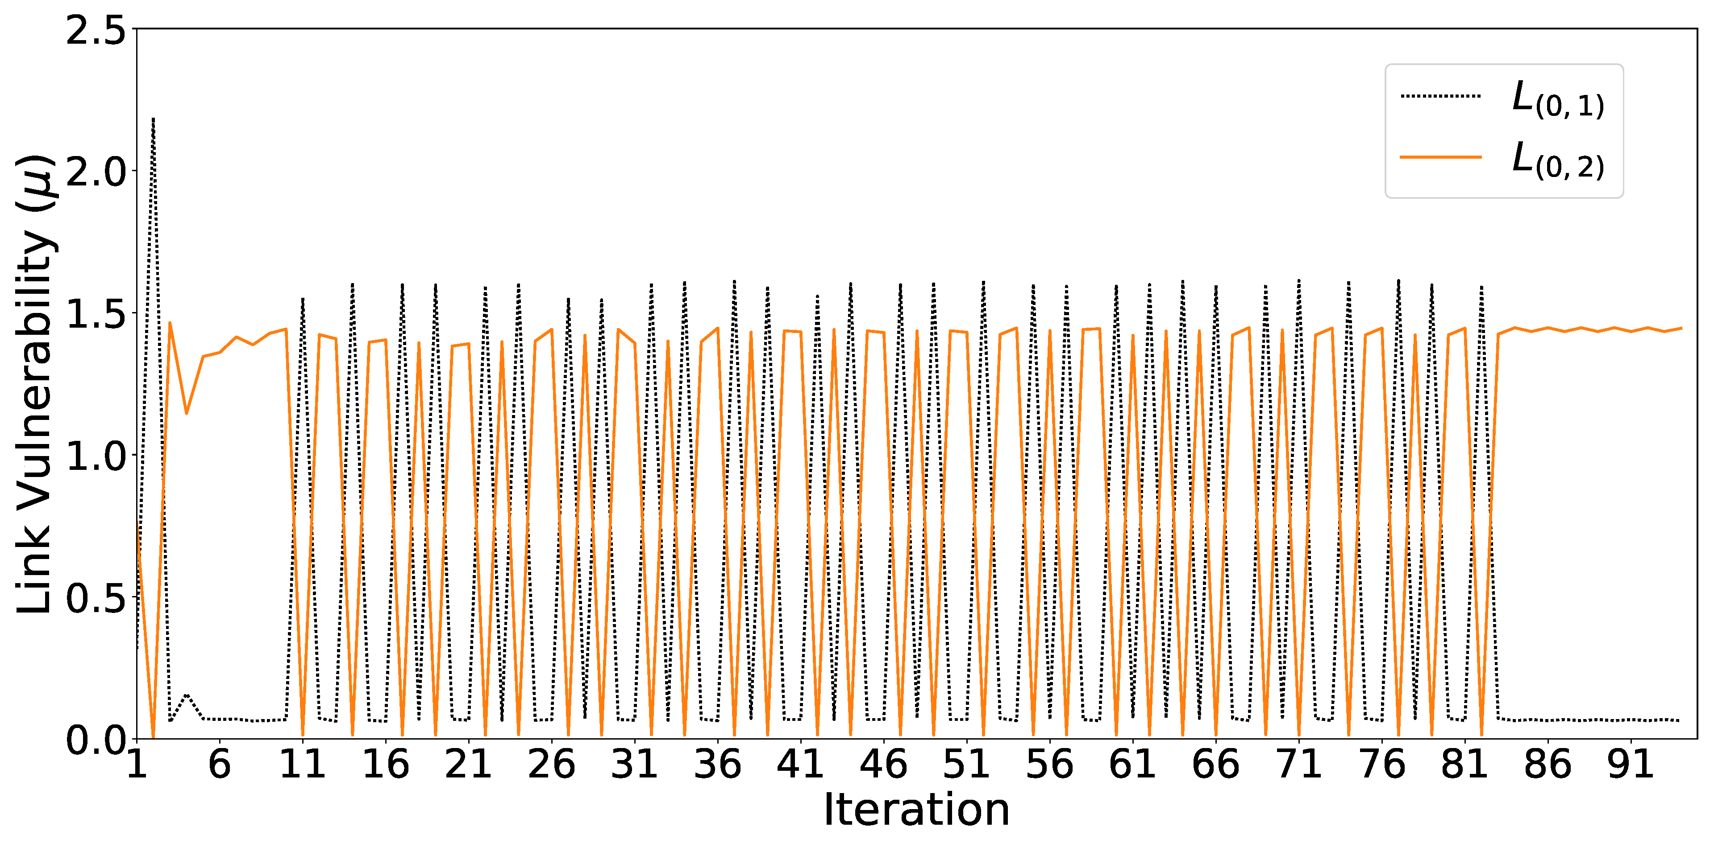
Link Vulnerability
Link level vulnerability oscillates until a stable solution is found

Slide 16
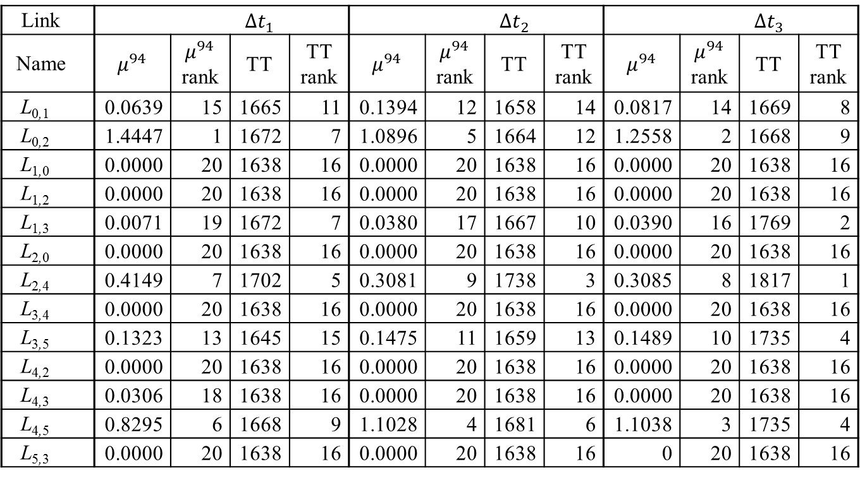
Comparison of game-theoretic and deterministic methods
Link |  |  | $$Δt_{1}$$ |  |  |  | $$Δt_{2}$$ |  |  |  | $$Δt_{3}$$
Name | $$μ^{94}$$ | $μ^{94}$ rank | TT | TT rank | $$μ^{94}$$ | $μ^{94}$ rank | TT | TT rank | $$μ^{94}$$ | $μ^{94}$ rank | TT | TT rank
L_{0,1} | 0.0639 | 15 | 1665 | 11 | 0.1394 | 12 | 1658 | 14 | 0.0817 | 14 | 1669 | 8
L_{0,2} | 1.4447 | 1 | 1672 | 7 | 1.0896 | 5 | 1664 | 12 | 1.2558 | 2 | 1668 | 9
L_{1,0} | 0.0000 | 20 | 1638 | 16 | 0.0000 | 20 | 1638 | 16 | 0.0000 | 20 | 1638 | 16
L_{1,2} | 0.0000 | 20 | 1638 | 16 | 0.0000 | 20 | 1638 | 16 | 0.0000 | 20 | 1638 | 16
L_{1,3} | 0.0071 | 19 | 1672 | 7 | 0.0380 | 17 | 1667 | 10 | 0.0390 | 16 | 1769 | 2
L_{2,0} | 0.0000 | 20 | 1638 | 16 | 0.0000 | 20 | 1638 | 16 | 0.0000 | 20 | 1638 | 16
L_{2,4} | 0.4149 | 7 | 1702 | 5 | 0.3081 | 9 | 1738 | 3 | 0.3085 | 8 | 1817 | 1
L_{3,4} | 0.0000 | 20 | 1638 | 16 | 0.0000 | 20 | 1638 | 16 | 0.0000 | 20 | 1638 | 16
L_{3,5} | 0.1323 | 13 | 1645 | 15 | 0.1475 | 11 | 1659 | 13 | 0.1489 | 10 | 1735 | 4
L_{4,2} | 0.0000 | 20 | 1638 | 16 | 0.0000 | 20 | 1638 | 16 | 0.0000 | 20 | 1638 | 16
L_{4,3} | 0.0306 | 18 | 1638 | 16 | 0.0000 | 20 | 1638 | 16 | 0.0000 | 20 | 1638 | 16
L_{4,5} | 0.8295 | 6 | 1668 | 9 | 1.1028 | 4 | 1681 | 6 | 1.1038 | 3 | 1735 | 4
L_{5,3} | 0.0000 | 20 | 1638 | 16 | 0.0000 | 20 | 1638 | 16 | 0 | 20 | 1638 | 16

Slide 17
Results
Spearman’s rank correlation
Correlation $r_{s}=0.8882$
P value = $4.63×{10}^{−14}$
Strong correlation between the approaches
As size of network increases, number of simulations will reduce

Slide 18
Conclusion
Presented a game-theoretic approach to assess dynamic vulnerability of a transportation network
Attacker seeks to disrupt the normal flow of traffic
Defender attempts to minimize risk
Considers relative vulnerability of all links and time intervals in parallel

