Slide 1
Strategic Planning for ITS Technologies:
Status of Strategic Planning
Status of ITS Architecture
Roundtable Discussion
MAINE
NEW HAMPSHIRE
VERMONT
MASSACHUSETTS
NEITS Annual Meeting – May 10, 2018
Providence RI

Slide 2
What technologies do we strategically plan for?
Connected Vehicle
Interoperability/FirstNet
Master Plans for CCTV, DMS
RWIS - VMS - WIMS
Roundtable Discussion
MAINE
NEW HAMPSHIRE
VERMONT
MASSACHUSETTS
NEITS Annual Meeting – May 10, 2018
Providence RI

Slide 3
New Hampshire HB 314
Roundtable Discussion
MAINE
NEW HAMPSHIRE
VERMONT
MASSACHUSETTS
Quick Points
Would allow car manufacturers to test automated vehicles on New Hampshire roads by January 2019 (Applies to “Level 5” vehicles only)
Anyone with a self-driving vehicle, a $10 million insurance plan and $500 for a state licensing fee could apply with the DOT to test the vehicle on NH roads.
Applicants would be required to produce certification that the vehicle had been previously tested under controlled conditions that would simulate the testing environment in New Hampshire.
They would need to demonstrate a plan for how the vehicle would interact with law enforcement
NE Transportation Consortium
The New England Transportation Consortium (NETC), a cooperative effort of the Departments of Transportation and the Land Grant Universities of the six New England States (CT, NH, ME, MA, RI and VT) has recently begun an initiative to identifying issues related to the testing and deployment of connected and automated vehicles extending beyond state lines.
As a first step, an initial research task is being started to identify multi-state issues. New Hampshire DOT will be participating in this project and can provide lessons learned from the evolving NHDOT ITS Program.
NEITS Annual Meeting – May 10, 2018
Providence RI

Slide 4
Roundtable Discussion
MAINE
NEW HAMPSHIRE
VERMONT
MASSACHUSETTS
Key Areas
Policy and Planning
  Within New Hampshire, the DOT serves as the lead agency of CAV activities.
  With much of the current V2I focus on communications, traffic signals, and various sensor technologies, the TSMO Bureau is representing NHDOT.
Long Range Transportation Plans
  Both increases in capacity and changes to traveler behavior due to automated vehicles are being assessed for NHDOT long range transportation plans.
  If levels of automation continue at the current pace, infrastructure investments will be assessed considering the likely impacts of CAV systems as an additional variable within the model.
Infrastructure
  NHDOT is monitoring the guidance being issued by FHWA, NHTSA and others related to CAV deployment and evaluating any recommended changes.
  Early adoption will likely ease any transition before widespread deployment.
Traffic Control Strategies
  NHDOT is supporting the efforts in Dover, NH to implement various signal controller platforms to test V2I strategies.
  NH is also participating with neighboring states (Vermont & Maine) in a regional approach to CAV planning and deployment through the NE Compass software platform.
V2X
  NHDOT continues to monitor the progress of V2X and the two scenarios.
  Potential permitting of expanding 5G systems are being evaluated within the state.

Slide 5
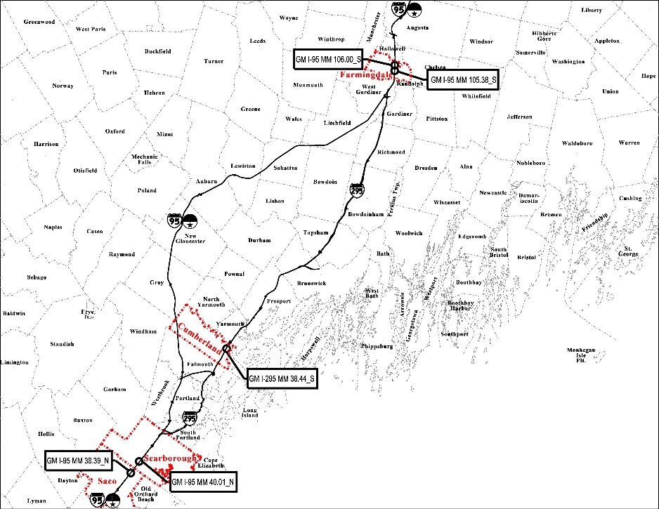
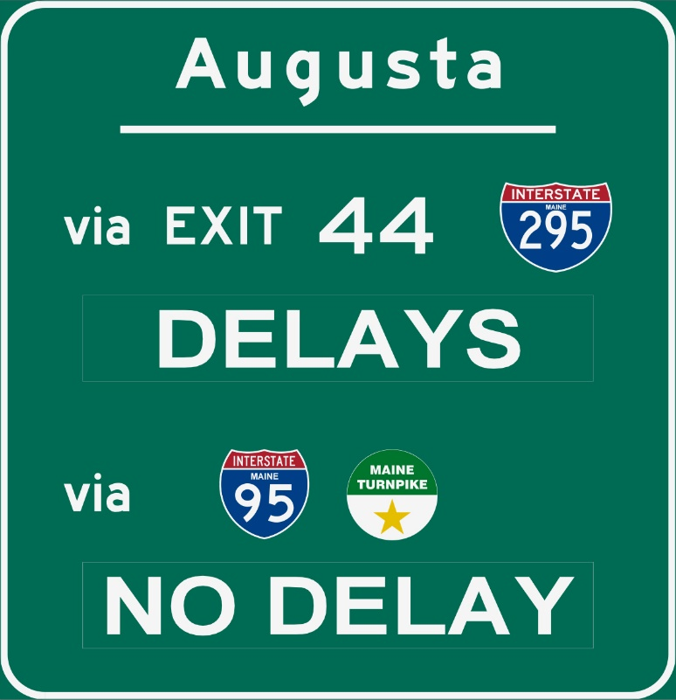
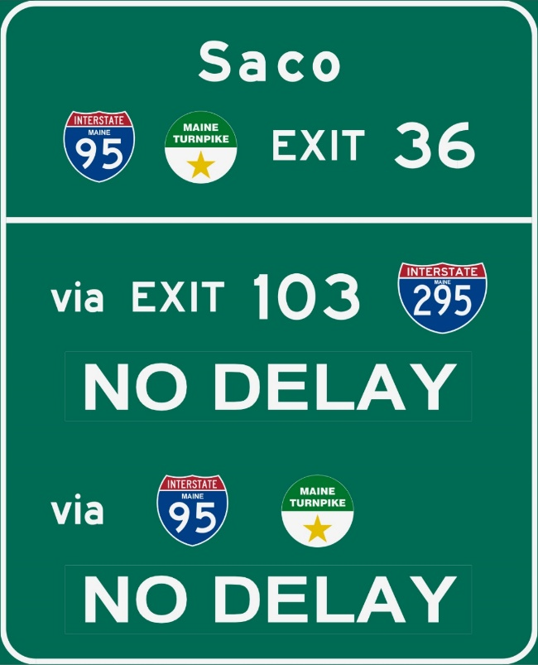
Turnpike NB
At Flag Pond Road
Turnpike SB
North of I-295 split
Roundtable Discussion
MAINE
NEW HAMPSHIRE
VERMONT
MASSACHUSETTS
NEITS Annual Meeting – May 10, 2018
Providence RI

Slide 6
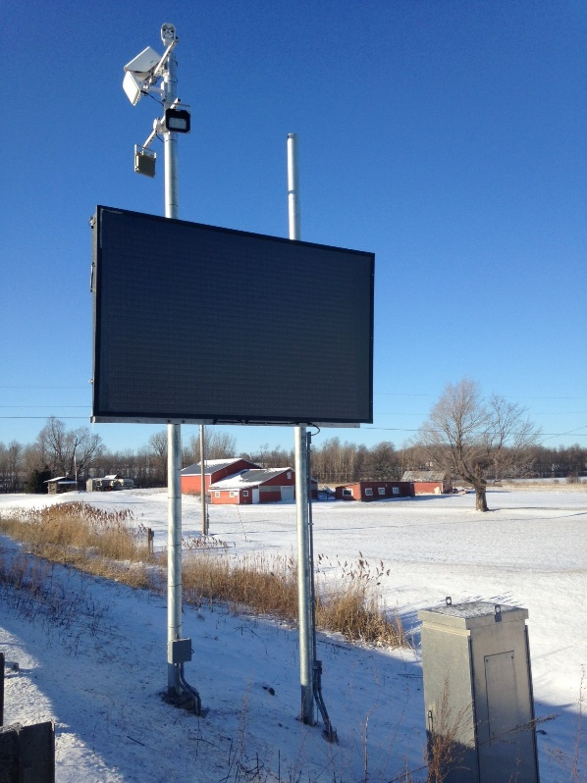
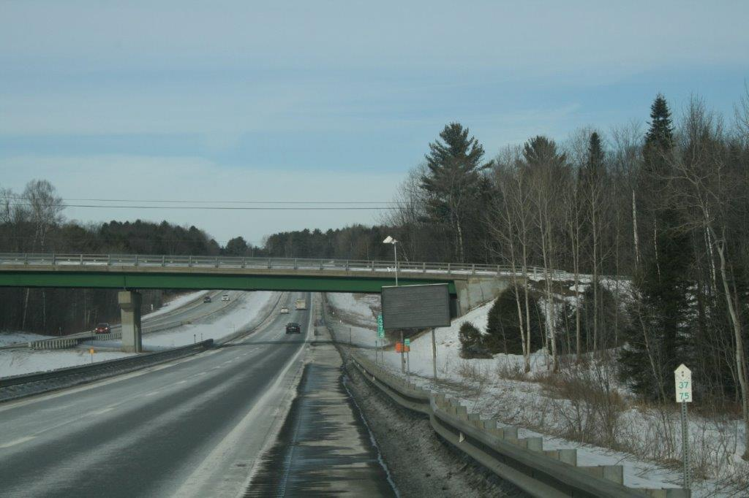
RWIS/DMS
Roundtable Discussion
MAINE
NEW HAMPSHIRE
VERMONT
MASSACHUSETTS
NEITS Annual Meeting – May 10, 2018
Providence RI

Slide 7
Are there technologies that we should NOT be planning for due to the pace of rapidly changing technology?
i.e. Probe Data Layers
Roundtable Discussion
MAINE
NEW HAMPSHIRE
VERMONT
MASSACHUSETTS
NEITS Annual Meeting – May 10, 2018
Providence RI

Slide 8
General Discussion
Differences between rural and metro areas relative to ITS technologies?
How do you work with procurements of your ITS technologies?
How is your ITS Stewardship agreement set up?
Roundtable Discussion
MAINE
NEW HAMPSHIRE
VERMONT
MASSACHUSETTS
NEITS Annual Meeting – May 10, 2018
Providence RI

