Slide 1



Rhode Island Transportation Innovation Partnership
AUTONOMOUS VEHICLE MOBILITY CHALLENGE
RIDOT’s POLICY & INNOVATION TEAM
Julia Gold, Chief of Sustainability and Innovation
Division of Planning
July 24, 2017
Notes:
Introduction…
My name is …

Slide 2
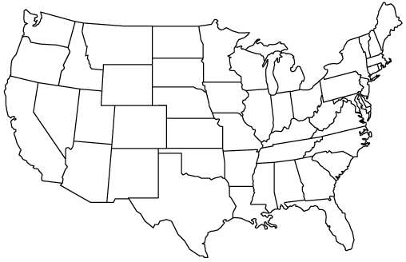

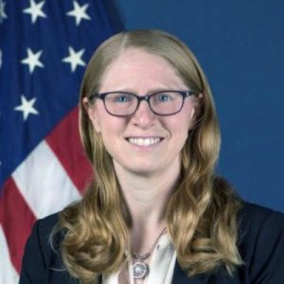


RIDOT’s Policy and Innovation Team
Pamela Cotter
Policy Director
Rhode Island Department of Transportation (RIDOT)
Julia Gold – Project Manager
Chief of Sustainability and Innovation
Rhode Island Department of Transportation (RIDOT)
Russell Holt, P.E.
Senior Civil Engineer
Rhode Island Department of Transportation (RIDOT)
Shoshana Lew
Chief Operating Officer
Rhode Island Department of Transportation (RIDOT)
Ken White
Programming Services Officer
Rhode Island Department of Transportation (RIDOT)
Christos Xenophontos
Assistant Director
Rhode Island Department of Transportation (RIDOT)
Source: Contra Costa Transportation Authority

Slide 3

RIDOT’s Efforts to Date
April 2017: RIDOT hosts International Mini-Summit on CAVs
June 2017: RIDOT issues Request for Information (RFI) on CAVs and innovative transit systems
July 2017: The Rhode Island Transportation Innovation Partnership (TRIP) is established
September 2017: TRIP hosts CAV Expo at The New England Institute of Technology
October 2017: RFI Closed & Reviewed
November 2017: Joint research forum with URI on “Transportation Innovation Partnership (TRIP): Leading the Way for Research”

Slide 4

Rhode Island Transportation Innovation Partnership

Slide 5
TRIP Autonomous Vehicle Mobility Challenge
A pilot program aimed to safely test multi-passenger autonomous vehicles (SAE Level 3+) on Providence’s streets
Presenting a unique opportunity to explore the integration of new technologies into public transit
Providing the public exposure to autonomous vehicles and the opportunity to engage in the Challenge and learn with us

Slide 6




PARTNERS
Source: Contra Costa Transportation Authority

Slide 7
TRIP AUTONOMOUS VEHICLE MOBILITY CHALLENGE
STRATEGIES
Create a safe and accessible environment for testing autonomous vehicles in RI
Reduce emissions and congestion
Improve mobility with a focus on equity
Create a framework for economic growth and a stronger workforce
Integrate Smart City applications and explore data management and privacy concerns
Leverage academic partners to research social, behavioral, environmental, and systemic opportunities and challenges related to AVs

Slide 8
Next Steps…
Pre-Proposal Conference
May 21, 2018 @ 1:00 PM
RFP Issued:
April 27, 2018
Submissions Due
June 8, 2018 @ 11:30 AM
Notes:
Important dates to keep in mind...

Slide 9
For more information, contact:
Julia Gold
Chief of Sustainability and Innovation
Rhode Island Department of Transportation
Julia.Gold@dot.ri.gov
401-222-6940 x4665
www.dot.ri.gov/TRIP
Notes:
9

