Slide 1
ITS Strategic Plan 2015-2019
http://www.its.dot.gov/strategicplan/
Source: USDOT
Notes:
The ITS Strategic Plan 2015-2019 outlines the direction and goals of the USDOT’s ITS Program and provides a framework around which the ITS JPO and other Department agencies will conduct research, development, and adoption activities to achieve them.

Slide 2
Source: USDOT ITS JPO (Ken Leonard TRB 2015 presentation: http://www.its.dot.gov/presentations/pdf/TRB_State_ITS_Session2015v1.pdf

Slide 3
Strategic Priorities
Two Strategic Priorities reflect a sense of where the bulk of transportation research and innovation is heading. These priorities are not exclusive of other technologies or research areas.
Realizing Connected Vehicle Implementation – Builds on the substantial progress made in recent years around design, testing, and planning for connected vehicles to be deployed across the nation.
Advancing Automation – Shapes the ITS Program around research, development, and adoption of automation related technologies as they emerge.
Source: USDOT, “ITS Strategic Plan, 2015-2019”: http://www.its.dot.gov/strategicplan/

Slide 4
Strategic Themes
Enable Safer Vehicles and Roadways by developing better crash avoidance, performance measures, and other notification mechanisms; commercial motor vehicle safety considerations; and infrastructure-based and cooperative safety systems.
Enhance Mobility by exploring methods and management strategies that increase system efficiency and improve individual mobility.
Limit Environmental Impacts by better managing traffic flow, speeds, and congestion, and using technology to address other vehicle and roadway operational practices.
Promote Innovation by fostering technological advancement and innovation across the ITS Program, continuously pursuing a visionary/exploratory research agenda, and aligning the pace of technology development, adoption, and deployment to meet future transportation needs.
Support Transportation Connectivity through the development of standards and systems architectures, and the application of advanced wireless technologies that enable communications among and between vehicles of all types, the infrastructure, and portable devices.
Source: USDOT, “ITS Strategic Plan, 2015-2019”: http://www.its.dot.gov/strategicplan/

Slide 5
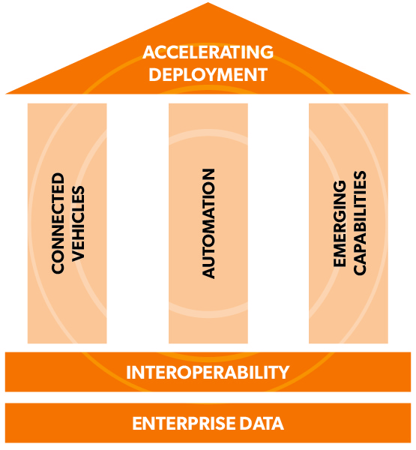
Program Categories
Connected Vehicles program category will primarily focus on adoption and eventual deployment of the system.
Automation research will focus on topics related to automated road-vehicle systems and related technologies that transfer some amount of vehicle control from the driver to the vehicle.
Emerging Capabilities will focus on future generations of transportation systems.
Enterprise Data programs will continue existing efforts in operational data capture from stationary sensors, mobile devices, and connected vehicles, and expand into research activities involving the development of mechanisms for housing, sharing, analyzing, transporting, and applying those data for improved safety and mobility across all modes of travel.
Interoperability focuses on how to ensure effective connectivity among devices and systems.
Accelerating Deployment advances the work from adoption to wider scale deployment in coordination with several other DOT agencies.
Source: USDOT
Source: USDOT, “ITS Strategic Plan, 2015-2019”: http://www.its.dot.gov/strategicplan/
Notes:
The ITS Strategic Plan includes program categories to provide the necessary structure for research, development, and adoption of ITS technologies. These categories reflect modal and external stakeholder input about the areas where attention, focus, and resources should be devoted.

Slide 6
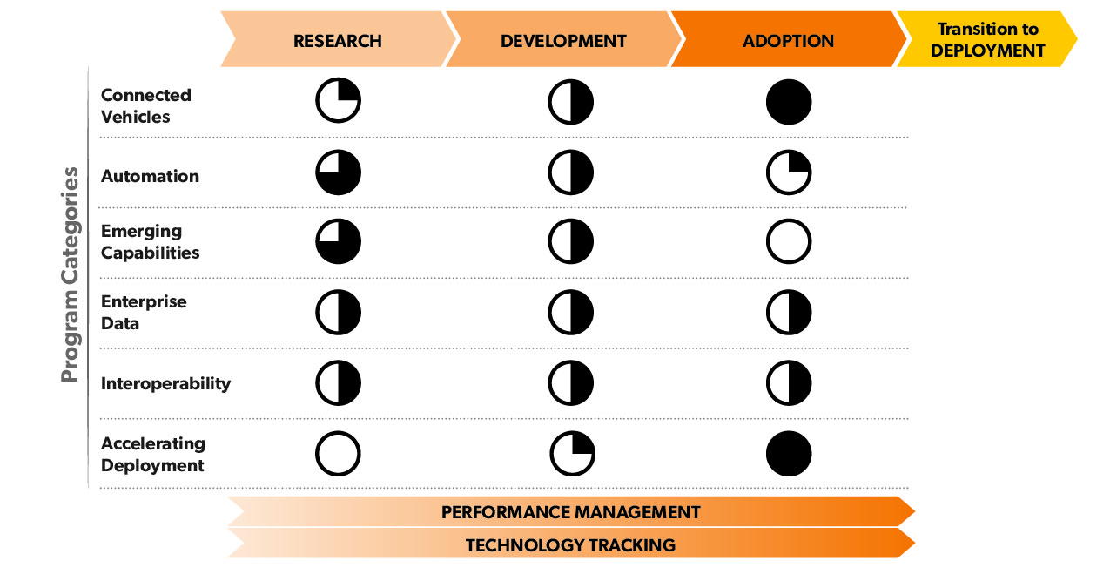
ITS Program Emphasis According to Technology Lifecycle Stages
Source: USDOT, “ITS Strategic Plan, 2015-2019”: http://www.its.dot.gov/strategicplan/

