Slide 1
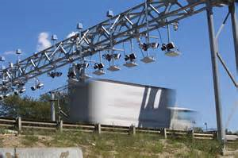
Bridge Reconstruction - All Electronic Large Commercial Truck Tolling Program
NEITS
Providence, RI
May, 2018

Slide 2
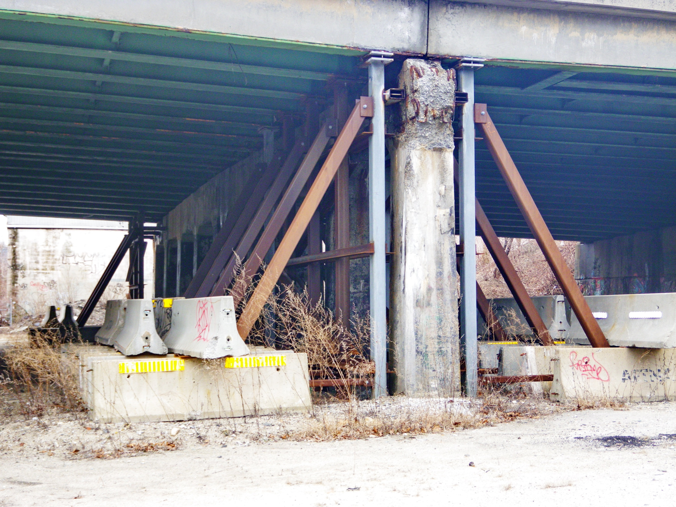
The Problem

Slide 3
The Problem – Rhode Island’s Bridges
Rhode Island ranks last in the nation - 50th out of 50 states - in percent of structurally deficient bridges by deck area

Slide 4
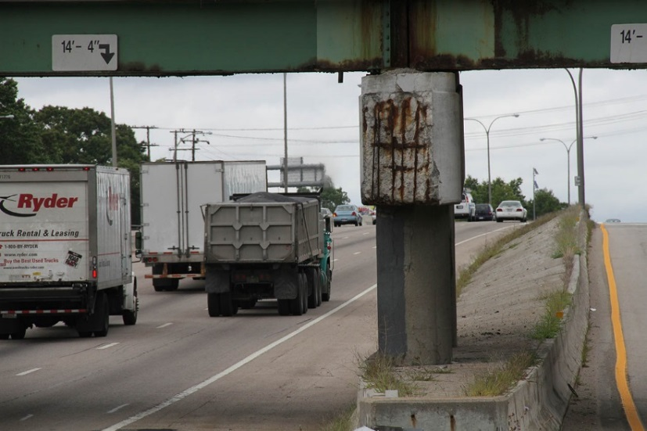
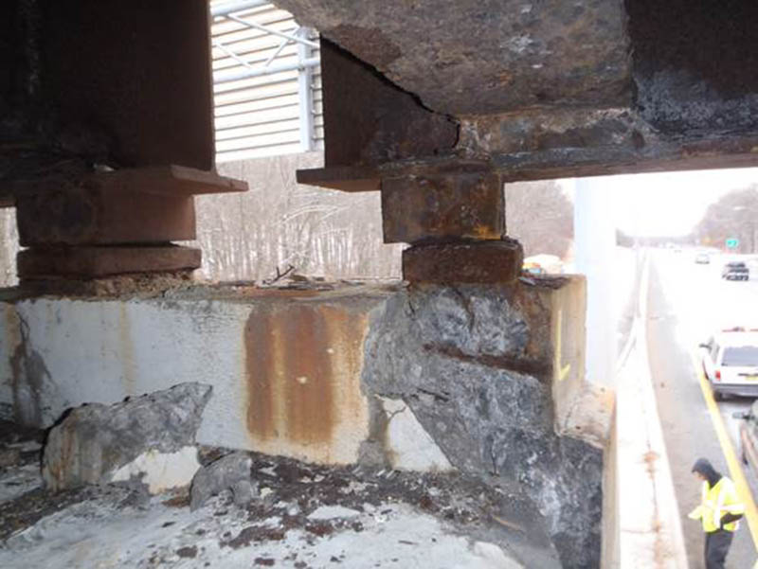
The Problem:
Crumbling Infrastructure
1,162 bridges in Rhode Island
One in Five is structurally deficient
Need to repair 659
Roads need repair
6/10 Represents a significant safety concern

Slide 5
How Did We Get Here?
Per Capita FY 13 State and Local Expenditures by State
 |  | Highway Spending ($)
46 | Tennessee | 370
47 | Michigan | 351
49 | South Carolina | 330
49 | Rhode Island | 330
50 | Georgia | 296
According to a 2013 analysis by the Tax Policy Center, Rhode Island is tied with South Carolina for second lowest per capita state and local highway spending in the nation
% Shares of Total Spending
 |  | Federal | State & Local
46 | Wyoming | 40% | 60%
47 | Mississippi | 41% | 59%
48 | Georgia | 44% | 56%
50 | Montana | 55% | 45%
50 | Rhode Island | 55% | 45%
According to a 2014 Pew Charitable Trust report on Surface Transportation Funding, Rhode Island is tied with Montana for lowest state and local funding as a % of total surface transportation funding in the nation

Slide 6
The Solution

Slide 7
RhodeWorks Bridge Reconstruction – Large Commercial Truck Tolling Program
What is RhodeWorks?
Asset Management Approach
“Biggest bang for the buck” vs. “fix the worst first”
Infusion of money upfront to save in long-term
Sustained Adequate Funding
Dedicated Transportation Trust Fund
Focus on Economic Recovery
Put people to work
Building first class infrastructure that invites commerce.

Slide 8
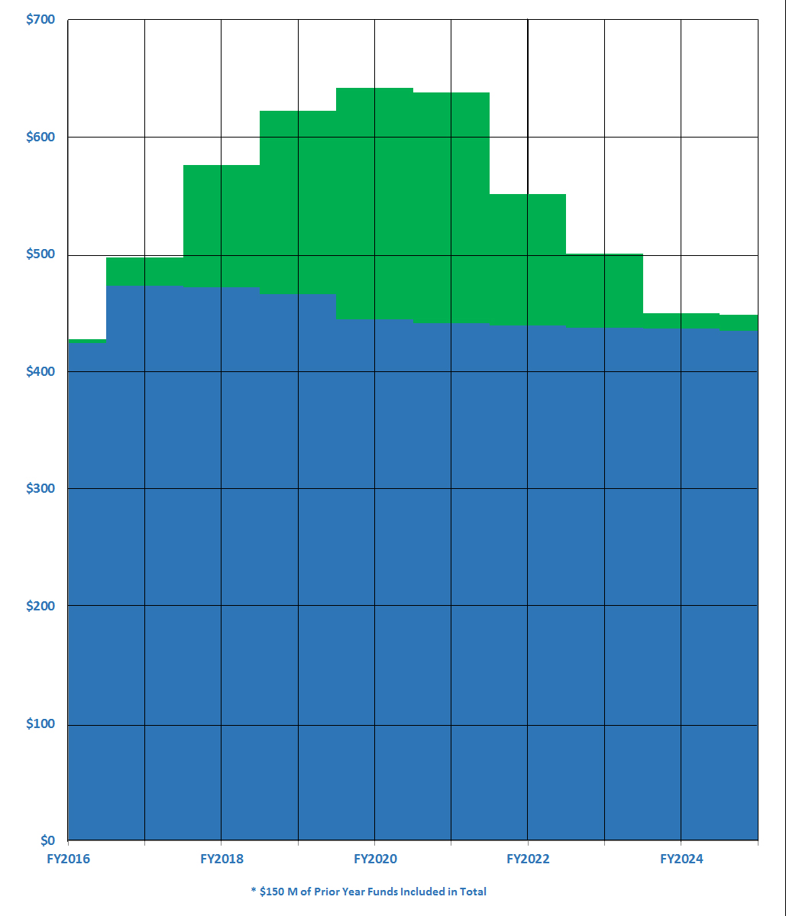
What is RhodeWorks?
Annual Funding
It’s a bold action plan that will:
Invest over $1 Billion over previous funding for our crumbling bridges
Fix 150 structurally deficient bridges
Make repairs to another 500 bridges to keep them from becoming deficient
%
increase in funding compared to previous program
30

Slide 9
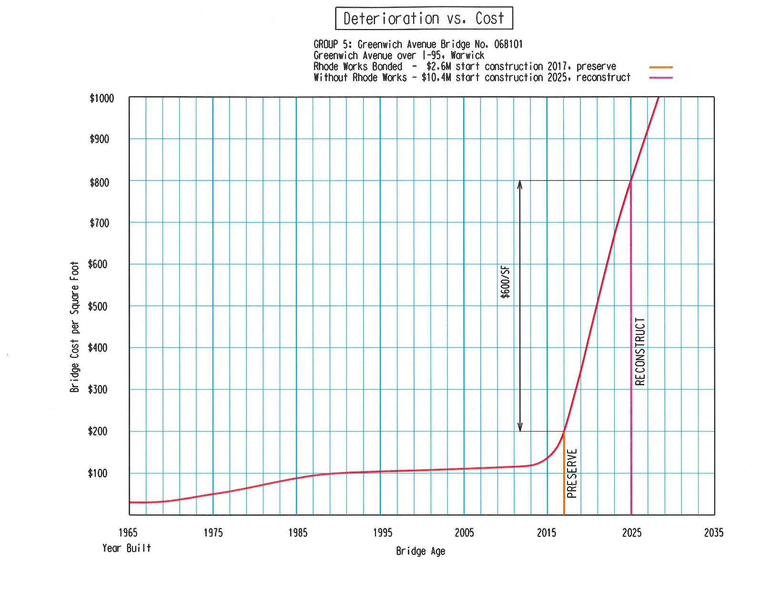
Estimated Savings of
$950
Million
By Accelerating Bridge Reconstruction
If we don’t do this now, it will continue to become more expensive
Greenwich Avenue Bridge, Warwick
Preservation vs. Reconstruction

Slide 10
RhodeWorks – 90% Structural Sufficiency in 10 Years
RhodeWorks

Slide 11
All ElectronicTolling

Slide 12
Tolling Program
Key Component of Plan to Reach 90% Sufficiency in 10 years
$45 Million a year of additional revenue.
Allows for a revenue mechanism to repay bond.
Hurdles to Tolling in Rhode Island
Prohibition against Tolling Interstates
Tolling only the states 4 major bridges not politically feasible.
Tolling the states many smaller bridges not financially feasible.
How to determine a fair user fee based on system “consumption.”

Slide 13
Solution: All Electronic Tolling
No Toll Booths
Feasible to toll any bridge reconstruction project regardless of size.
(3) Limitations on use of revenues. — (A) In general. — A public authority with jurisdiction over a toll facility shall use all toll revenues received from operation of the toll facility only for —
(v) if the public authority certifies annually that the tolled facility is being adequately maintained, any other purpose for which Federal funds may be obligated by a State under this title.

Slide 14
Solution: Tractor-Trailer User Fee
Large Commercial Truck ONLY - Bridge Tolls
Bridge Reconstruction Tolling Allowed under 23 USC Section 129
Only Recently Feasible on Lower Cost Projects Due to AET
Per Section 129, States Set Toll Policy RE:
Toll Collection in One or Both Directions
Toll Rates
Discount Programs
Classes of Vehicle Upon Which Tolls are Charged

Slide 15
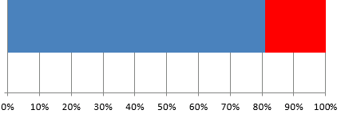
Assessing User Fees Based on Damage Caused
Source of Damage
All Other Vehicles
Tractor Trailers
30%
70%
Source of Funding
Source: Government Accountability Office
Non-Trucks
Trucks*
81%
19%
* Includes diesel taxes and truck-related taxes and fees

Slide 16
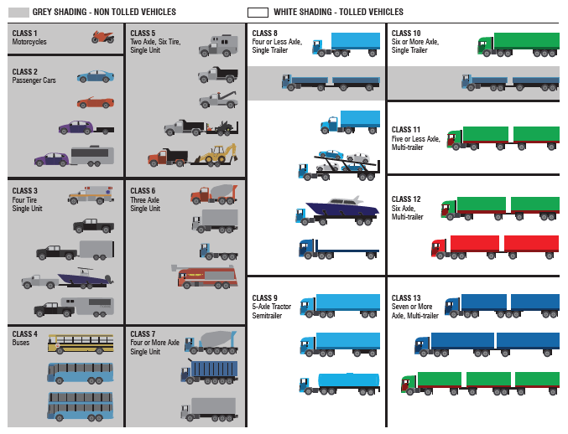

Slide 17
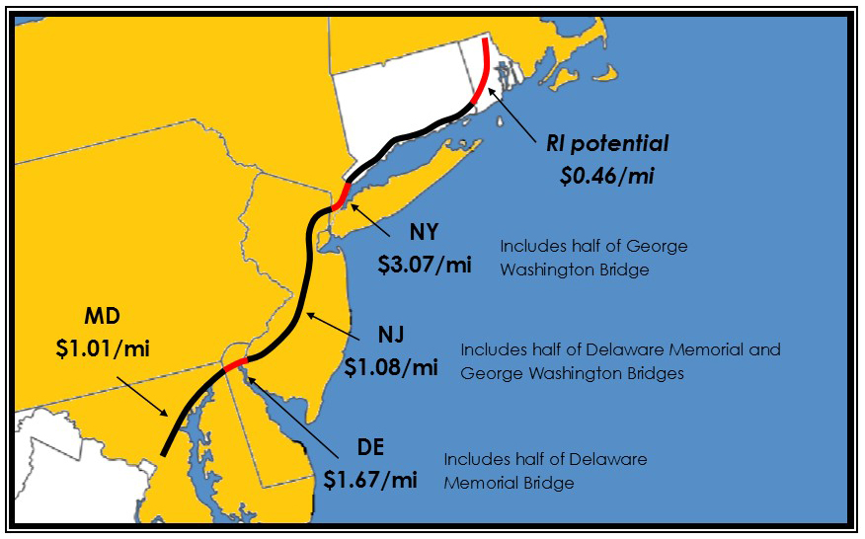
Tolling Discounts/Caps
Once per gantry per calendar day per direction
I-95 border-to-border trip costs $20 each way with electronic pass
Max daily cap of $40 with electronic pass
Mass Pike
$0.17, $0.57 /mi
Cross-state is $0.17/mi, Boston Ext. is $0.57/mi
Tolling Rates
Toll rate is lower than neighboring states
Expected to generate about $45 million annually for bridge reconstruction
Average toll from New York to Maryland is $1.71 per mile

Slide 18
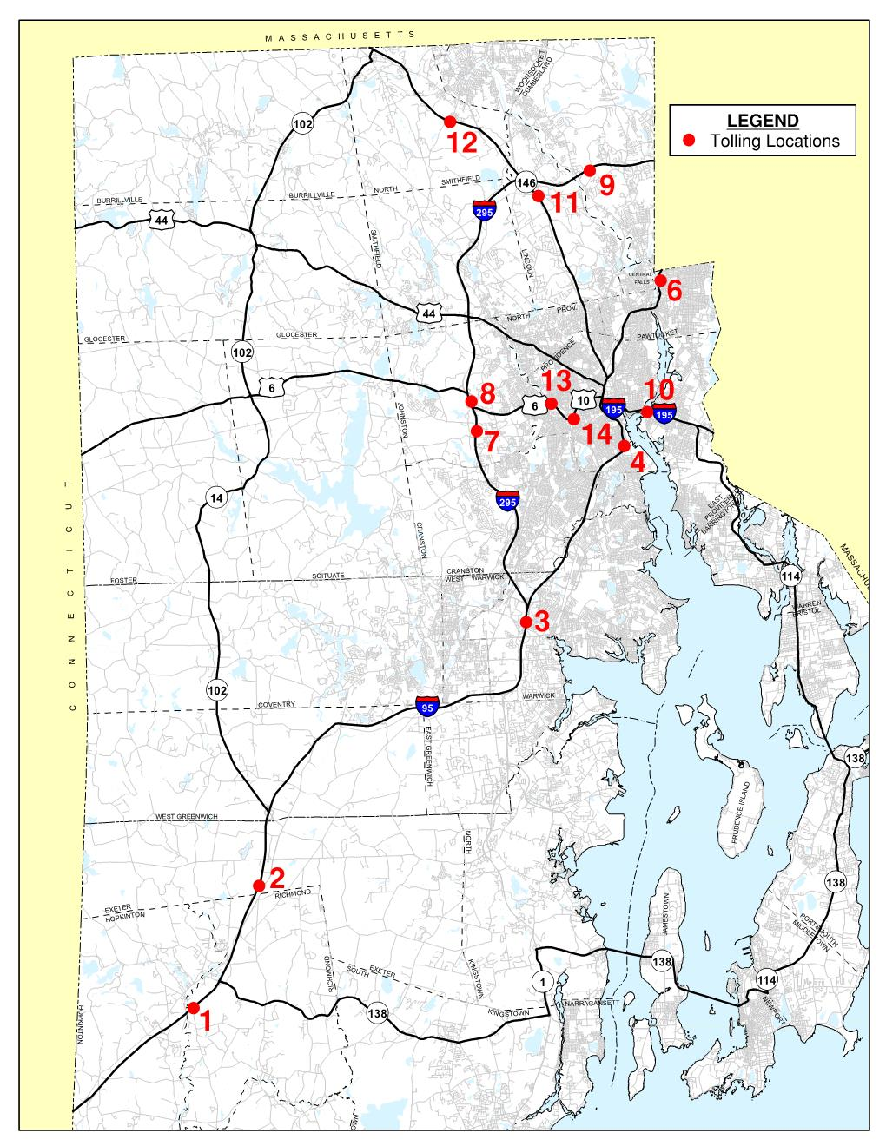
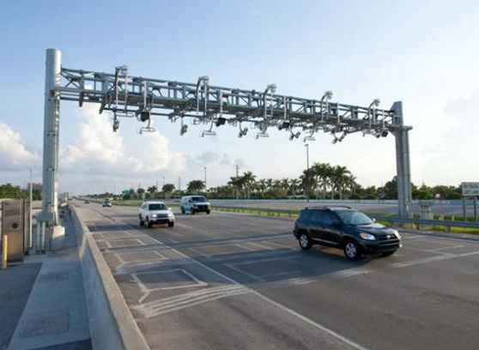
RhodeWorks Bridge Reconstruction – Large Commercial Truck Tolling Program
All Electronic Tolling (AET)
Transponder Equipped Vehicles (E-ZPass) OR
“Pay by Plate” Customers
10 year D-B-O-M Contract
RIBTA Back Office Vendor
Photo Credit: Unknown

Slide 21
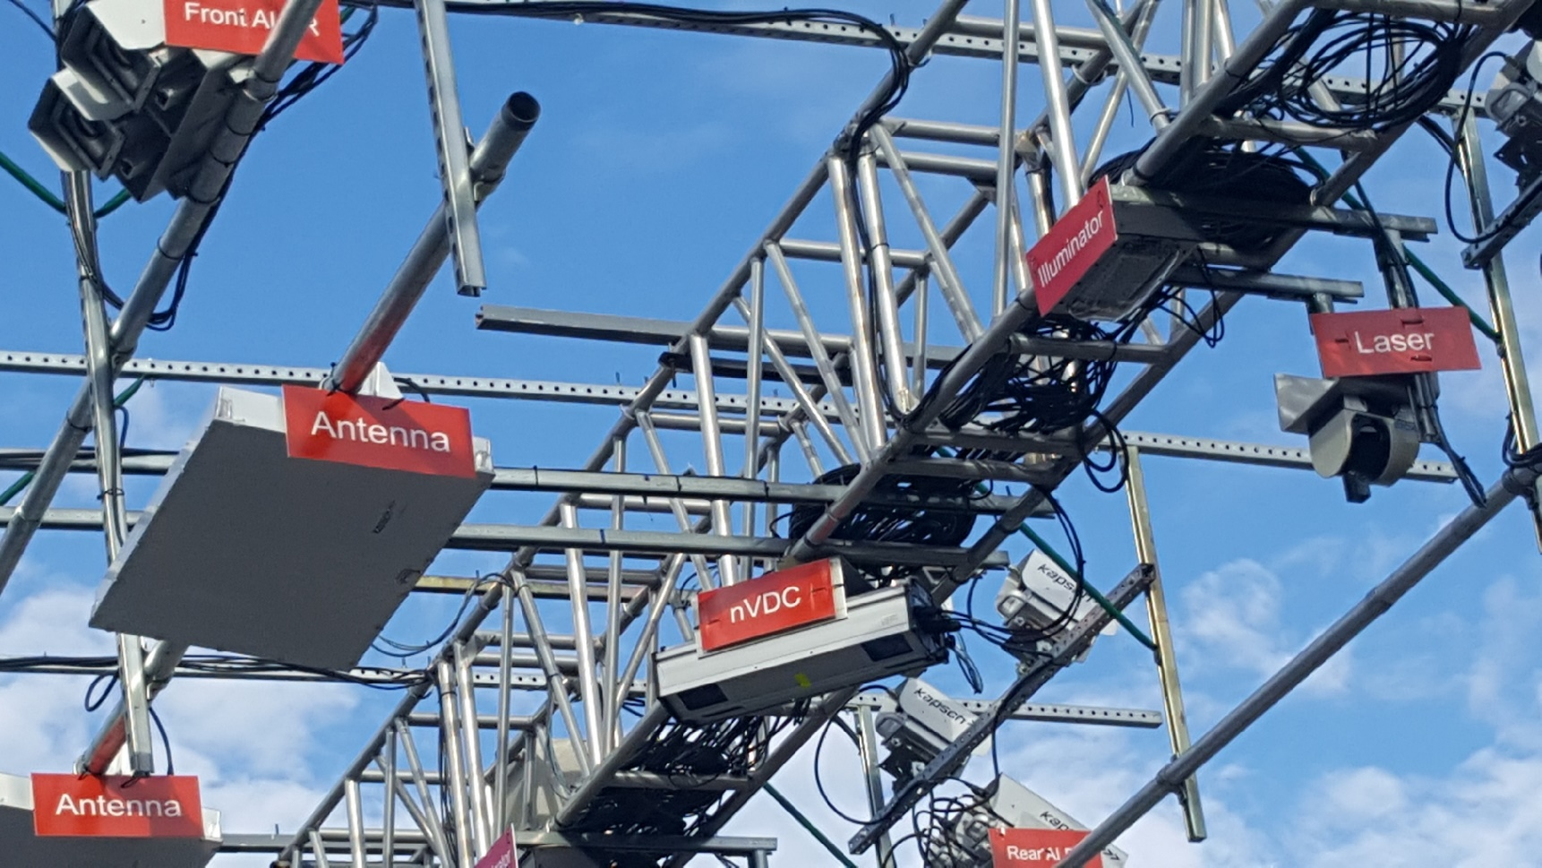
Gantry Components
Front camera (captures front plate)
Antenna
(reads
E-ZPass tags)
Laser
(aids in vehicle classification)
nVDC – Video Detection Classification
(FHWA class)
Illuminator
(infrared illuminator – not visible to naked eye)

Slide 22
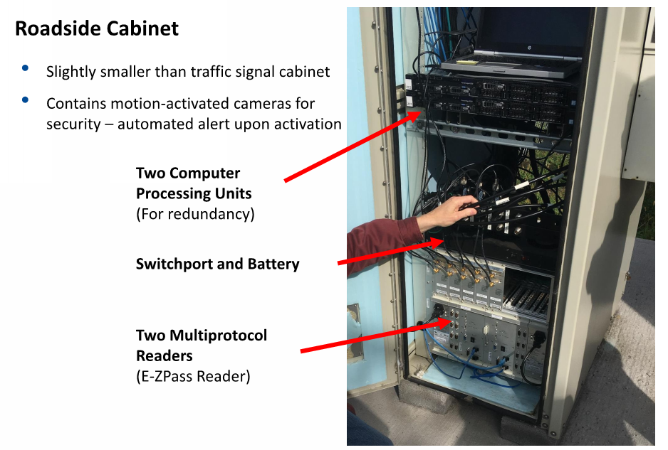

Slide 25
RhodeWorks Bridge Reconstruction – Large Commercial Truck Tolling Program

Slide 26
PLACE HOLDER FOR VIDEO

Slide 27
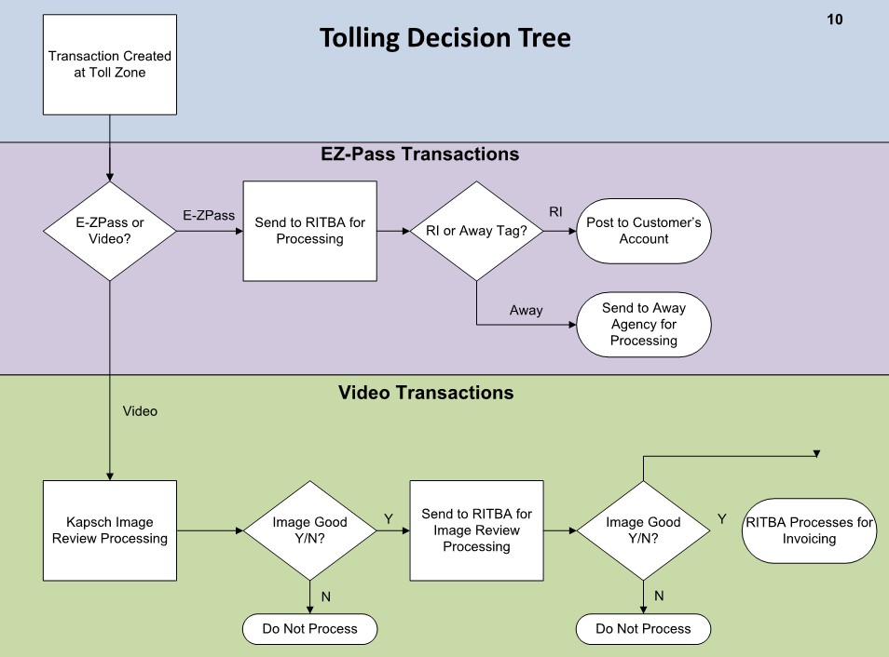

Slide 28
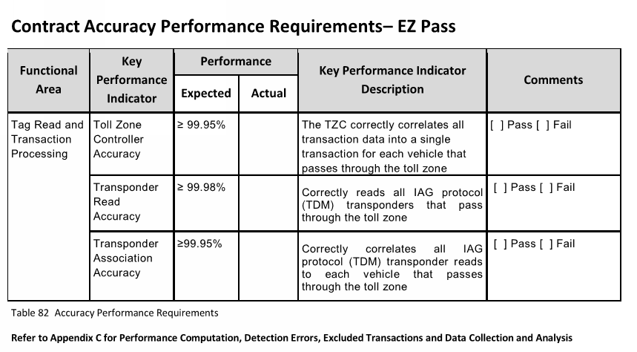

Slide 29
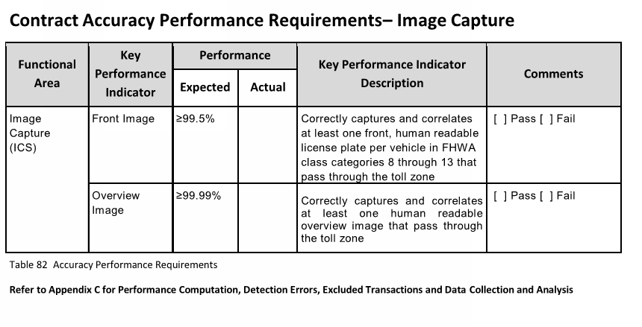

Slide 30
RhodeWorks Bridge Reconstruction – Large Commercial Truck Tolling Program
AET Truck Bridge Toll Project
RhodeWorks Legislation passed February, 2016
MOUs with FHWA executed September, 2016
Agreement that truck tolling meets requirements based on 23 USC 129 (a)(1)
Design-Build-Operate-Maintain Contract
Awarded to Contractor May, 2017
Locations 1 & 2 start revenue collection May/June, 2018
Remaining Location start revenue collection Late 2018/ Early 2019
10-year O&M phase w/ two optional 5-year extensions

Slide 31
RhodeWorks Bridge Reconstruction – Large Commercial Truck Tolling Program
QUESTIONS?
Photo Credit: Unknown

