Slide 1
Traffic Incident Management Performance Measures
The New Hampshire Every Day Counts Initiative
Nicholas King – TMC Operations Supervisor

Slide 2
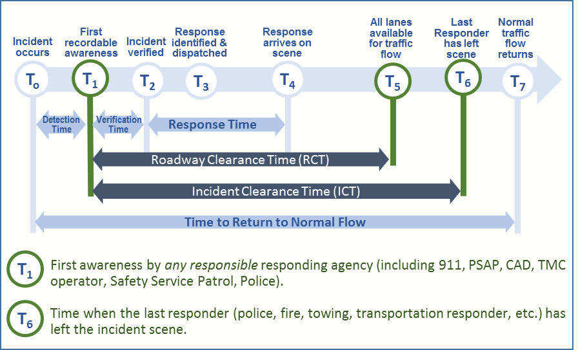
TIM Performance Measures
Roadway Clearance Time (T5-T1)
Incident Clearance Time (T6-T1)
Secondary Crashes

Slide 3
EDC 4 – Using Data to Improve TIM
Workshop on May 9, 2017 identified Five Goals
Goals:
Meet with stakeholders to determine existing process and document
Identify gaps in reporting and develop options to eliminate gaps
Identify, assess, and compare crash statistics between NHDOT and NHSP
Determine if gap eliminating options are feasible and at what cost
Implement cost effective measures if funding available
Due October 2018
Notes:
PHOTO

Slide 4
Goal 1 Meet with stakeholders to determine existing process and document
Action Item | Status
Work through TIM committee | Conducted the TIM Self-Assessment on July 12, 2017
Work through performance measures subcommittee of NH-ME | Quarterly meetings are being held to work through the data being collected and to strive to standardize the metrics being reported.

Slide 5
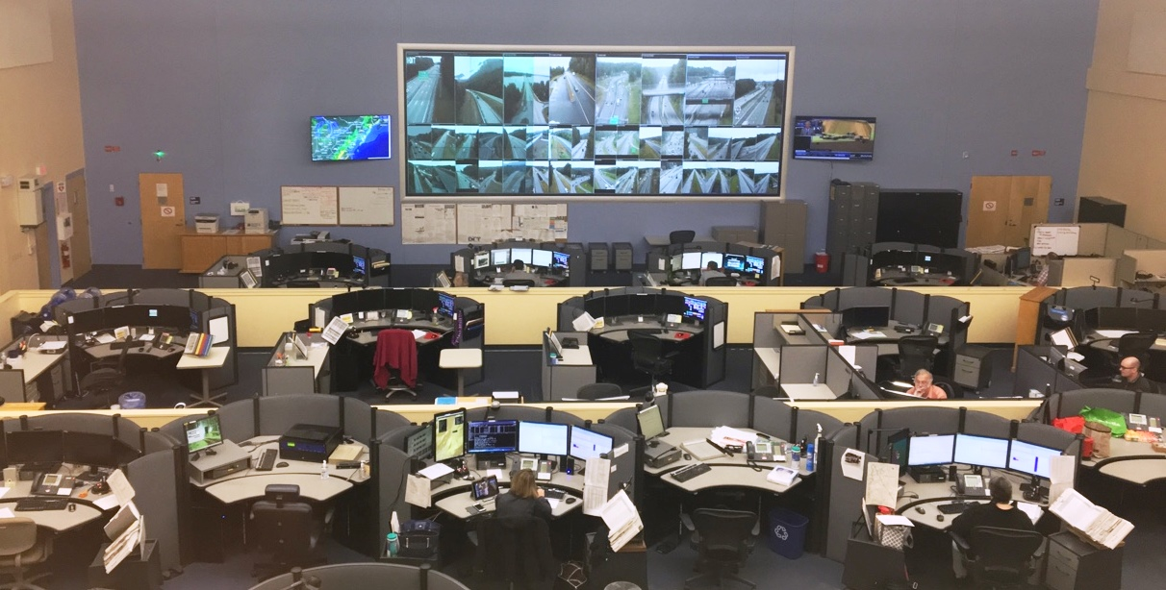
SPHQ and TMC in same room
Notes:
Huge advantage to TIM data

Slide 6
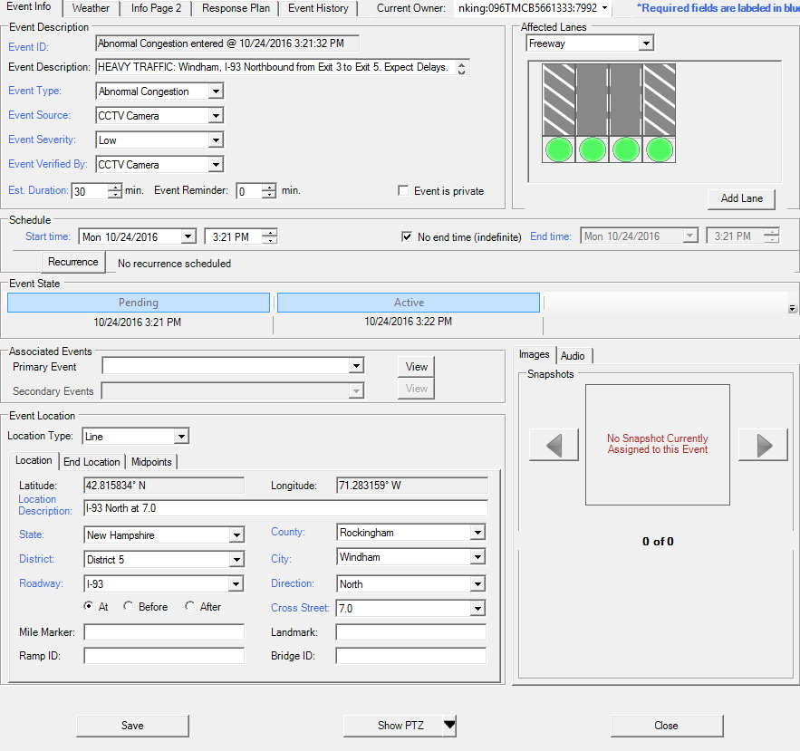
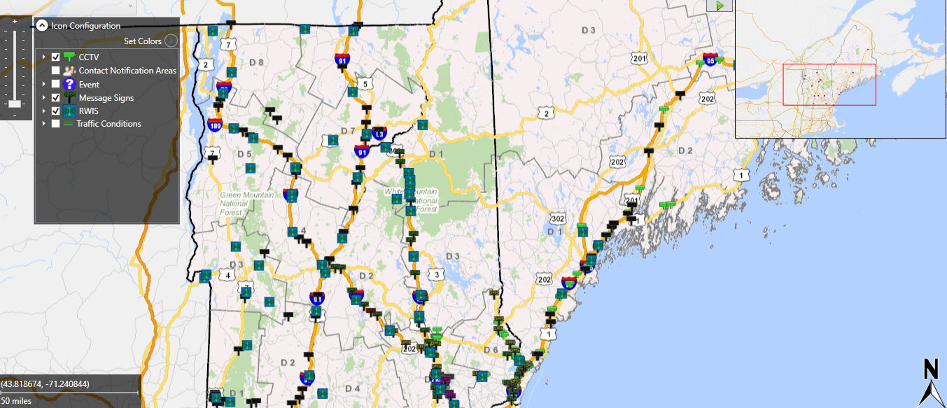
Advanced Transportation Management System (ATMS)
Notes:
System we use to capture data

Slide 7
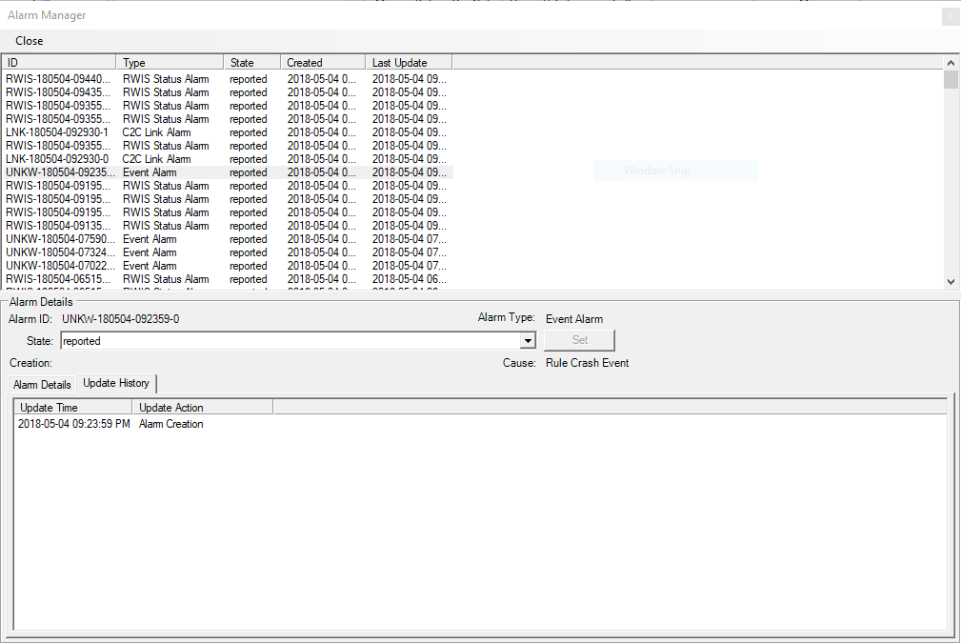
Current CAD integration Alarm Manager
Notes:
Current CAD- point out what is good and what needs improvement

Slide 8
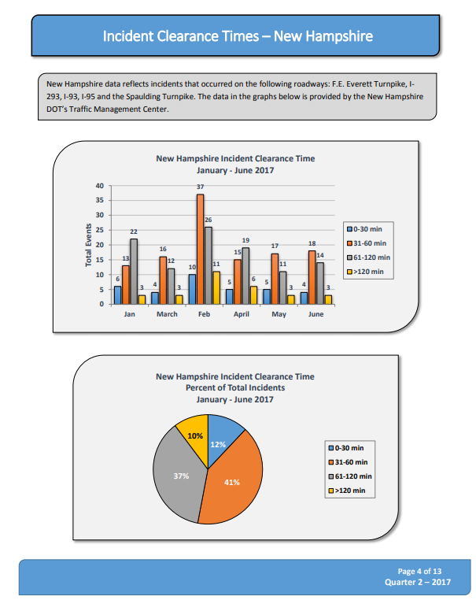
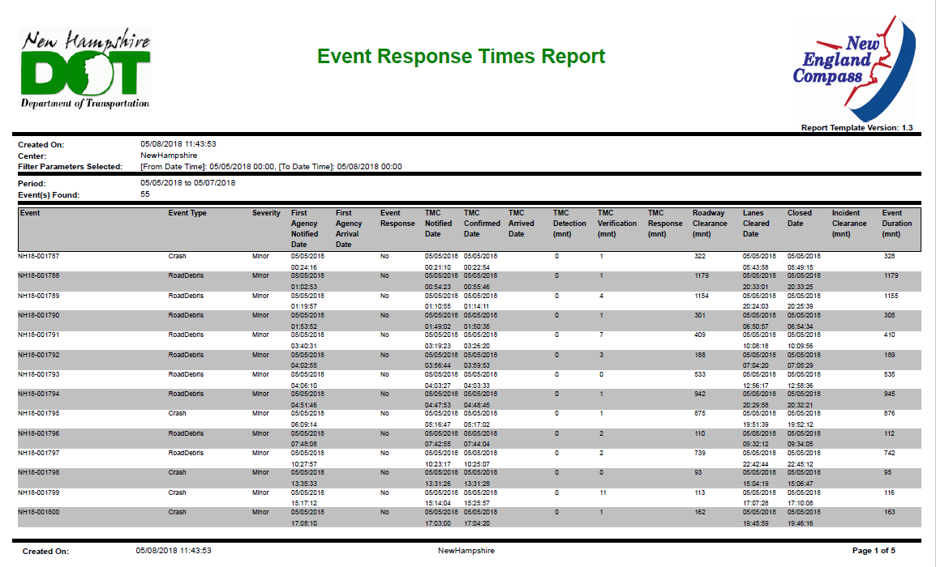
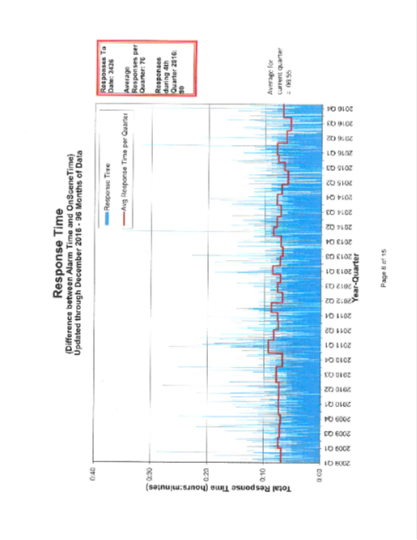
Scattered Data & Reporting

Slide 9
I-93 by Consultant

Slide 10
I-95 by ME

Slide 11
New England Compass Autoreport

Slide 12
Goal 2 Identify gaps in reporting and develop options to eliminate gaps
Action Item | Status
Compile and assess data reports (NHDOT, NH-ME, SP, I-93) | Assessment completed in September 2017 and summarized.
Identify gaps in reporting | Datasets have been evaluated
Identify “standard” data elements/fields to share (from NHSP to NHDOT) from data element list | Meeting was held in February 2018 to determine a standard data dictionary.

Slide 13
Goal 3 Identify, assess, and compare crash statistics between NHDOT and NHSP
Action Item | Status
Identify/assess what NHDOT and NHSP have for crashes and compare numbers for accuracy | TMC Operations Supervisor reviewed with SPHQ Supervisor
Secondary crashes – compare results generated from NHDOT to what’s being collected by NHSP on crash report | Ongoing

Slide 14
Goal 4 Determine if gap eliminating options are feasible and at what cost
Action Item | Status
Work to add fields in ATMS to capture RCT | Design complete
Work to add fields in CAD to capture RCT and export to NHDOT | Upcoming meeting with SP to discuss details
Identify how NHDOT wants to present/report TIM PMs | In process
Geo-location of incident locations from state police via CAD – explore whether this information can create an alert in ATMS | In process
Work to add check boxes for time stamps (T₅ and T₆) in CAD to capture RCT and ICT, as well as other desirable data elements (event ID, location) | In process

Slide 15
Goal 5 Implement cost effective measures if funding available
Action Item | Status
Because RCT will be in the new MMUCC, NH will eventually incorporate it into the crash report | No action needed at this time
Notes:
Talk about new video

Slide 16
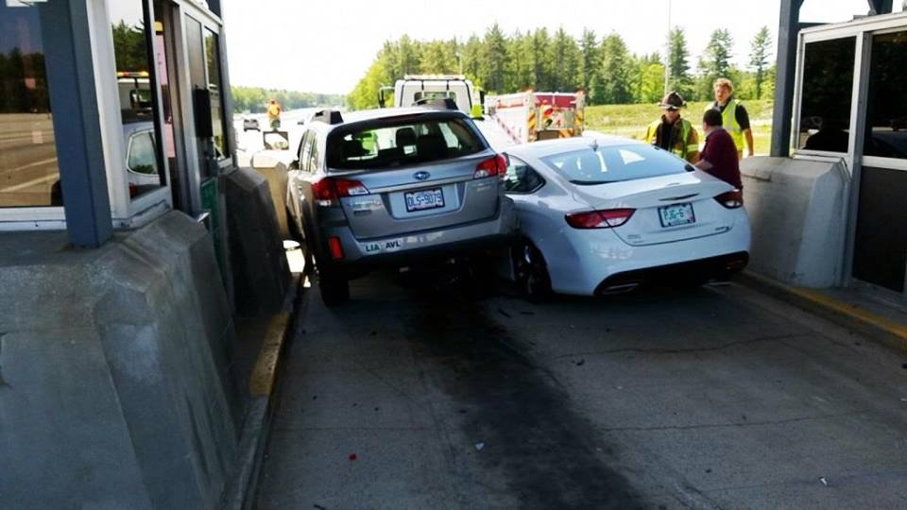
Questions?

