Slide 1
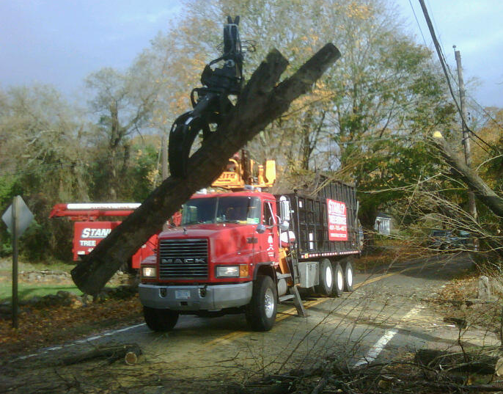
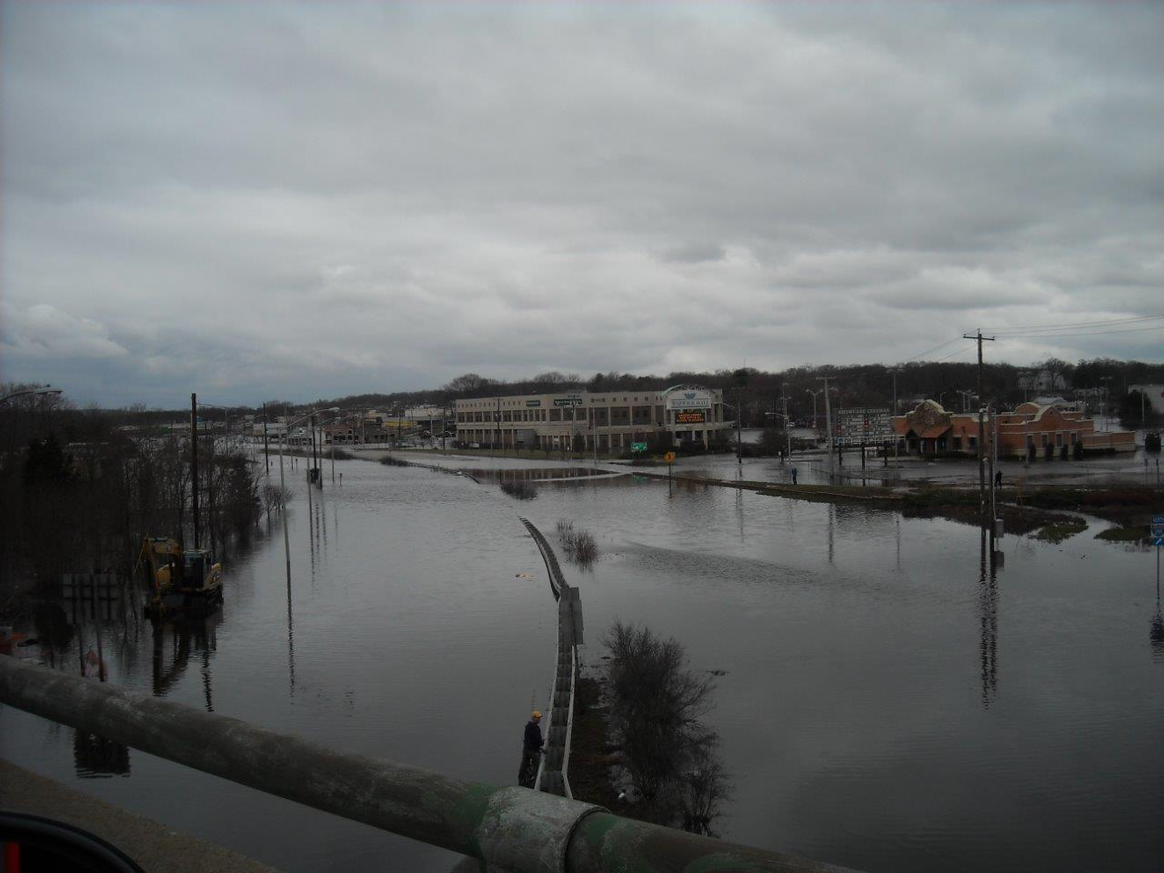
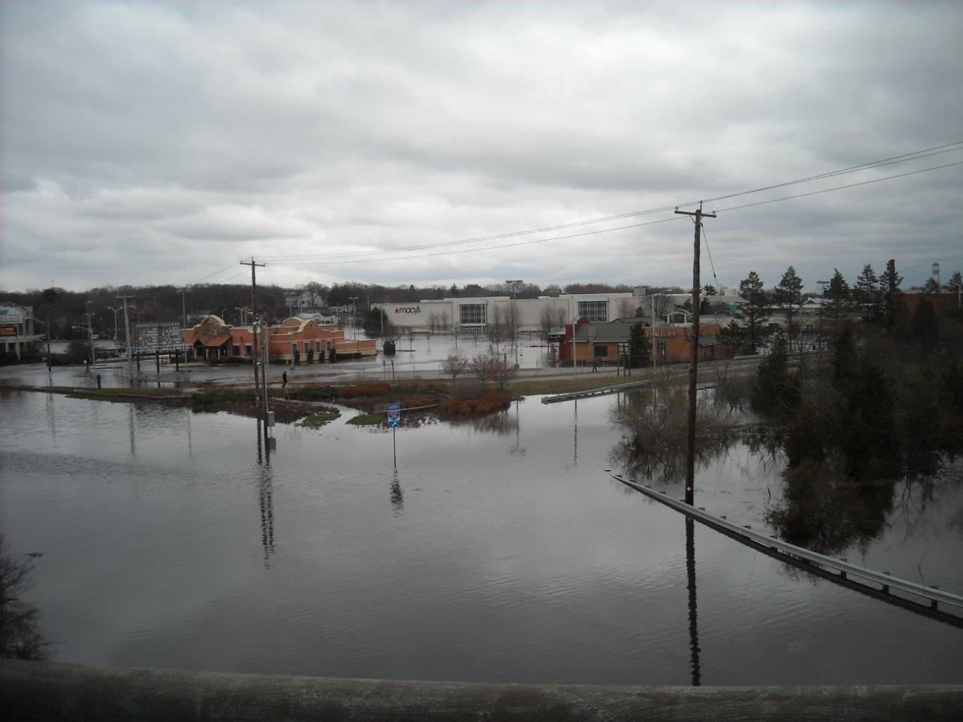
RI LESSONS LEARNED FROM 2010 FLOODS
AND PROGRESS MADE SINCE THEN

Slide 2
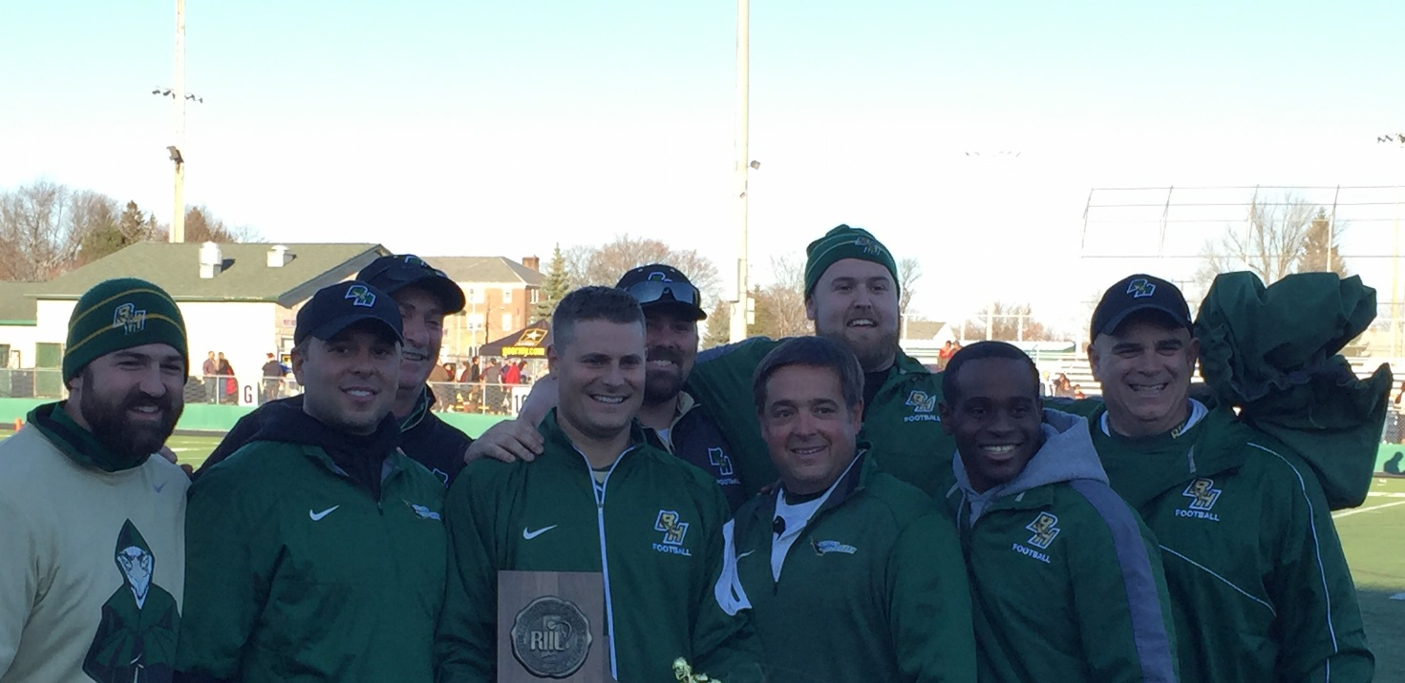
BISHOP HENDRICKEN HIGH SCHOOL FOOTBALL UPDATE
WON 7 CONSECUTIVE DIVISION I STATE CHAMPIONSHIPS
A RI STATE RECORD
WERE CHASING BISHOP GORMAN HIGH SCHOOL IN NEVADA
LOST THE SUPER BOWL LAST YEAR BY A POINT
CHANCE TO WIN
MISSED A FIELD GOAL

Slide 3
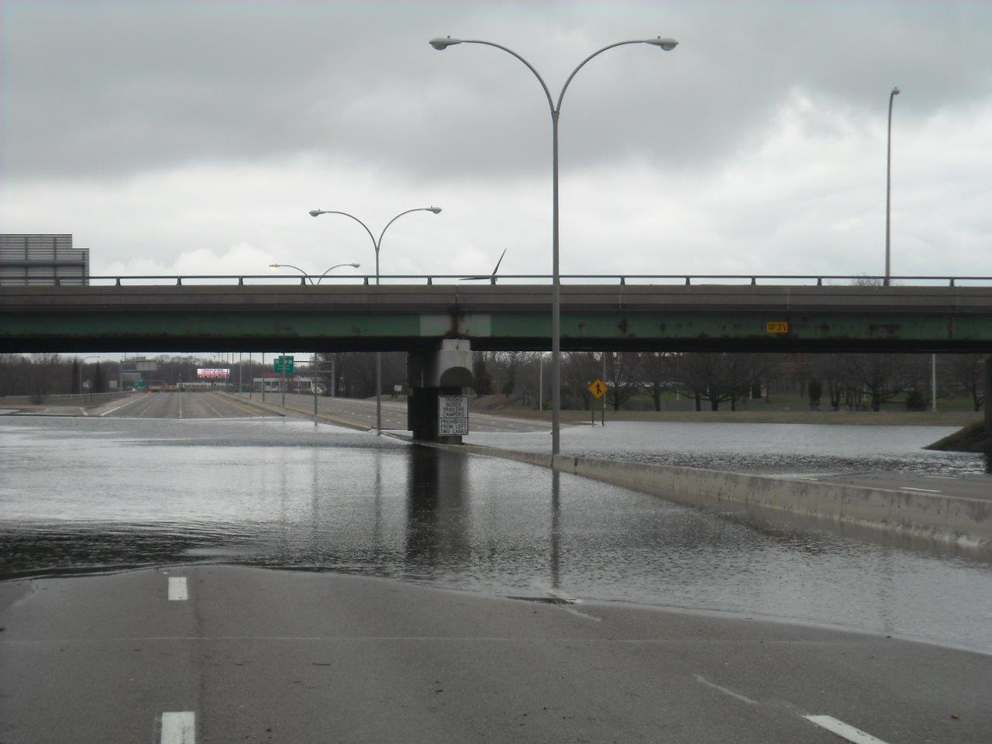
I-95 / AIRPORT CONECTOR ROAD

Slide 4
WASHINGTON COUNTY RESIDENTIAL AREAS

Slide 5
KENT COUNTY RESIDENTIAL AREAS

Slide 6
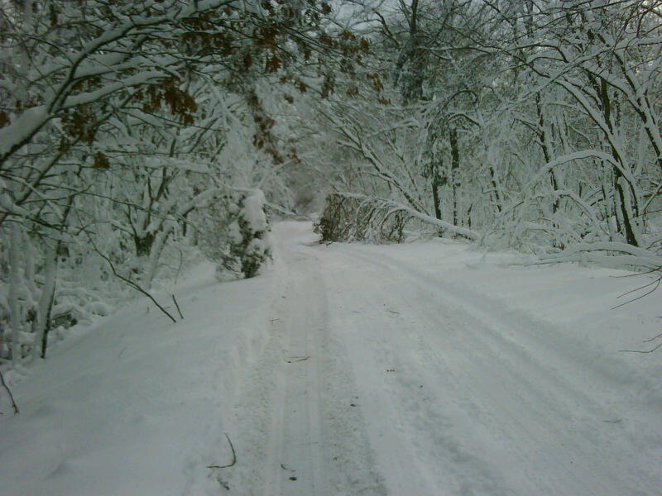
OTHER TYPES OF RIDOT EMERGENCY RESPONSE
BLIZZARDS / SNOW EVENTS

Slide 7
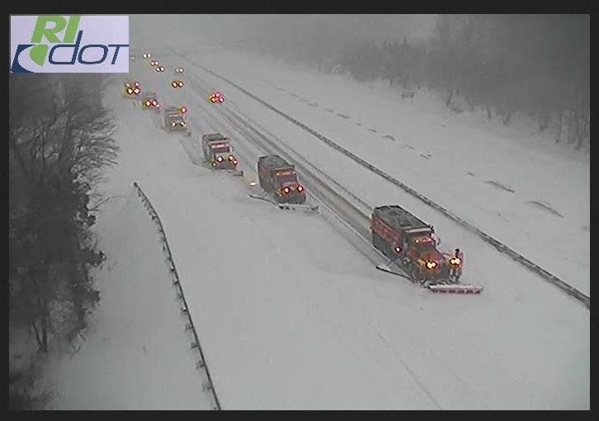

Slide 8
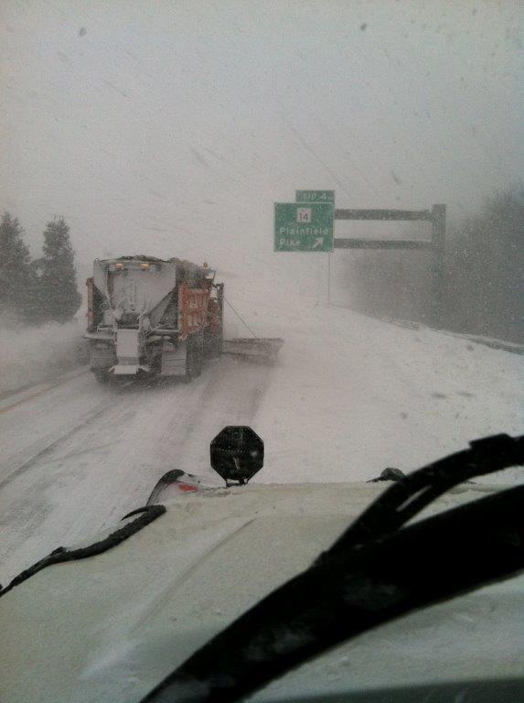

Slide 9
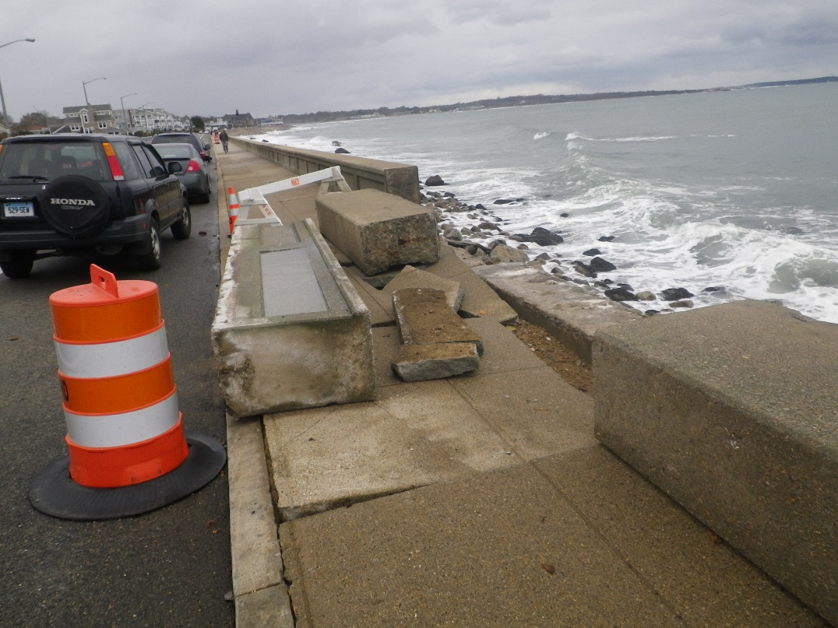
HURRICANES

Slide 10
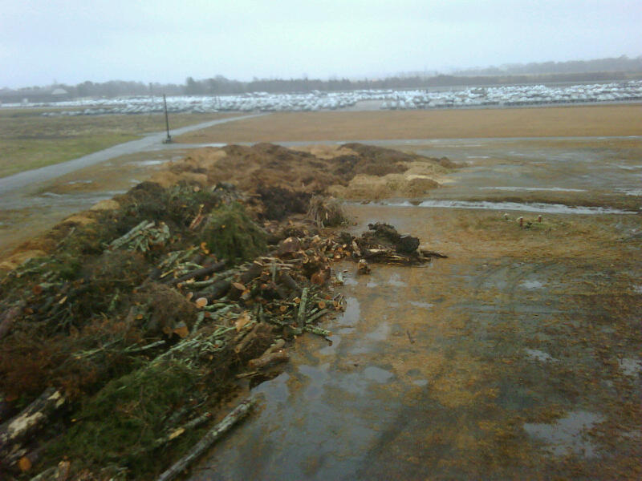

Slide 11
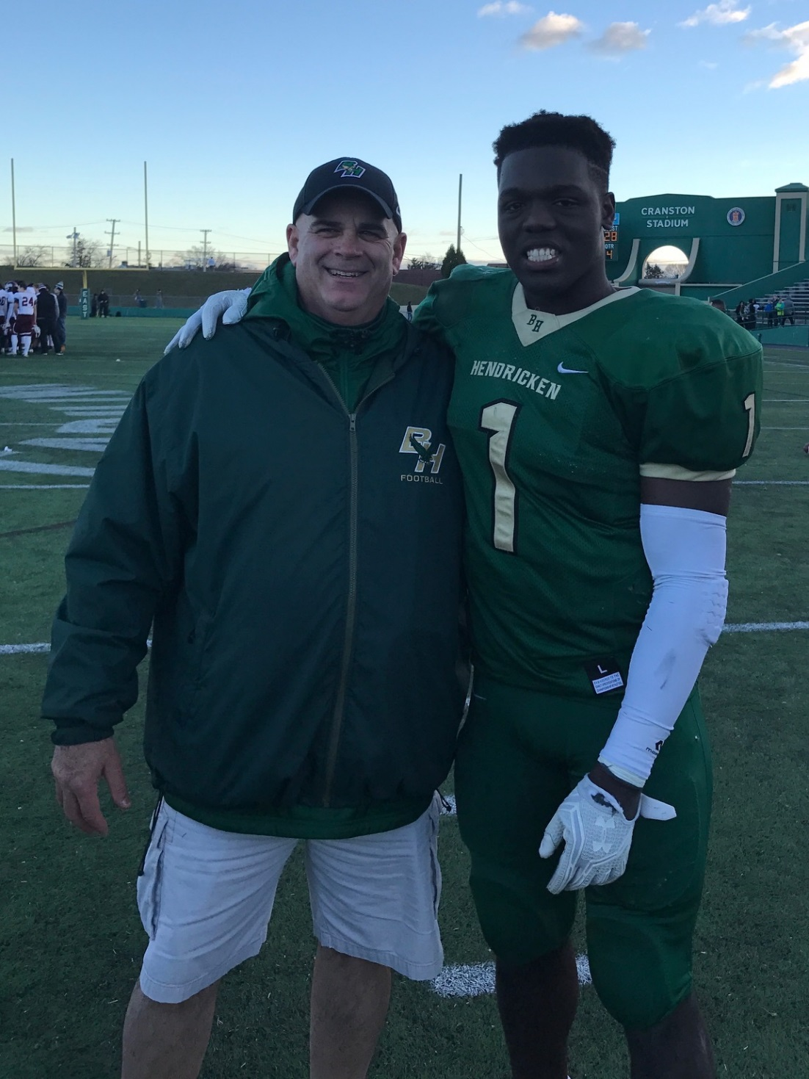

Slide 12
DURING THE 2010 FLOODS WE RECOGNIZED WE NEEDED TO BE GET BETTER AT;
Organizing and dispatching our limited resources
Communicating with our operations staff
Having a unified approach to dealing with these types of incidents
Disseminating information to the public
Internally managing operational staff and assets during incidents
SO, WHAT DID WE DO? …
Started with low hanging fruit!

Slide 13
Notes:
WE IMPLEMENTED THE ICS STRUCTURE WITHIN RIDOT AND CREATED 3 BASIC LEVELS OF COMMAND RESPONSE

Slide 16
UPDATED OUR OPERATIONS CENTER AT MAINTENANCE HQ aka “STORM CENTRAL”
This room is now;
Primary command center for all RIDOT Maintenance Division Incident Response
RIDOT’s EOC during a RIEMA Activation
Web EOC
ESF-1, ESF-3 Desks
Director / Chief Engineer have spent full operations with us
COOP Backup site for the TMC & FHWA RI Division Emergency Response Staff
Fully equipped and compatible with;
Backup power supply
800 MHz Radio
CCTV
GIS / GPS / AVL

Slide 17
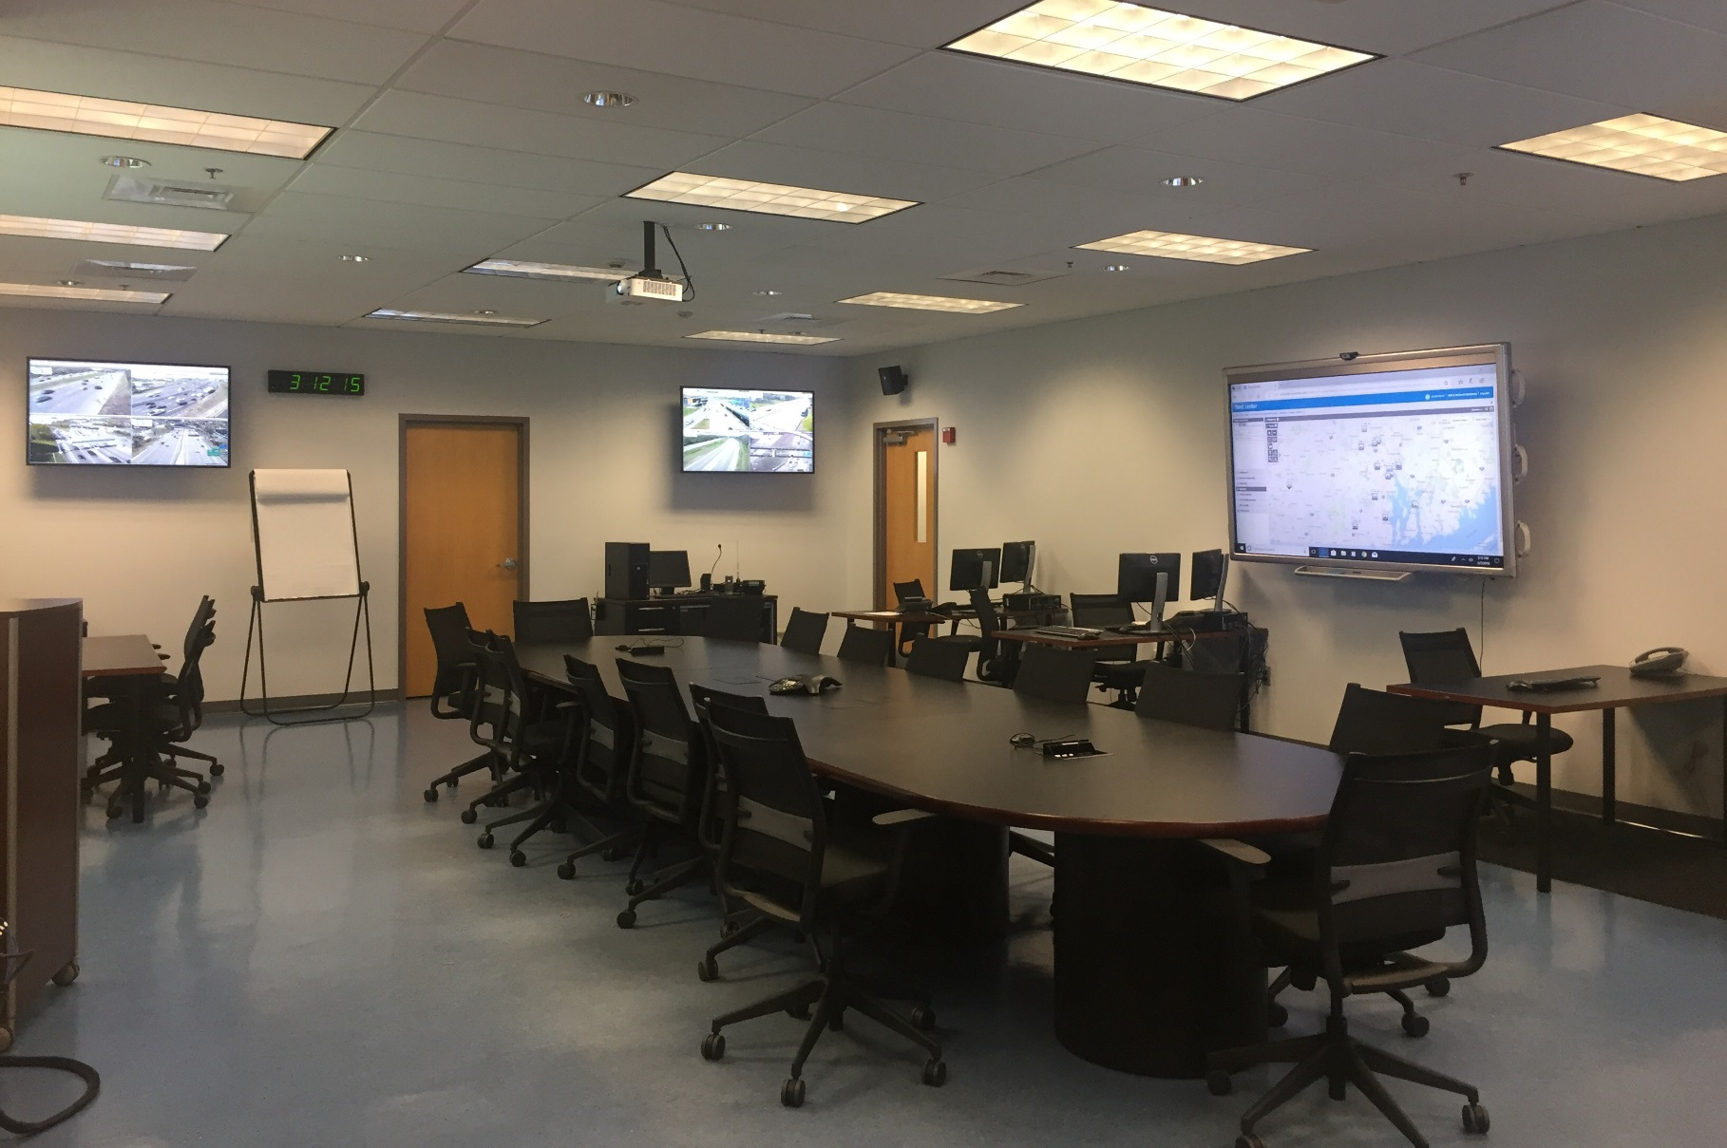

Slide 18
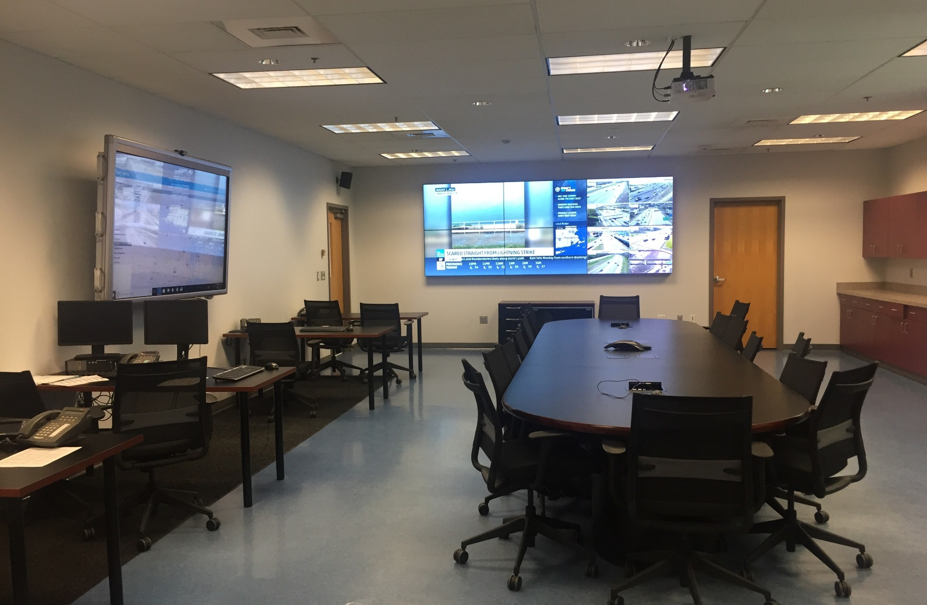

Slide 19
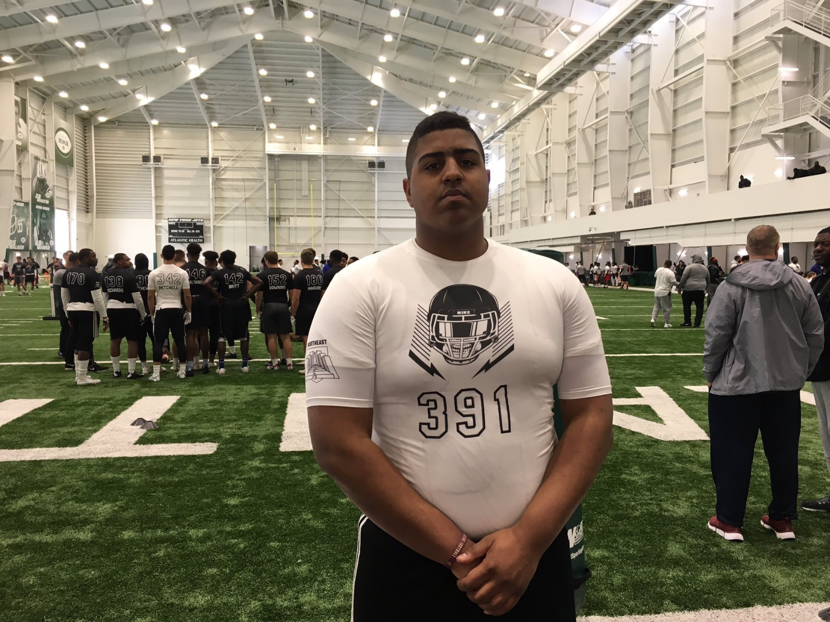

Slide 20
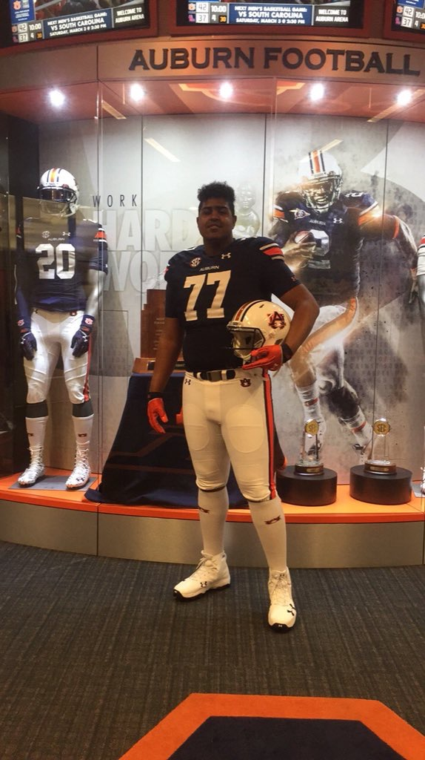

Slide 21
IMPROVED OUR RESPONSE & CAPABILITIES
After Action Meetings
Created “Strike Teams”
RIDOT, RISP, National Grid, RIEMA
Improved our weather forecasting & monitoring capabilities
Added some RWIS – more coming
Looking into new vehicle mounted probe technology
Expanded our Heavy Tow Plan
Improved Information Dissemination Pre-Event & During
Social Media
TMC Assets
Standardized Messaging
Notes:
AA meetings were internal, Heavy Tow went from Prov Metro to Statewide, Standardized = Nationwide Accepted Use, Clear Roads, AASHTO

Slide 22
REJUVINATED THE RI INCIDENT MANAGEMENT TASK FORCE
Made emergency response a priority
Developed a strategic plan to expand and improve RIDOT incident response (TMC)
Began statewide TIM training (ongoing)
Relationships developed through the IMTF have helped;
Foster better inter-agency emergency response
Provide a better understanding of each other’s roles and how we interact

Slide 23
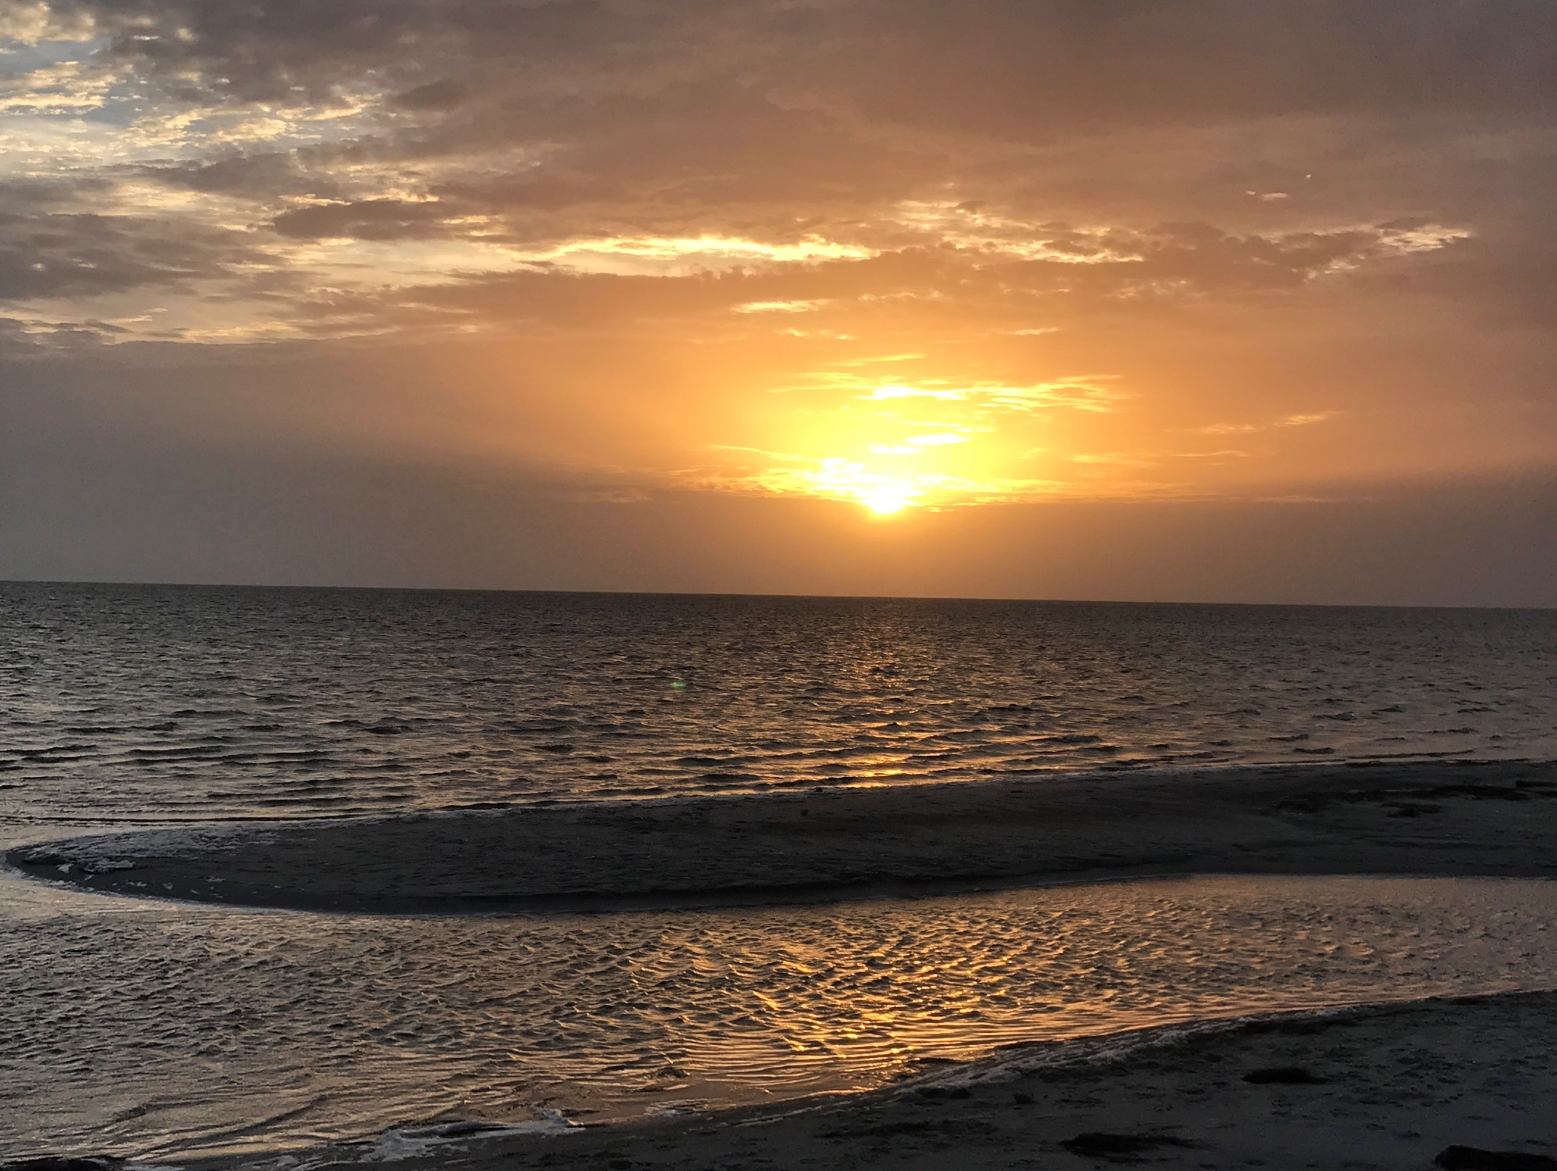

Slide 24
Thank You
Joseph A. Bucci, P.E.
State Highway Maintenance
Operations Engineer
www.dot.ri.gov
www.facebook.com/ridotnews
@ridotnews

