Slide 1

Intelligent Transportation Systems (ITS) Joint Program Office (JPO)
Connected Vehicle Reference Implementation Architecture (CVRIA) and Certification Projects
Presented to ITS Massachusetts March 10, 2015, Alan Chachich

Slide 2
Making sure things work together
Conformance testing programs usually include:
Standard or specification
Test tool (e.g., tool, suite, and/or reference implementation)
Procedures for testing
Organization(s) to do testing, issue certificates of validation, and arbitrate disputes
Notes:
Reference implementation is tool to allow conformance testing

Slide 3
Reference Implementation (NIST)
A reference implementation is an implementation of a standard
  by definition it conforms to the standard
  provides a proof of concept of the standard
  is a tool for developing the conformance test suite (by generating expected values, testing the test suite, etc.)
Notes:
Ref Impl. is ONE way a standard can be implemented, but not the only way.

Slide 4
Reference Implementation (WikiP)
an implementation of a specification to be a definitive interpretation for that specification
to develop the conformance test suite, it provides at least one relatively trusted implementation of each interface to
  (1) discover errors or ambiguities in the spec.
  (2) validate the correct functioning of the test suite.^{[1]}
Notes:
* It has to include every interface. * Will show where your standards/specs have problems or gaps. * Will prove your testing will work.

Slide 5
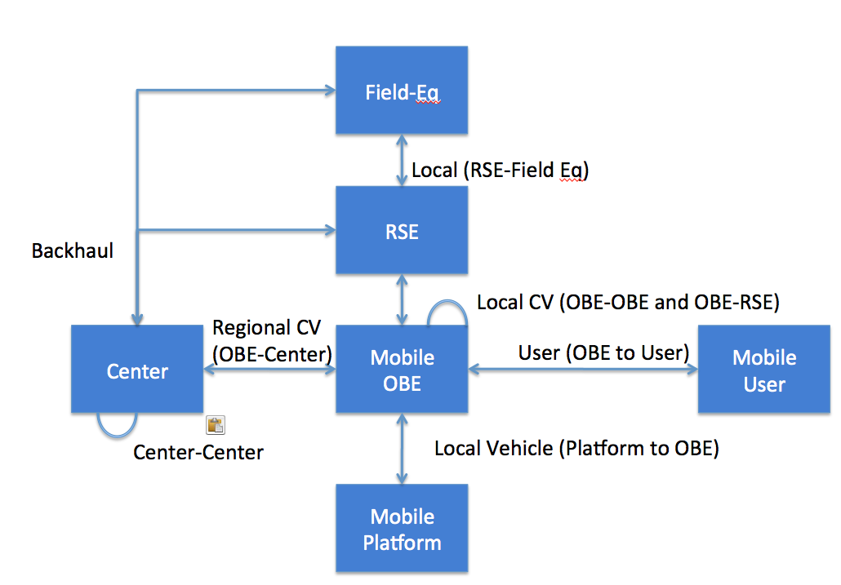
CVRIA
Notes:
This is what our ref impl looks like at the highest level.
* Only 7 defined interfaces * Limited set of communication stacks for any interface * We identify standards for each interface

Slide 6
Unified Implementation of the CVRIA
Connected Vehicle Reference Implementation Architecture (CVRIA)
Architecture site
http://standards.its.dot.gov/DevelopmentActivities/CVReference
SET-IT tool site
  Version 1.0
  Sample project
http://www.iteris.com/cvria/html/resources/tools.html
Notes:
What our ref. impl looks like at a more practical level.
Boxes are things Inside the boxes are applications
The Unified Implementation of the reference architecture project embodies the fundamentals we need to work on:
All elements of a connected vehicle system – mobile, field, center.
Multiple communication media with a common process for assuring trust and protecting confidentiality.
Data abstraction points to facilitate data flow and aggregation. A place is provided for multiple application interest groups to connect up and use (and contribute to) the flow.
************
The boxes are physical objects and things in the boxes are application objects. Lines are information flows
The blue boxes (upper right) are inside the vehicle
Yellow boxes are travelers and their equipment
In the middle (orange) exist at the boundary between moving and fixed elements. Bridge between wired and wireless
On the left side (teal): fixed infrastructure – they exist somewhere at an IP address. Data are gathered and aggregated and synthesized
Black oval: facilitate the flow of the fundamental data that all travelers need.
Center and Bottom (dark green): support services for overall concept – to make it all work
This is the kind of system that we think could be scaled up to national level

Slide 7
Fundamental Information Flows
Pilots will explore implementation and use of uniform information flows
  From vehicles
  From field devices
  From back offices
Uniform overall communication security
Notes:
To actually achieve program objectives, you need an understanding of the ebbs and flows in the underlying system.
All “Internet of Things” systems have these flows:
Information flows:
From the mobile objects (vehicles) toward places where aggregation and analysis can take place (vehicles)
From objects at the boundary between fixed and mobile (field devices) that distribute
From objects at fixed locations (back offices) where actionable information is created
Typical of any commodity-based enterprise
Producers
Distribution
Refiners

Slide 8
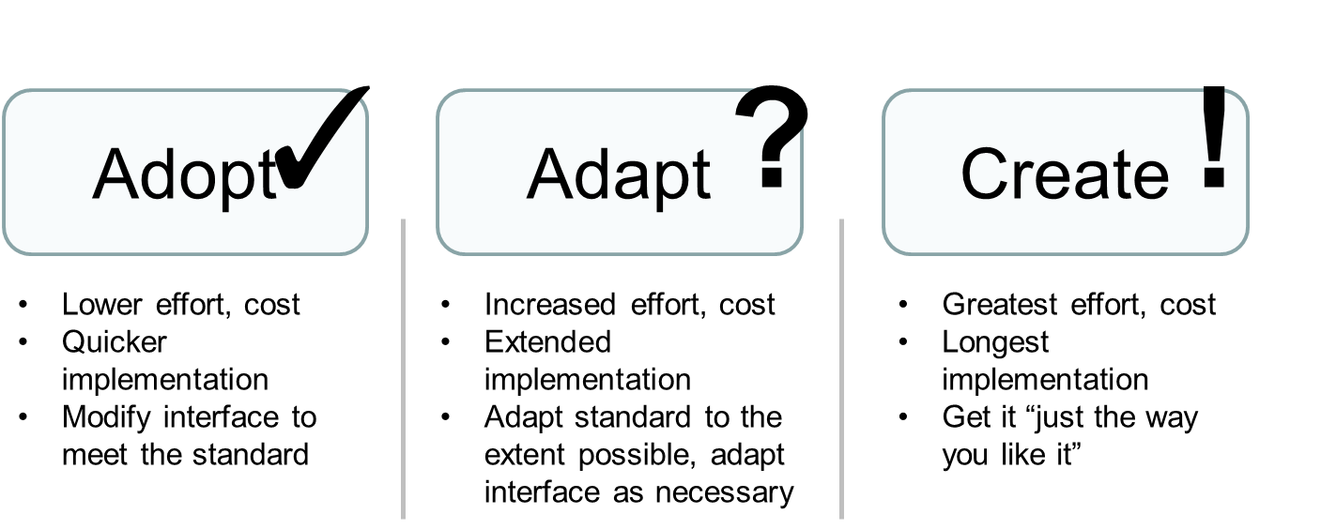
CVRIA and Standards
The USDOT’s ITS Joint Program Office (JPO) → standards plan
Guide ITS standards-related activities to support the connected vehicle research program, and broad deployment of connected vehicle technologies
Living document to evolve as ITS technologies, implementation strategies, and policies develop
The plan will help the USDOT bridge the “standards gap”
Notes:
This is our approach.
ITS Joint Program Office is developing a standardization plan to assist USDOT in determining and setting its priorities and in directing its funding.
It’s intent is to guide the public-sector role, and not necessarily to drive any private interests or activities.
The first iteration of the plan is expected to be complete in February of 2014.
Going forward, the plan will be a living document that should be updated as Connected Vehicle technologies, policies, priorities and of course, standards evolve—about every six months.
The plan will help USDOT bridge the gap between the standards as they exist today and the standards that will be needed to implement Connected Vehicle applications now and in the future.
The plan will help answer the questions:
Which existing or emerging standards can be Adopted?
Which existing or emerging standards can be Adapted to better fit CV needs?
Are there missing standards that need to be Created from scratch?

Slide 9
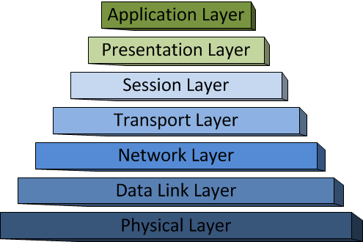
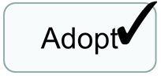


Standards at Different Layers of the OSI Stack
May need new standards or portions of standards
Prefer off-the-shelf implementations at the lower levels
(step 3)
(step 4)
Key Question: Can CV needs be fulfilled with off-the-shelf standards at the lower levels, and within the scope of J2735 at the higher levels?
Notes:
Most communications that we need exist already and have standards.
We are most likely to have to create standards at the application level.

Slide 10
The CVRIA provide the interfaces, data flows exchanges, sample applications, etc.
From that …
Prioritize Applications
Prioritize Exchanges
Map Exchanges to Standards
Map Interfaces to Standards
Identify gaps … Prioritize
Roadmap to fill the gaps
Notes:
These are the phases of the CVRAI project. Currently in step 5.
For example the 4 priority ONE exchanges identified were
Connected Vehicle Data * Misbehavior Report * Security Credential Revocations * Security Credentials

Slide 11
Certification Project
What?
  Determine how to certify connected vehicle processes and devices
  Set up initial certification mechanisms
Who?
  ITS JPO
  Danlaw (global provider of telematics, automotive electronics and embedded engineering services)
  7Layers (wireless test and engineering group)
  OCS (not for profit certification organization)
Notes:
What do we do with the CVRIA? The Certification project is that next step.
OCS (not for profit certification organization founded by OmniAir, an industry consortium dedicated to interoperability in the transportation industry, led by SwRI)

Slide 12
Certification cont’d
How
  Work collectively to define
    the scope of certification activities,
    test procedures
    test equipment to be used.
  Consult significant stakeholder communities
  Work independently to set up facilities to operate the tests
  Services should be available prior to the start of the buildup of the CV Pilots

Slide 13
Phased Approach
Phase 1: Agree on the extent of the project
  Awardees must be capable of establishing certification services for Layers 2 and 3 of the certification scheme,
  Have a way to achieve Layer 1 certification.
  May also be able to implement all others layers of certification.
Phase 2: Agree on device specifications
  Evolve equipment, application support specifications, and application specifications. All awardees and USDOT will
  Work with significant outside stakeholders to agree on the specifications used for testing done under this agreement.
Phase 3: Define test procedures and equipment requirements
  Common practices and key tools must held constant so all awardees will be able to deliver fundamentally the same results.
  Completion target January 1, 2016

Slide 14
Phased Approach cont’d
Phase 4: Construct Individual test facilities
  Implement the test procedures with the tools defined in Phase 3
  Be available for device and application testing.
  Participate in USDOT sponsored PlugFests
  The test tools and test suite software will remain the intellectual property of the awardees. However, USDOT will have the right to use the test suites for Federal government purposes.
Phase 5: Operate Individual test facilities
  Operate facilities as needed by device makers and application developers.
  Charge fees for whatever services they perform. Partial Federal support continues.
  USDOT sponsored and self-sustaining certification testing activities.
Phase 6: Update business plans, test procedures and tool requirements
  Review the operation of the certification processes when in use.
  Recommend improvements to test procedures and tool requirements
  Update their business plans.

Slide 15
For more information
CVRIA
http://www.iteris.com/cvria/html/about/connectedvehicle.html
http://standards.its.dot.gov/DevelopmentActivities/CVReference
Certification
http://www.its.dot.gov/connected_vehicle/connected_vehicle_cert.htm
Questions?
alan.chachich@dot.gov 617.494.3530

Slide 16
BACKUP SLIDES FOLLOW

Slide 17

Step 1: Prioritize Applications
Applications are derived from the CVRIA and prioritized
CVRIA Database is baseline of all of our work
We prioritized applications based on averaged team rating of
  Importance
  Timeframe
  Complexity
Results in a prioritized list of applications

Slide 18
Preliminary Results …Prioritized top 20 Applications
Communications Support
Core Authorization
Data Distribution
Emergency Vehicle Alert
Incident Scene Work Zone Alerts for Drivers & Workers
Spot Weather Impact Warning
Curve Speed Warning
Emergency Electronic Brake Light
Advanced Traveler Info Systems
Forward Collision Warning
Emergency Vehicle Priority
Infrastructure Management
Border Mgmt. Systems
Vehicle Emergency Response
Signal Phase and Timing
Warnings about Hazards in a Work Zone
Road Weather Advisories and Warnings for Motorists
Intelligent Traffic Signal System
Intersection Movement Assist
Road Weather Information for Freight Carriers
- 206 …

Slide 19
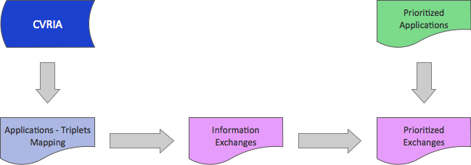
Step 2: Prioritize Exchanges
An “exchange” is an information flow over one of the seven major interface types.
Results in a prioritized list of exchanges

Slide 20
Preliminary …Top Prioritized Exchanges
Connected Vehicle Data (4) – BH, C2C, LCV, RCV
Misbehavior Report (3) – BH, C2C, RCV
Security Credential Revocations (3) – BH, C2C, RCV
Security Credentials (3) – BH, C2C, RCV
BH – Backhaul
C2C – Center-to-Center
LCV – Local Connected Vehicle
RCV – Regional Connected Vehicle
LV – Local Vehicle

Slide 21
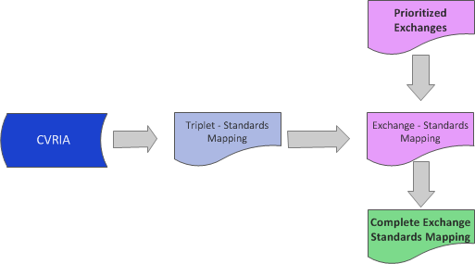
Step 3: Map Exchanges Standards
Standards are based on CVRIA mappings
We exported the mappings of the triplets to standards from the CVRIA
We paired these mappings against output of our prioritized exchanges
Team manually mapped remaining exchanges to information/application level standards
Results in a complete mapping between defined exchanges and information standards

Slide 22
Preliminary Results …Prioritized Standards by Exchanges
Of the top 70 prioritized exchanges, the following standards were identified as high-priority.
19 of the top 70 exchanges do not have standards identified for them at this time.
Standard | Supported Exchanges
SAE J2735 | 28
SAE J2945 | 10
NTCIP 12xx | 5
ITE TMDD | 4
NTCIP 12xx | 4
IEEE IM | 2
NTCIP 1209-TSS | 2
NTCIP 1205-CCTV | 2
NTCIP 1203-DMS | 2
Report J3067 | 1

Slide 23
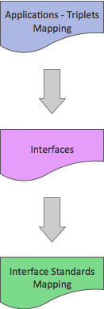
Step 4: Map Interfaces to Standards
An interface is a connection between two objects of known types
Only 7 defined interfaces in our model
Limited set of communication stacks for any interface
We identify standards for each interface
Results in mapping between interfaces and interface standards

Slide 24

Step 6: Identify Gaps
Each Exchange and Interface is reviewed and rated
The mappings are then reviewed to determine if the standard is both
  Completed (i.e., approved), and
  Sufficient for the need
Exchanges and interfaces that are not fulfilled are noted as “gaps”
Results in a listing of gaps that identify work that needs to be done

Slide 25
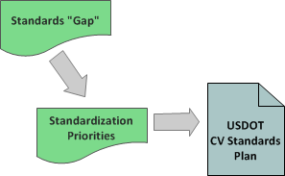
Step 7: Prioritize Work & Develop Plan
We recognize that there are multiple teams that can work in parallel
A final review of highest priority gaps
  Eliminates any futuristic exchanges
  Identifies if USDOT support is needed
  Produces a listing of the highest priorities for each standard
Results in list of priorities for each standards working group

Slide 26
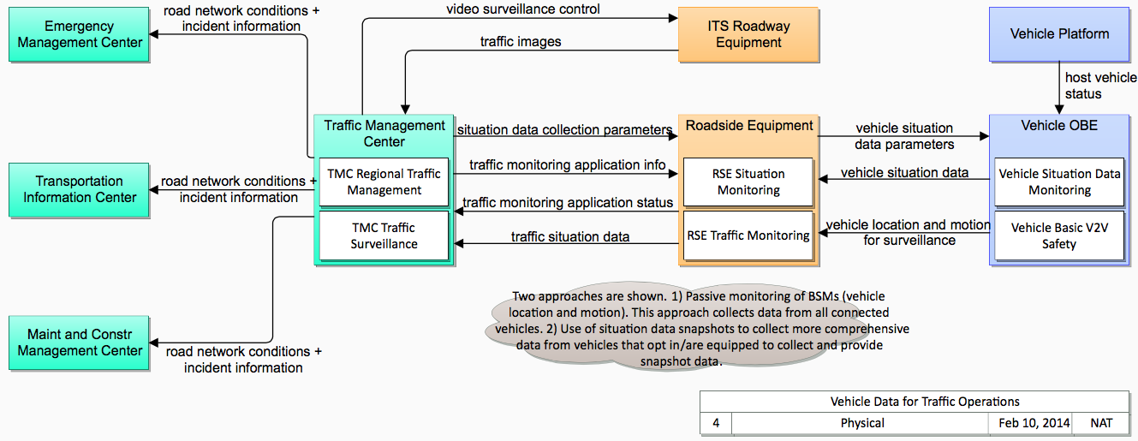
Example – Vehicle Data for Traffic Operations
Application among highest priority
  Uses Center-to-center, Backhaul, Connected Vehicle, and Local Vehicle Interfaces
  Uses TMDD, NTCIP, J2735, etc.
  All flows must be standardized for application to interoperate
  Each of the standards include lower priority information as well

Slide 27
Example – Vehicle Data for Traffic Operations
Gaps
Application among highest priority
Standards Gap
  Collecting situation data snapshots from vehicles and relaying to center
Priorities for
  J2735 (for individual vehicle data)
  NTCIP 12xx (for consolidated information)

