Slide 1
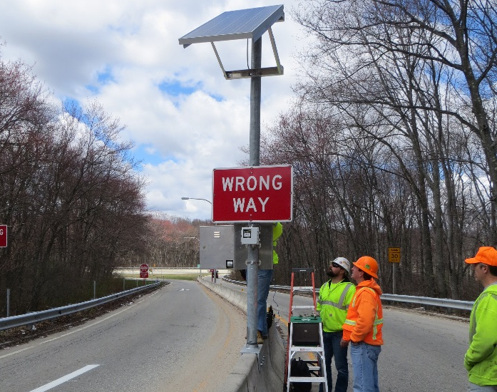
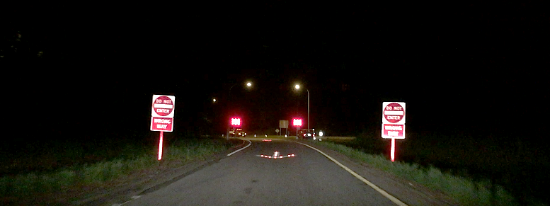
RIDOT’s Wrong-Way Driving Mitigation Program

Slide 2
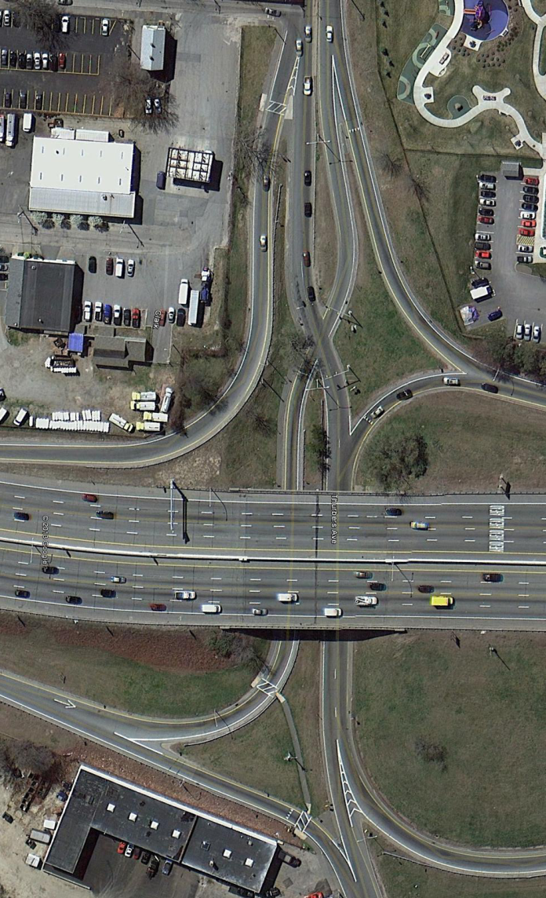
Pilot Detection Systems
Wrong Way Detection Systems on 24 locations
Worked with State Police to pinpoint locations
Citation/incidents – corridors chosen
Side-by-side ramps, isolated off-ramps, and confusing geometry.
All solar powered/wireless systems
Goal – to provide active feedback to the:
Wrong-way driver via flashing signage
Right-way drivers via Dynamic Message Signage
TMC/RI State Police

Slide 3
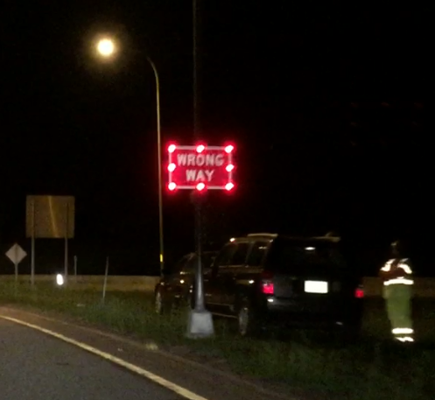
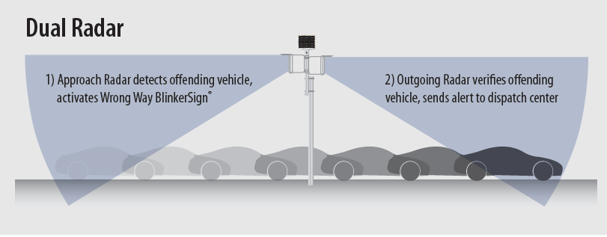
Pilot Detection Systems
Wrong-Way Alert Generated
Offending vehicle tracked 100’ by incoming radar
Offending vehicle crosses camera trip line
Offending vehicle detected by outgoing radar
Once all three conditions are satisfied, alert is sent

Slide 4
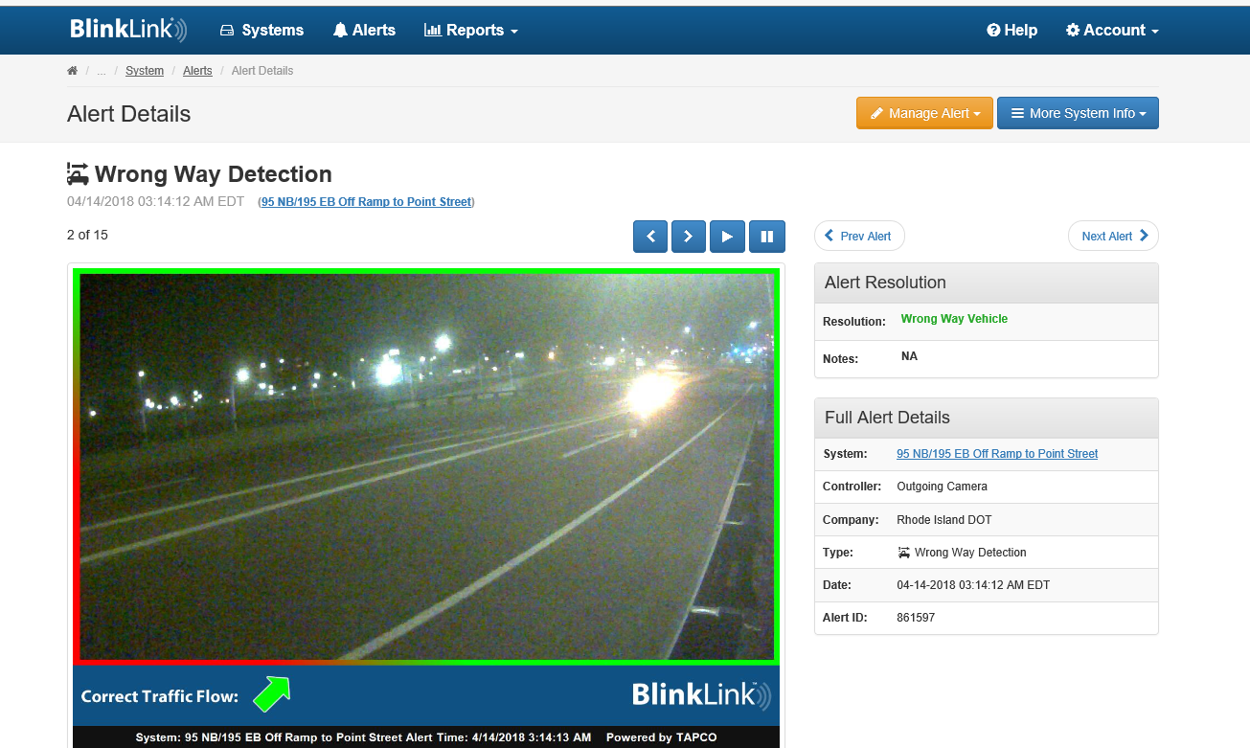
Wrong-Way Vehicle Alert – Web-Based System Alert

Slide 5
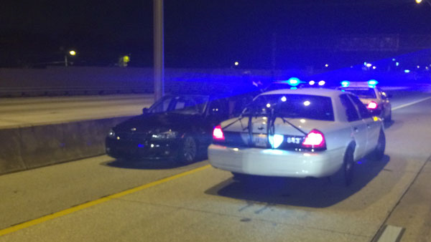
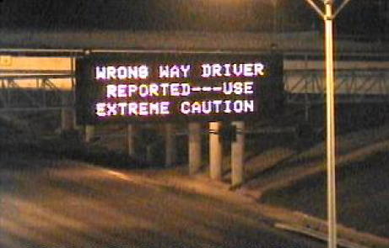
Alert Protocol
RIDOT
Alert via website at RIDOT TMC
Email sent to TMC
TMC locate vehicle on overhead camera (if available)
TMC and police make phone contact
TMC activates DMS sign (if available)
Police and TMC coordinate resolution
State Police
Alert via website at State Police
TMC and police make phone contact
Police dispatched
Police and TMC coordinate resolution
Notes:
RIDOT’s Message - WRONG WAY DRIVER REPORTED – USE CAUTION

Slide 6
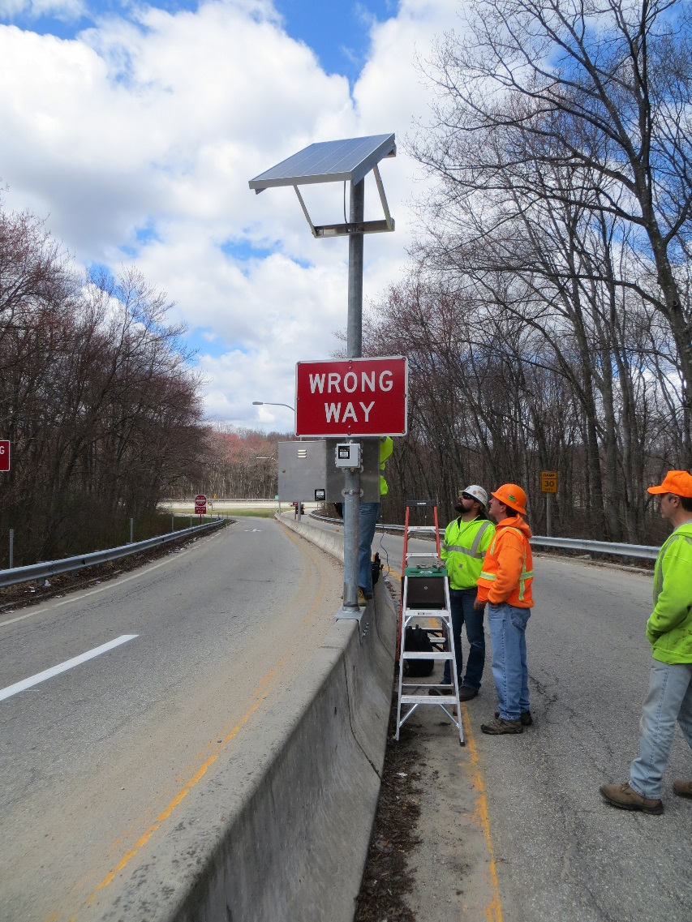
Pilot Overview
Cost
$2.2 Million
Effectiveness
100+ wrong-way events since May 2015
Resulted in no fatalities or reported crashes
Allowed for data driven approach to geometric improvements.
Maintenance
Added 100K annual funds to existing on-call ITS Maintenance contract
System Testing
Individual systems tested if no alert received within 60 days
All detection systems tested annually, regardless of alerts received

