Slide 1
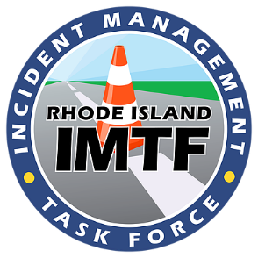
Michael Wreh
May 10, 2018

Slide 2
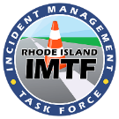
Our Take
Safety: TIM training isn’t just for severe incidents but 365 operations and improves the safety of all responders on the roadway.
Communication: Rhode Island is in a unique position to improve safety by putting faces to names and forging relationships between stakeholders from other agencies. IMTF helps foster this environment.
Mobility: Decrease incident clearance time and secondary crashes.

Slide 3
TIM Training in Rhode Island
RI 52.4% * vs. National 28.6%
448 Law Enforcement Personnel
1,431 Fire Rescue
10 Towing & Recovery
15 EMS
187 Transportation/PW
46 Other Disciplines
Completed 2 Train-the-Trainer Sessions
*As of April 16,2018

Slide 4
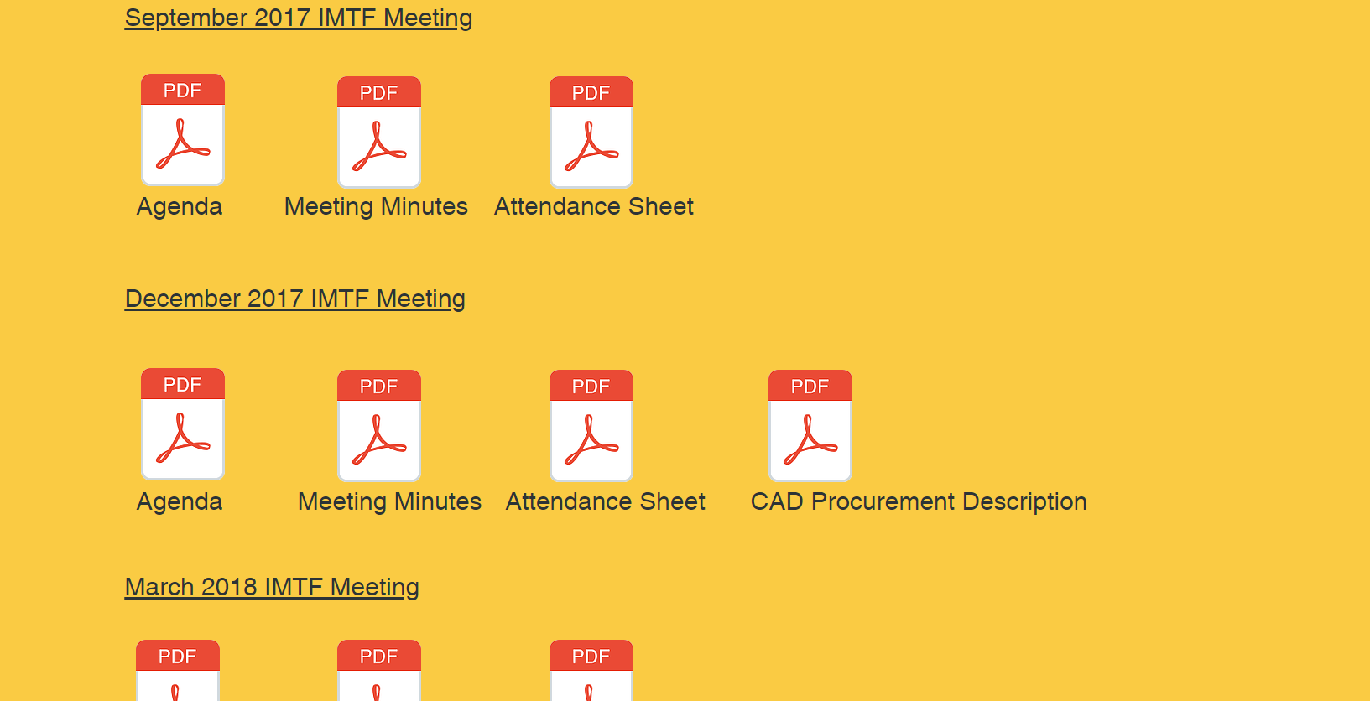
TIM Support- IMTF
Incident Management Task Force (IMTF) goal to Increase Participation in TIM Programs and Awareness of their Benefits
Unified Response Manual update
Package training materials and feedback sheet to be used in the future
Created website www.crashmgt.com
www.crashmgt.com

Slide 5
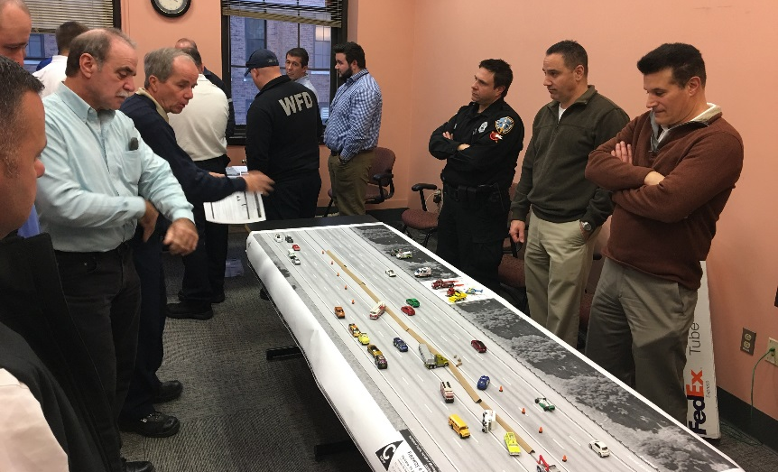
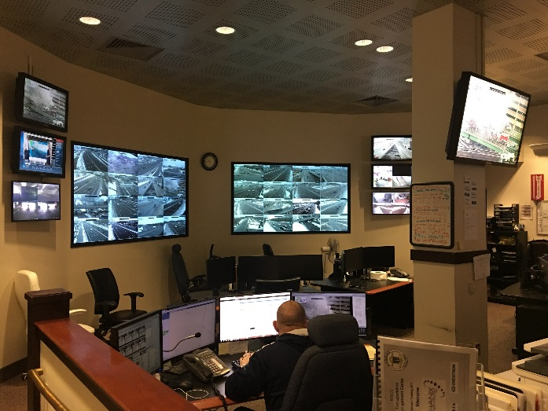
TIM Support- TMC
Transportation Management Center (TMC) Operators have all completed the TIM training program
24/7 Operations with State Police in Providence, RI
Visual incident detection and verification for dispatch
Enter incident data into RhodeWAYS database for performance measurement
Electronic message board display control to communicate with the motorist
Organized and hosted Train-the-Trainer Session

Slide 6
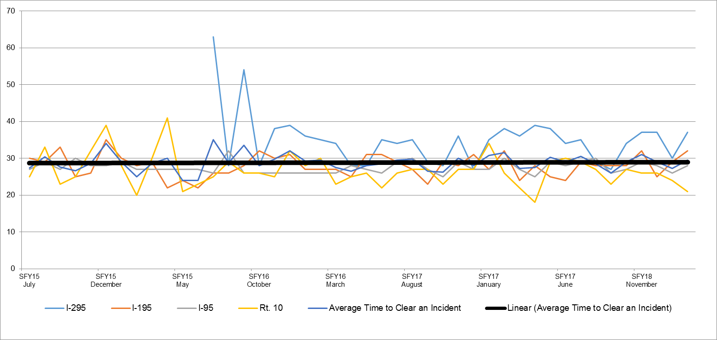
TIM Support-TMC Data
Incident Clearance Time Trends
Incident Clearance Time (min)
 | 2015 | 2016 | 2017 | 2018
I-295 | N/A | 37 | 34 | 33
I-195 | 28 | 28 | 27 | 29
I-95 | 28 | 27 | 28 | 28
Rt. 10 | 28 | 26 | 26 | 25
Overall Average Incident Clearance Time (min) | 28 | 27 | 27 | 27

