Slide 1
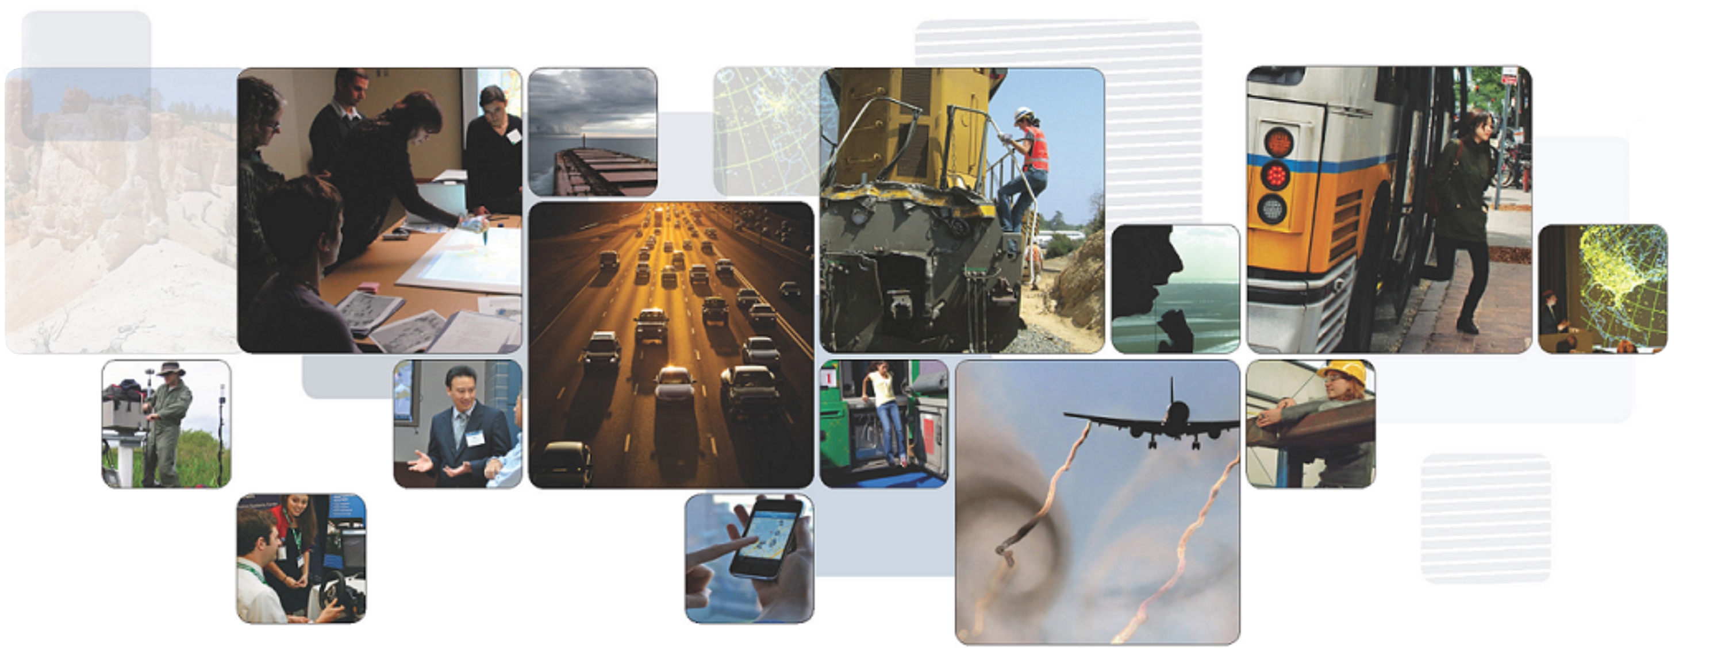
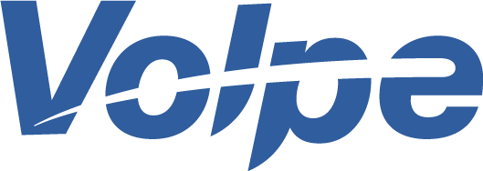

Multimodal payments: the future in Massachusetts?
Michael Dinning
ITS MA Visit to Volpe Center – March 10, 2015
The National Transportation Systems Center
U.S. Department of Transportation
Office of the Secretary of Transportation
John A. Volpe National Transportation Systems Center
Advancing transportation innovation for the public good

Slide 2
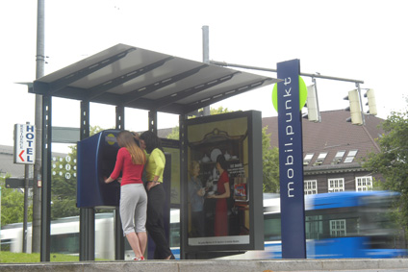

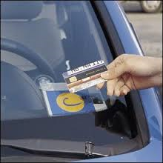
“eierlegendewollmilchsau”
This is our future way to pay?
“egg-laying wool milk sow”

Slide 3
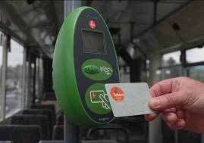
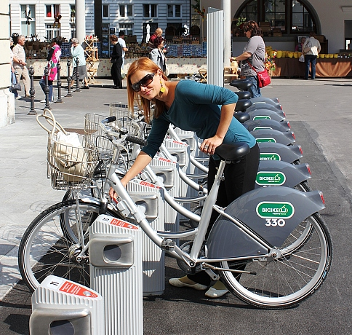
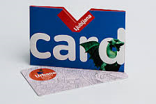
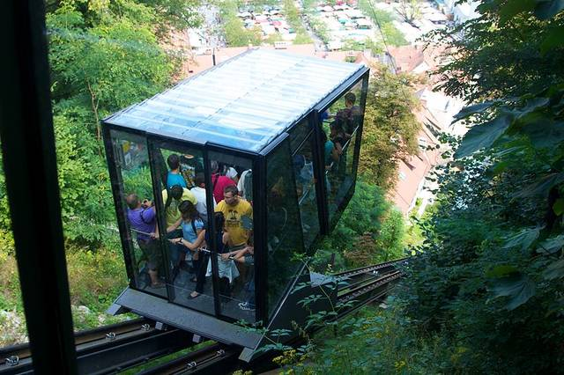
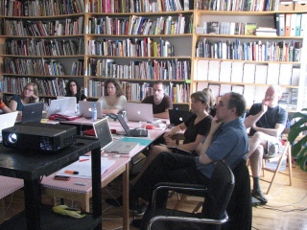
“Single City” cards emerging
Capital of Slovania
URBANA City Card

Slide 4
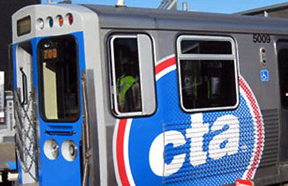
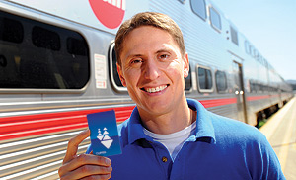
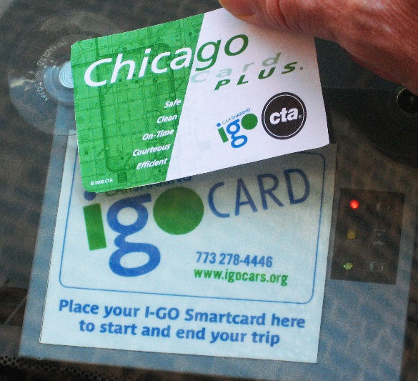
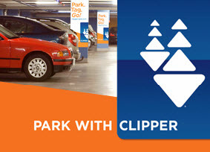
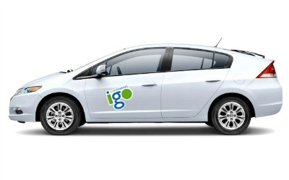
Drive towards convenience with common payment media
Notes:
Actually, over 50% of the riders on the largest transit systems in San Francisco use the Clipper Card. It’s a contactless smart card, which the Metropolitan Transportation Commission and the regional transit agencies have implemented. The Clipper card can be used on all types of transit, it’s reloadable and it was recently demonstrated for parking payment.

Slide 5
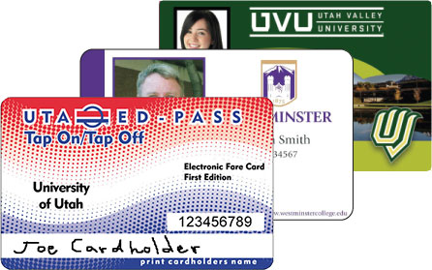
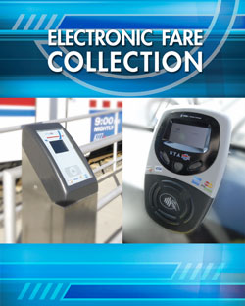
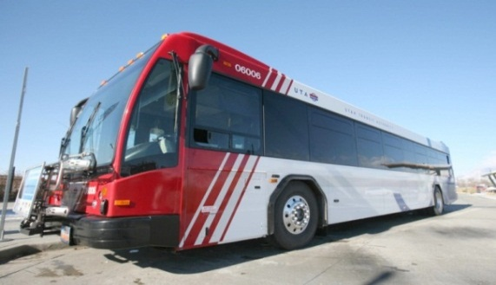
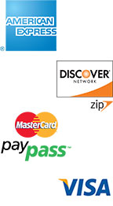
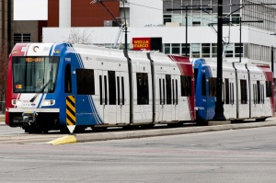
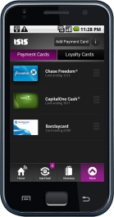
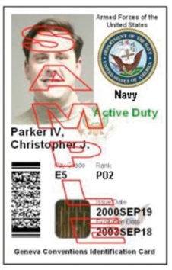
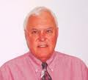
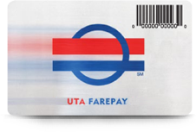
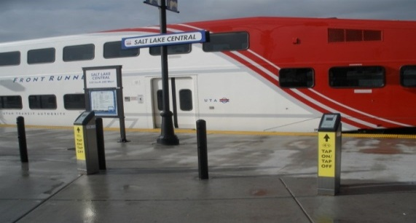
Will we have open payments which accept any media?
Notes:
Utah Transit Authority, here in Salt Lake City, was the first to implement an open transit payment system, and UTA has been a model of innovation for us ever since.
UTA accepts cards issued by employers, universities, financial institutions, and they have demonstrated use of secure government ID’s. As we heard earlier today, they also accept mobile wallets, and we’ve all got one of their general purpose reloadable cards.

Slide 6
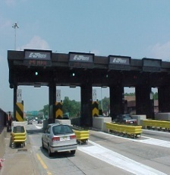
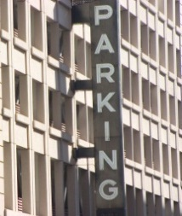
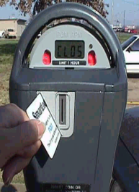
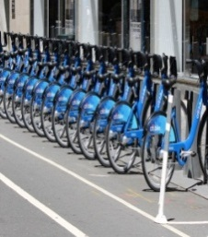


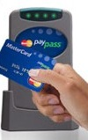


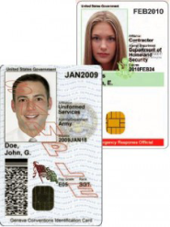
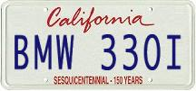



:
Will we provide universal (or linked) transportation accounts?
Hot Lanes & Tolls
Airport/Off-Street Parking
On-Street Parking
Shared use
mobility
Transit Fare Collection
Bus
Rail
Transponders
License Plate
Smart Cards Transit or Bank Issued
Smart Media
ID Cards
Universal or linked accounts
Coordinated incentives
Integrated customer services
Adapted from Mike Nash, Xerox
Notes:
As the LA ExpressLanes project demonstrates, account-based payment systems can facilitate convergence. Many in the Alliance, like Mike Nash, whose diagram I’ve borrowed, envision a Universal Transportation Account, which would link travelers’ payments for any mode of transportation.
This will provide convenience to customers, and the ability to give cross-modal incentives as LA has done.

Slide 7
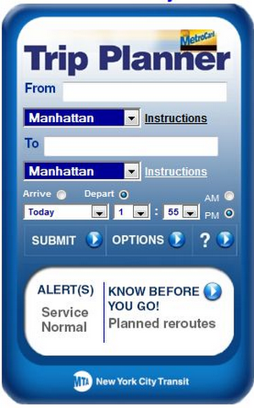
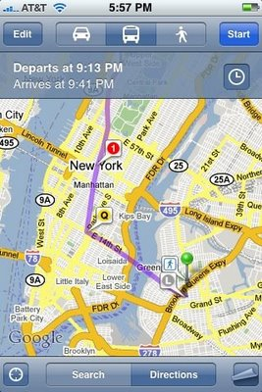
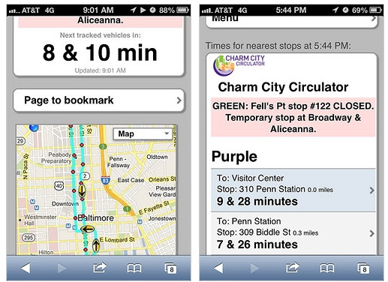
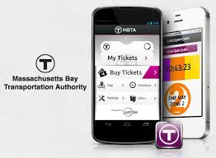
Will we integrate mobile apps to facilitate seamless travel?
City-Go-Round
Plan
Google
nextbus
Travel
MBTA JustRide – “Bring Your Own Infrastructure”
Pay
“You don’t have a lot to figure out. We all have navigators in our pockets.”
Notes:
Transit travelers can easily get information to help them plan a trip, tell them exactly when the next bus or train will arrive, and pay for their trip with mobile ticketing or a mobile device or wallet.

Slide 8
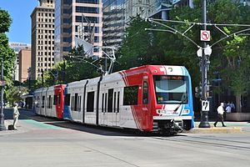
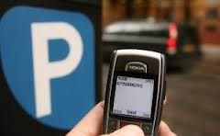
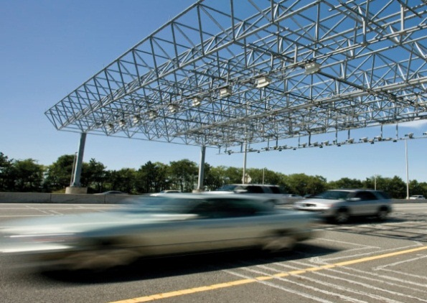

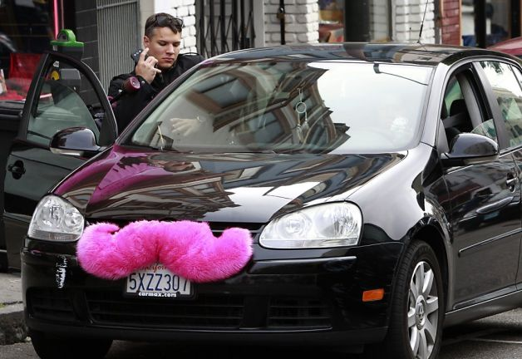
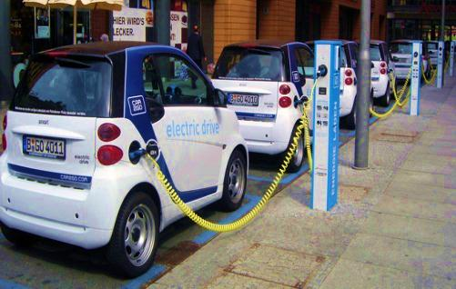
Will we provide access to any transportation option?
“Travelers want choices more than ever before”
“Mode choice is now situational, not habitual”

Slide 9
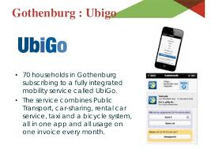
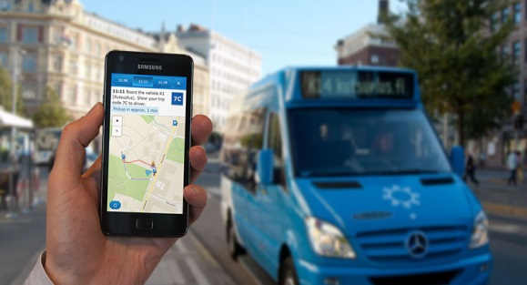
Will we offer ‘Mobility as a Service’ providing ‘Mobility on Demand’?
“Multimodal payment is a key lynchpin”
UbiGo transport broker
Gothenburg
Mobility As A Service
Helsinki
“Millennials want apps, not cars”

Slide 10



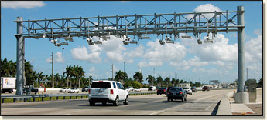
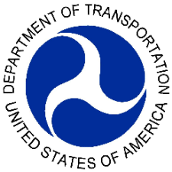

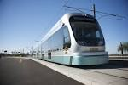


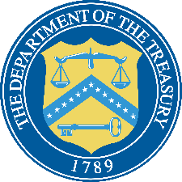




Multimodal Payments Convergence Workshop – January 15, 2015
Multimodal
payments
convergence
Notes:
Can be linked to financial industry issued media or banks.
A Common Transportation Account enables travelers to manage payment of all their transport needs
Eliminate the “stove-piped” experience in traveling, commuting, or navigating within or between cities or regions.
Leverages multiple payment media
Financial industry-issued media
Employer credentials
Transportation agency-issued media(e.g., cards, mobile wallets enabled by NFC) for payment at points or entry/exit to modes of transportation thereby changing the transport operator role to a merchant rather than a card/other media issuer.
Closed loop media such as branded cards, toll transponders and tickets are used as tokens by OPS through secure channels to access electronic purses underwritten by financial industry instruments.

Slide 11


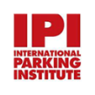

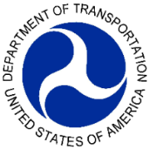
Converging on convergence –
How can you participate?
Socialize concepts
Share information
Demonstrate concept
Standards and architecture
development
Regional mobility initiatives
Innovative development

Slide 12
Michael Dinning
U.S. Department of Transportation
John A. Volpe National Transportation Systems Center
55 Broadway, Cambridge, MA 02142
michael.dinning@dot.gov
617-494-2422 (o)
617-694-7518 (m)
The ideas in this briefing are the personal thoughts of the author, not the United States Department of Transportation.
The United States Government does not endorse products or manufacturers. Trade or manufacturers’
names appear solely to illustrate the concepts presented in the briefing.
Notes:
…and I look forward to working with all of you to make it happen!

