Slide 1
Federal Highway Administration Traffic Incident Management Training Update

Slide 2
National TIM Responder Training Program Implementation Progress - As of May 1, 2018
Train-the-Trainer Sessions
Web-Based Training (WBT)
Total Trained: 331,426
In-Person Responder Training
12,396 sessions with 286,575 participants
33,902 total | 25,708 NHI | 1,610 Other
365 sessions with 10,949 participants
23% of participants have provided training
6,584 ERSI Responder Safety Learning Network

Slide 3
TIM Training Program Implementation Progress Train-the-Trainer (TtT) Sessions - As of May 1, 2018
2
WA
NH
ME
MT
ND
VT
OR
2
MN
ID
WI
NY
MA
2
2
3
SD
3
MI
3
WY
2
2
2
RI
2
IA
PA
CT
2
NV
NE
3
OH
2
NJ
2
IL
2
3
2
DE
CA
UT
2
2
3
IN
WV
2
MD
CO
2
KS
2
2
VA
2
MO
KY
DC
TN
9
NC
AZ
2
3
2
2
14
2
FHWA Sponsored
TtT Session Conducted
2
7
2
AR
3
NM
OK
3
SC
AL
2
2
MS
GA
State/Local Led/Funded
TtT Session Conducted
TX
2
LA
AK
2
FHWA and State/Local Co-Sponsored
TtT Session Conducted
3
FL
TtT Session Planned
HI
2
PR
365 | Number of TtT Sessions Conducted

Slide 4
TIM Training Program Implementation Progress Total Trained - As of May 1, 2018
Canada: 567
NH: 1,986
3,241
VT: 1,430
1,163
3,411
1,164
MA: 4,196
5,522
3,037
565
2,218
11,134
5,974
RI: 2,138
1,256
6,404
8,705
3,960
9,325
NJ: 12,383
CT: 1,179
4,184
5,796
15,187
1,618
12,143
4,241
DE: 446
7,051
22,883
MD: 6,215
20,693
4,024
9,965
9,849
11,584
17,424
8,954
DC: 2,115
5,747
405
1,821
5,090
2,008
6,977
4,489
4,247
Mexico: 875
31,609
AK: 532
7,434
HI:
785
PR:
4,077
331,426 | Total Trained

Slide 5
TIM Training Program Implementation Progress Percent Trained – SIP 18 Goal of 30% - As of May 1, 2018
NH: 27.7%
(7,175)
15.6%
(20,777)
32.5%
(10,502)
VT: 51.1%
(2,796)
15.5%
(7,510)
29.2%
(3,993)
14.1%
(21,542)
21.0%
(26,350)
MA: 34.7%
(12,079)
4.8%
(11,781)
45.0%
(4,930)
41.1%
(27,081)
11.0%
(54,443)
RI: 52.4%
(4,080)
33.3%
(3,770)
19.7%
(32,555)
13.1%
(30,208)
17.1%
(54,500)
NJ:
41.6%
(29,798)
CT: 37.8%
(3,120)
46.4%
(9,019)
50.9%
(17,100)
40.9%
(37,126)
20.7%
(7,831)
22.2%
(54,699)
19.0%
(30,546)
DE: 9.5%
(4,715)
35.4%
(19,894)
30.7%
(13,830)
43.1%
(53,082)
29.1%
(71,223)
48.5%
(8,300)
32.1%
(31,000)
54.2%
(18,177)
MD: 26.8% (23,218)
31.3%
(55,670)
67.6%
(13,245)
35.2%
(32,948)
DC: 32.4%
(6,534)
25.5%
(22,500)
4.1%
(9,932)
17.1%
(10,627)
35.5%
(14,331)
48.9%
(8,683)
11.7%
(17,103)
24.5%
(28,532)
0.1 - 9.9% Trained
40.4% (78,309)
39.4%
(11,394)
10 - 19.9% Trained
AK: 11.1%
(4,797)
20 - 29.9% Trained
13.0% (57,367)
30 - 39.9% Trained
HI: 24.0%
(3,270)
PR: 68.8%
(5,924)
40 - 49.9% Trained
28.8% | Percent Trained
(1,149,916) | Total Responders To Be Trained
50+% Trained

Slide 6
Institutionalization - Adoption of TIM Training into Academies for Basic Certification
Arizona Department of Public Safety
Arkansas LE Technical College
Arkansas Fire Technical College
Austin Texas DPS Academy
Colorado State Police Academy
Colorado Fire Departments
Connecticut State Police
New Mexico State Police
New Mexico State Fire Academy
Delaware Fire School
District of Columbia Fire/Rescue
Florida Highway Patrol Academy
Georgia State Police Academy
Houston Police Academy
Houston Fire Academy
Illinois Fire Service
Iowa, Fire Service Training Bureau
Iowa LE Academy Basic Training
Kentucky Fire Commission
Kentucky Law Enforcement Council
Maryland State Police Academy
22. Massachusetts State Police Academy
23. Massachusetts Municipal Police Academy
24. New Jersey State Police Academy
25. New Jersey Forest Service Academy
26. N. Carolina Fire/Rescue Academy
27. N. Carolina State Police Academy
28. Pennsylvania Fire Academy
29. Pennsylvania State Patrol
30. Puerto Rico Fire Institute
31. Puerto Rico Law Enforcement Academy
32. E. Oklahoma City Fire Technical College
33. S. Carolina Fire/Rescue
34. Texas Commission Fire Protection
35. Texas Commission on Law Enforcement
36. Wisconsin State Patrol
37. Wisconsin Fire Academy (Pending)
38. Washington State Police Academy
39. West Virginia LE Academy
40. Washington State Fire Academy
41. Wisconsin State Patrol Academy
42. Vermont Police Academy

Slide 7
TIM Training Evaluation Tool
Very positive training impacts were reported by agency administrators and senior management.
92.3 percent believe that overall agency operations have been improved as a result of personnel attending the TIM Responder training.
96.2 percent believe that overall safety at traffic incidents has been improved as a result of personnel attending the TIM Responder training.
86.6 percent believe coordination among different agencies at traffic incident scenes has improved since TIM Responder training.

Slide 8
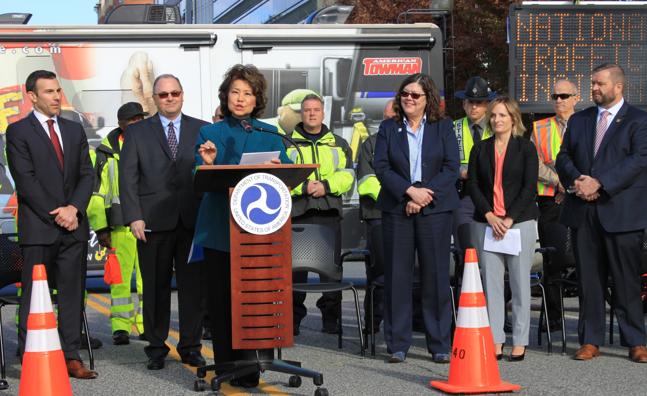
2017 National Traffic Incident Response Awareness Week – 300,000 Trained

Slide 9
2017 National Traffic Incident Response Awareness Week
Arizona: https://tim.az.gov launched its TIM website
Connecticut: MPO coordinated special media events
Colorado: Sponsored Statewide TIM Conference
Maryland: Rest area event
Florida: Video on Turnpike video displays inside rest areas, DMS, press event
Iowa: Very successful TIM display and TMC tour, strong social media presence
Missouri: Three major regional media events, DMS focus
Pennsylvania: SHRP2 training in Pittsburgh, responder and media outreach by DVRPC
Texas: DMS, social media, Day of Remembrance presence in San Antonio
Wisconsin: Governor’s Proclamation, multiple media events, DMS, produced a video

Slide 10
What Data Should be Collected?
3 Key Performance Measures:
Roadway Clearance Time – From the time an agency becomes aware of an incident and records it, to all lanes open for traffic flow.
Incident Clearance Time – From the time an agency becomes aware of an incident and records it, to time the last responder leaves the scene.
Secondary Crashes – The number of unplanned crashes recorded after the original incident either within the incident scene or within the queue in either direction.
Notes:
Paraphrase slide content

Slide 12
What does the future of TIM Training look like?
Increase use of data to identify needs/focus
Practical Exercise Facilities – TN, CO and PA
Other training – Training Compendium project
Computer Aided Dispatch – expanded use
Crowdsourcing for Operations – early notification (EDC5)
Big data to improve TIM
Training to reflect new technology – ADS, CAV, other

Slide 13
CAV Enhancing safe, quick incident clearance
Emergency Vehicle Preemption (PREEMPT) – preempts traffic signal operations to facilitate mobility of emergency vehicles.
Incident Scene Pre-Arrival Staging Guidance for Emergency Responders (RESP-STG) – provides input to responder vehicle routing, staging and secondary dispatch decisions.
Incident Scene Work Zone Alerts for Drivers and Workers (INC-ZONE) – warns on-scene responders/workers of vehicles with trajectories or speeds that pose a high risk to their safety. It also warns drivers passing an incident zone if they need to slow down, stop, or change lanes.

Slide 14
Mobility CV-TIM Applications
Significantly enhancing motorists’ awareness of incidents and maximizing mobility around/through incident scenes…
Motorist Advisories and Warnings (MAW) – data from downstream vehicles provide information/warnings to upstream motorists.
Intelligent Traffic Signal System (I-SIG) – an overarching system optimization application accommodating signal priority, preemption and pedestrian movements.
Dynamic Speed Harmonization (SPD-HARM) – recommends target speeds in response to congestion, incidents, and road conditions to maximize throughput and reduce crashes.
Queue Warning (Q-WARN) – provides drivers with timely warnings of existing and impending queues from incidents and work zones.

Slide 15
FHWA Vehicle for Public Safety Research
FHWA Turner Fairbanks Research staff to purchase vehicle focused on testing public safety focused emerging CAV technology.

Slide 16
Thank you!
For more information, please contact:
Jim Austrich Paul Jodoin
(202) 366-0731 (202) 366-5645
james.austrich@dot.gov paul.jodoin@dot.gov
16

