Slide 1
Massachusetts State Police Use of UAS’s at Major Traffic Collisions
2018 New England ITS Annual Interchange
Providence, Rhode Island May 10, 2018

Slide 2
Lieutenant Timothy Dowd Collision Analysis and Reconstruction Section
Massachusetts State Police -23 years
Collision Analysis & Reconstruction Section - 15 years
A.C.T.A.R. Accredited Reconstructionist #1486
Section Commander
FAA Remote Pilot Certification

Slide 3
Presentation Outline
Introduction
Massachusetts State Police C.A.R.S.
Measurement Techniques and Instruments
Unmanned Aircraft System (UAS)
Camera
Software
Case Studies
Questions and Discussion

Slide 4
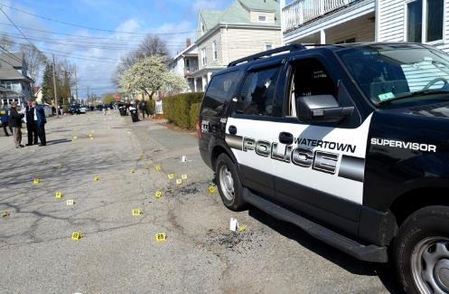
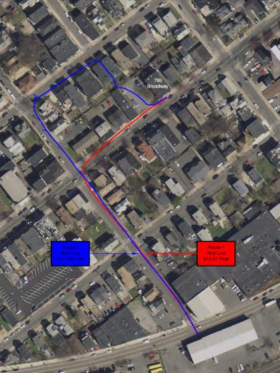
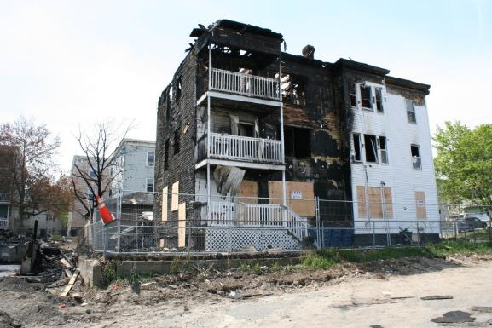
Massachusetts State Police C.A.R.S.
Notes:
The Massachusetts State Police Cars Section responds primarily to collisions involving serious injuries and fatalities. As a secondary function, we respond to crime scenes, arson scenes and assist in narcotics investigations, mostly for school zone violations.

Slide 5
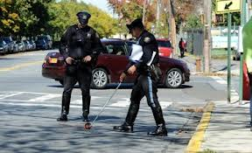
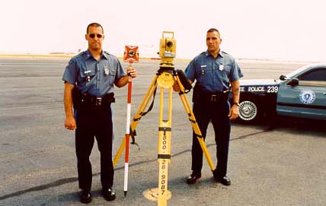
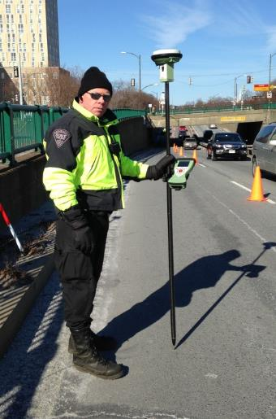
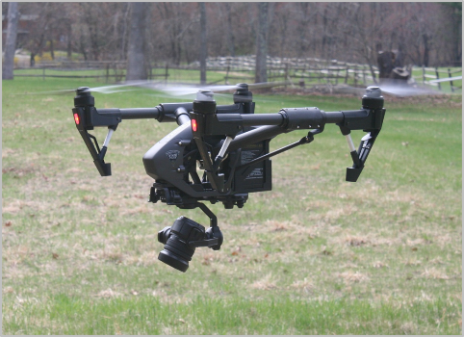
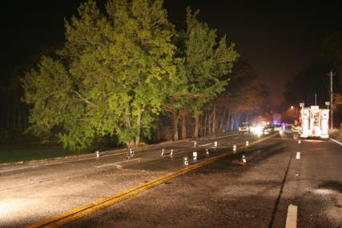
Massachusetts State Police C.A.R.S. History of Measurement Techniques

Slide 6
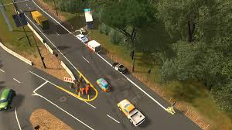
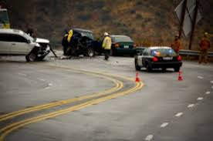
Coordinate Measurements
Accuracy?
Time??

Slide 7
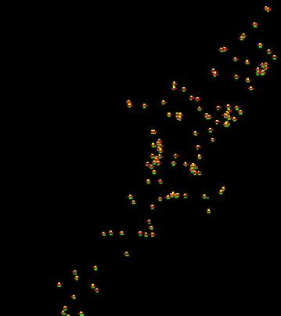
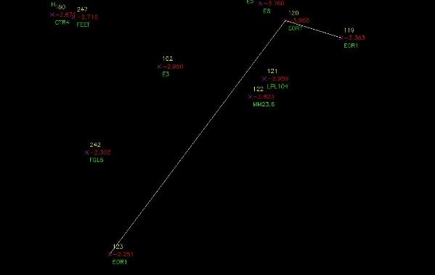
Total Station

Slide 8
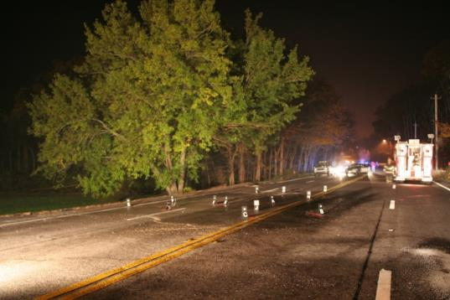
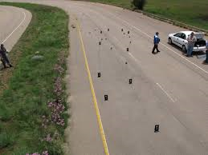
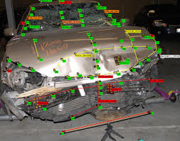
Photogrammetry
Environment
Office Time
Time??

Slide 9
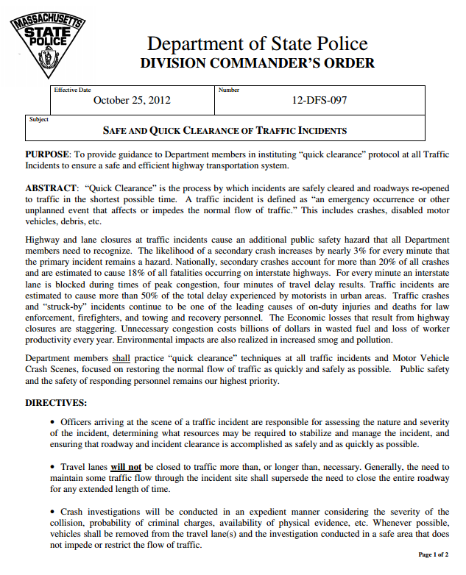
Massachusetts State Police C.A.R.S. Quick Clearance Directive October 2012
Goals:
Peak Traffic Times
Critical and Short-Lived Evidence
Accurately Document Evidence
Open Roadway to Restore Traffic Flow
Produce a Scaled Diagram for Court
Notes:
Secondary crashes increase 3% per minute that scene is not cleared Secondary crashes account for 20% of the total crashes and 18% of all fatalities on Interstate High
Ways
Traffic crashes and “struck-by” incidents continue to be one of the leading causes of on-duty injuries and deaths for law enforcement, firefighters, and towing and recovery personnel.

Slide 10
Massachusetts State Police Traffic Incident Management
Funding Partnership
Quick Clearance Scene Mapping Tools

Slide 11
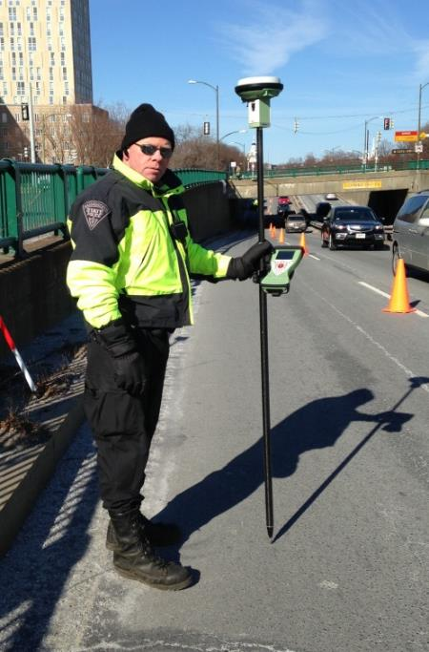
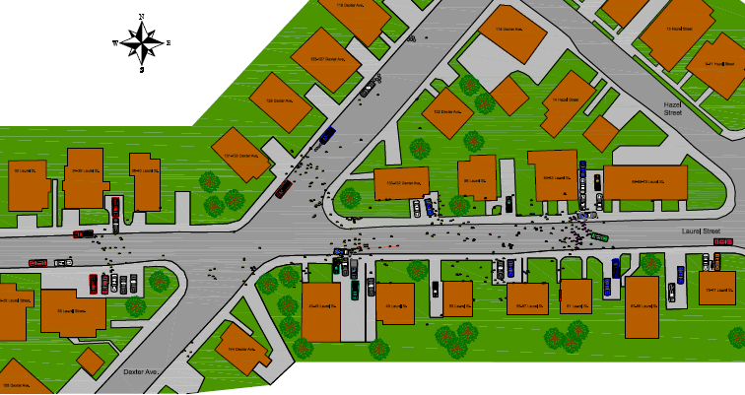
GPS/GNSS

Slide 12
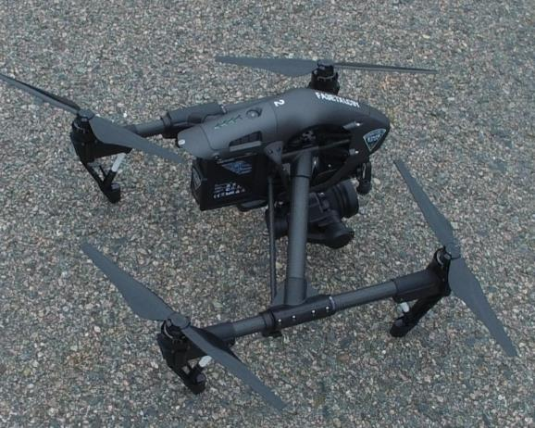
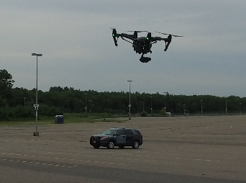
Massachusetts State Police CARS First UAS – November 2016 DJI Inspire 1 PRO with Zemuse X5 Camera

Slide 13
Massachusetts State Police C.A.R.S. 4 Teams
Notes:
MSP cars is broken into four teams. Each Team consists of a Sergeant/Team Leader. The Northeast Team has 6 troopers, the Southeast Team has 6 troopers, the Central Team has 4 troopers and the West Team has three troopers Each team has a DJI Inspire 1 Pro and at least two Part 107 Certified Remote Pilots. Currently, MSP CARS has ten members who attended a 40 hour “UAS Ground School and Flight Training Course”. Currently, the MSP CARS Section has 10 Part 107 Remote Pilots, three that are “active” Remote Pilots who fly missions. The remaining 7 act as Visual Observers and are training to fly active missions.

Slide 14
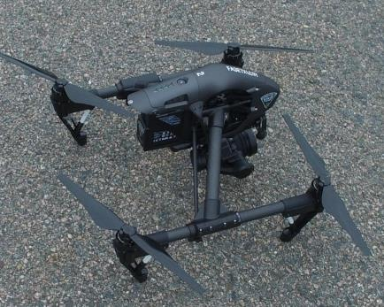
DJI Inspire 1 Pro
Quadcopter: Propelled by 4 rotors (2 CW and 2 CCW)
Weight: 3400 g ( 7.49 lbs) w/ battery & Zemuse X5
Adobe DNG RAW
Battery Life: 15-18 minutes with Zemuse X5
Max Speed: 18 m/s (40.26 mph)
Maximum Wind Resistance: 10 m/s (22 mph)
Operating Temperature Range: 14 ᵒ - 104ᵒ Fahrenheit
Maximum Transmitting Distance: Up to 3.1 Miles

Slide 15
Zemuse X5 3-Axis Gimbal and Camera
Zemuse X5 Camera Weight: 1.16 lbs
Camera Resolution: 16.0 Megapixels
Video: 4K Ultra High Definition
Sensor: 4/3-inch CMOS Sensor
in Adobe DNG RAW
Storage : Micro SD Card

Slide 16
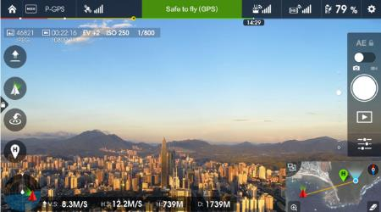
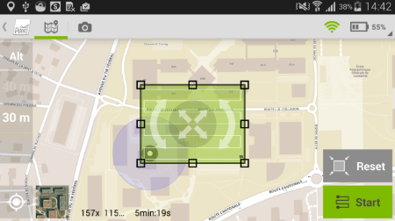
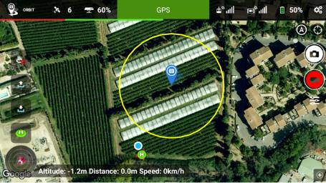
Software Applications - Tablet
DJI Go
Pix4D Capture
Litchi

Slide 17
Pix4D Capture App

Slide 18
Software Applications - Computer
Pix4D Mapper
Leica IMS Map360
IMS Map60 Point Cloud
AutoCAD Civil 3D

Slide 19
Case Studies
Rte 95 Attleboro Fatal Motor Vehicle Crash
Rte 6A Sandwich Fatal Pedestrian Crash
Rte 28 Bourne
Fatal Motor Vehicle Crash

Slide 20
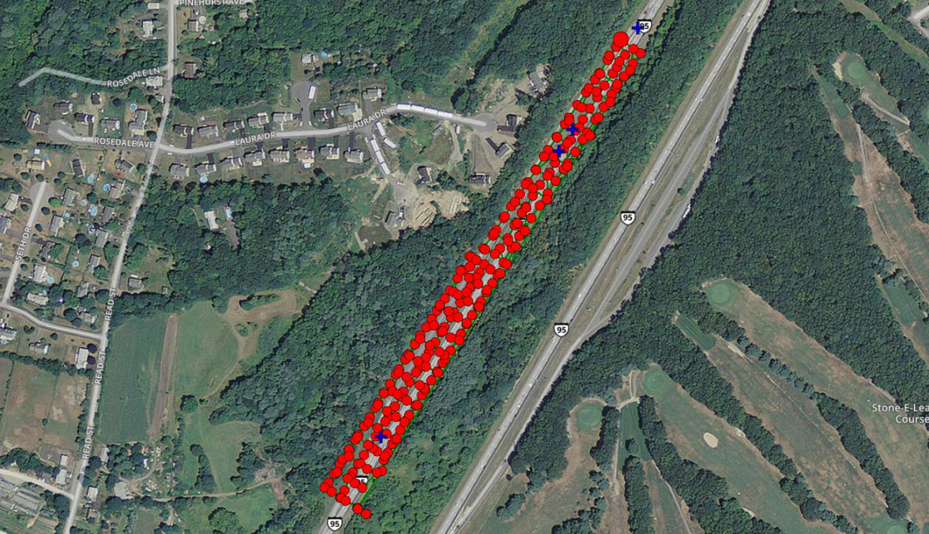
Pix4D – Map View
Rte 95 Attleboro

Slide 21
Pix4D – Camera Positions
Rte 95 Attleboro

Slide 22
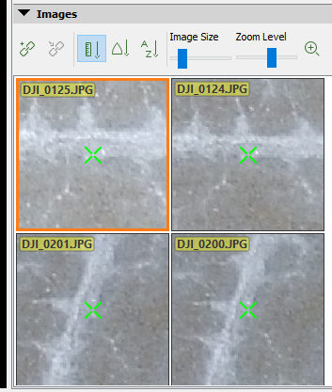
Pix4D – Camera Positions
Rte 95 Attleboro

Slide 23
Pix4D – Densified Point Cloud
Rte 95 Attleboro

Slide 24
Pix4D – Orthomosaic
Rte 95 Attleboro

Slide 25
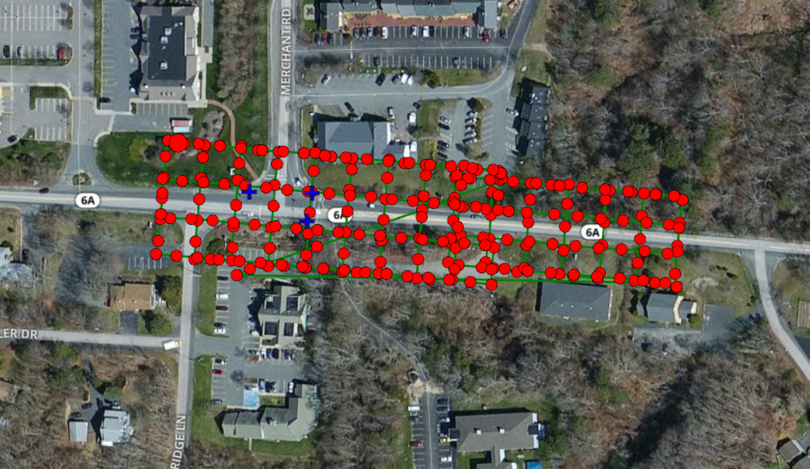
Pix4D – Map View
Rte 6A Sandwich

Slide 26
Pix4D – Camera Positions
Rte 6A Sandwich

Slide 27
Pix4D – Densified Point Cloud
Rte 6A Sandwich

Slide 28
Pix4D – Densified Point Cloud
Rte 6A Sandwich

Slide 29
Pix4D – Orthomosaic
Rte 6A Sandwich

Slide 30
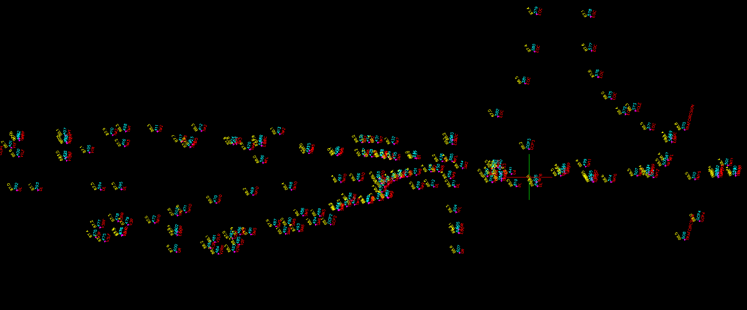
Data Points with Total Station or GPS
Rte 28 Bourne

Slide 31
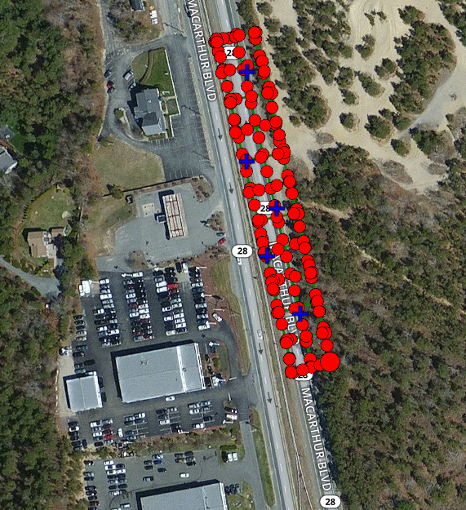
Pix4D – Map View
Rte 28 Bourne

Slide 32
Pix4D – Camera Positions
Rte 28 Bourne

Slide 33
Pix4D – Densified Point Cloud
Rte 28 Bourne

Slide 34
Pix4D – Orthomosaic
Rte 28 Bourne

Slide 35
Pix4D – Orthomosaic w/Data Points
Rte 28 Bourne

Slide 36
Lieutenant Timothy E. Dowd
Massachusetts State Police
Collision Analysis and Reconstruction Section
Timothy.dowd@massmail.state.ma.us
Office: 508-698-0485
Cell: 774-249-0323

