Slide 1

New England ITS
TRAFFIC INCIDENT MANAGEMENT
5/20/2018

Slide 2
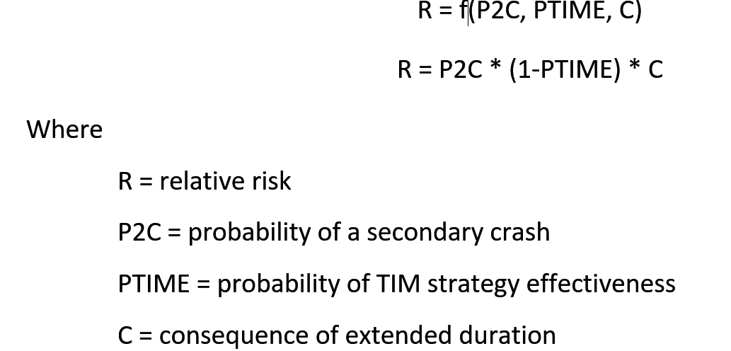
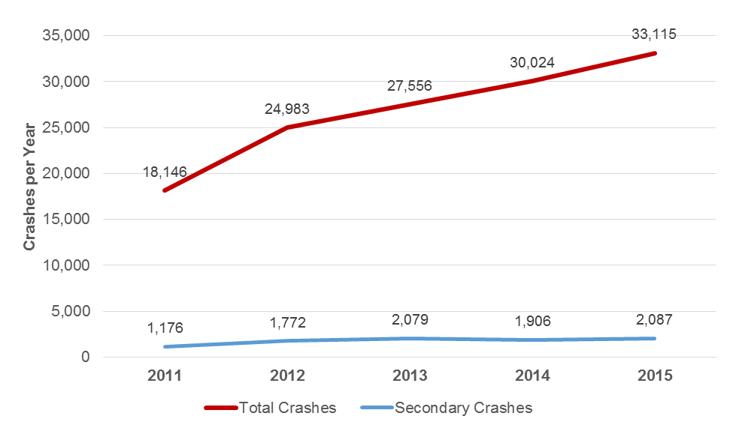
Future TIM Investment is Dependent on Risk Management
PTIME
P2C
C

Slide 3
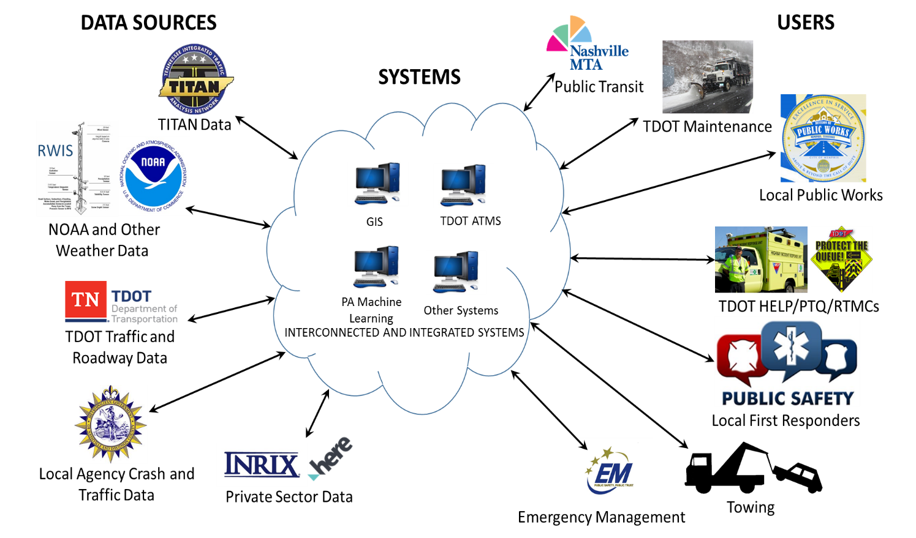
Predictive Operations Drive Resource Allocation and Responder Safety

