Slide 1
Applications of Small Unmanned Aircraft Systems (sUAS) in Ground Transportation
Michael Plotnikov, Ph. D.
Research Associate
Daiheng Ni, Ph. D.
Associate Professor of Civil and
Environmental Engineering
John Collura, Ph. D., P.E
Professor of Civil and Environmental Engineering
University of Massachusetts Transportation Center
UMass Aviation Center

Slide 2
Major Reasons for sUAS Implementation
Improvement in operations
Reduction in personnel
Increased safety
Time savings
Notes:
UAS applications can:
- cut twice the number of required workers;
shrink by four-fold the necessary time to conduct the activity;
minimize resulting congestion and need for heavy equipment; and
reduce operating costs sixteen-fold

Slide 3
Small UAS: Design and Area of Application
 | UAS Platform Design
 | Fixed Wing | Rotorcraft
Major Advantages | Longer flight endurance, higher speed, larger area of coverage | Better maneuverability, ability to hover over a selected point, vertical take-off and landing
Major Drawbacks | Require a launching and recovery device or larger open area | Limited endurance and flight distance
Preferred Area of Implementation | Large area survey, long-distance operations | Infrastructure survey, confined space survey
Examples of Application | Rail track inspection, campus mapping | Bridge inspection, cell tower inspection
Common UAS Examples | SenseFly eBee, Precision Hawk Lancaster | DJI Inspire, Yuneec H520

Slide 4
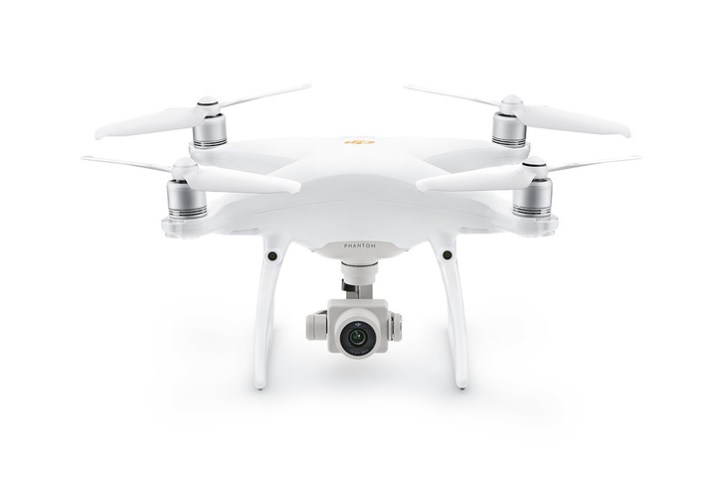
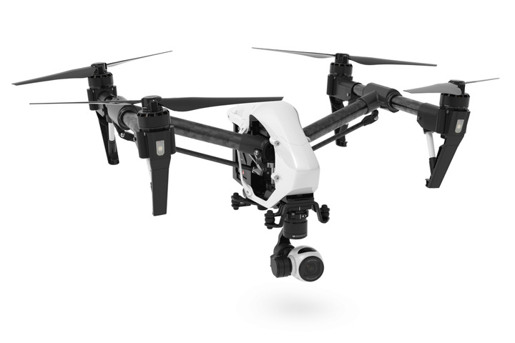
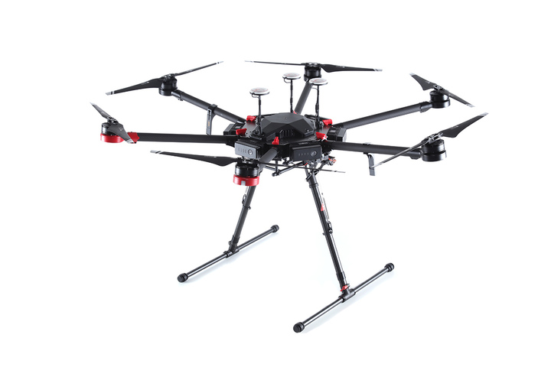
Rotorcraft sUAS: Examples
 | “Prosumer” | “Professional” | “Enterprise”
Manufacturer and Model | DJI Phantom 4 Professional | DJI Inspire 1 v.2 | Matrice 600 Pro
Airframe Type | Rotorcraft, quad-copter | Rotorcraft, quad-copter | Rotorcraft, hex-copter
Takeoff Weight, lbs. | 3.3 | 6.3 | 34
Payload, lbs. | - | 1.1 | 13
On-board Sensors | Visual (RGB) | Visual (RGB), Thermal (IR) | Multiple sensor options
Flight Time | 30 min. | 18 min. | 16-30 min.
Control Range | Up to 4.3 mile | Up to 4.3 mile | Up to 3.1 mile
Performed Tasks | Photo/video recording | Photo/video recording, thermal imaging | Various tasks (payload-dependent)
Price | $1,500 | $3,200+ | $5,000+

Slide 5
sUAS Activities at State DOTs
Alabama | Hawaii | Massachusetts | New Mexico | South Dakota
Alaska | Idaho | Michigan | New York | Tennessee
Arizona | Illinois | Minnesota | North Carolina | Texas
Arkansas | Indiana | Mississippi | North Dakota | Utah
California | Iowa | Missouri | Ohio | Vermont
Colorado | Kansas | Montana | Oklahoma | Virginia
Connecticut | Kentucky | Nebraska | Oregon | Washington
Delaware | Louisiana | Nevada | Pennsylvania | West Virginia
Florida | Maine | New Hampshire | Rhode Island | Wisconsin
Georgia | Maryland | New Jersey | South Carolina | Wyoming
Notes:
- 39 State DOTs have activities either directly or indirectly related to UAS applications
- 33 State DOTs have already deployed, experimented, or in or plan to deploy UAS applications
DESCRIBE COLOR – DIFFICULT TO READ!

Slide 6
sUAS Applications in Transportation
Asset management
Construction monitoring
Disaster response
Infrastructure inspection
Surveillance
Traffic operations/analysis
Notes:
Applications are listed in alphabetical order and not in order of importance!

Slide 7
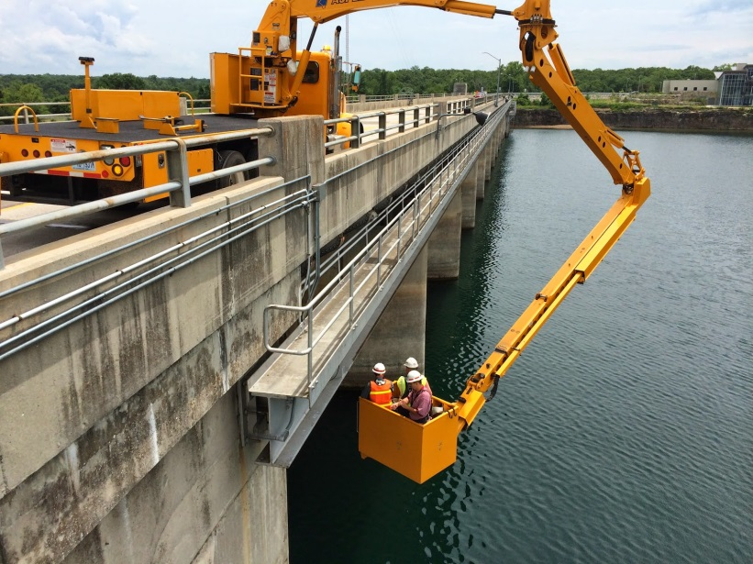
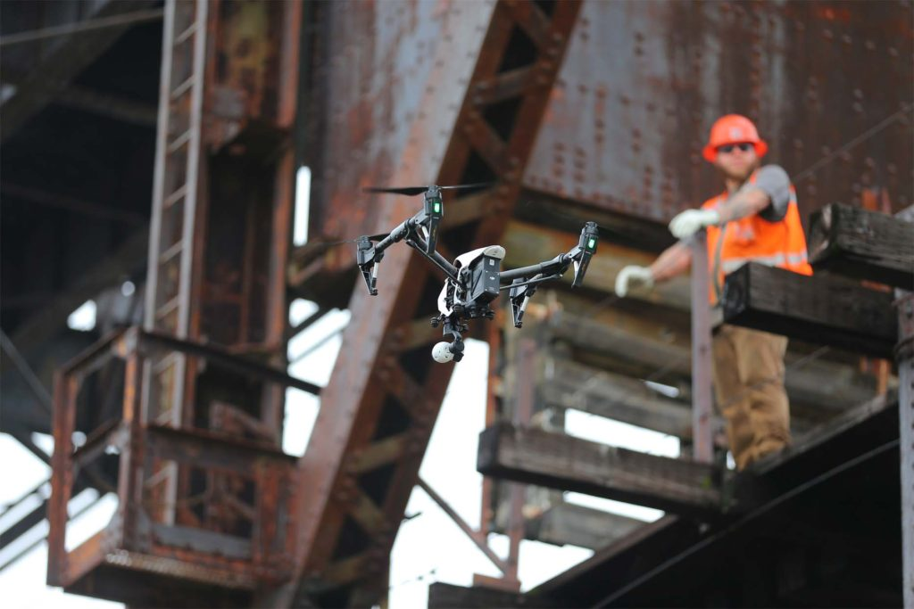
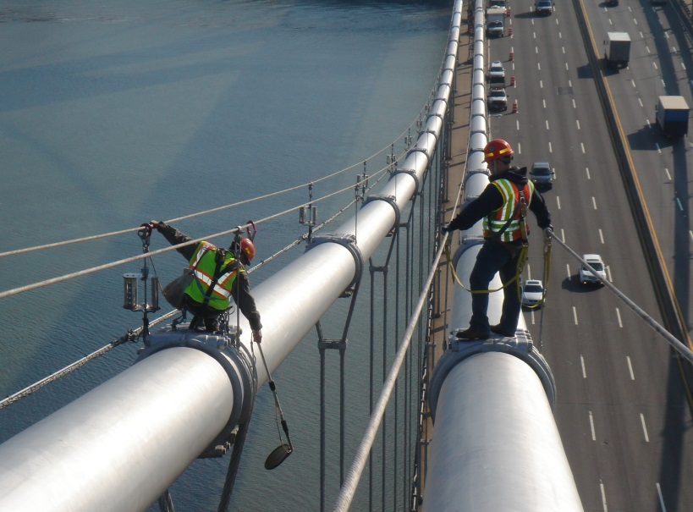
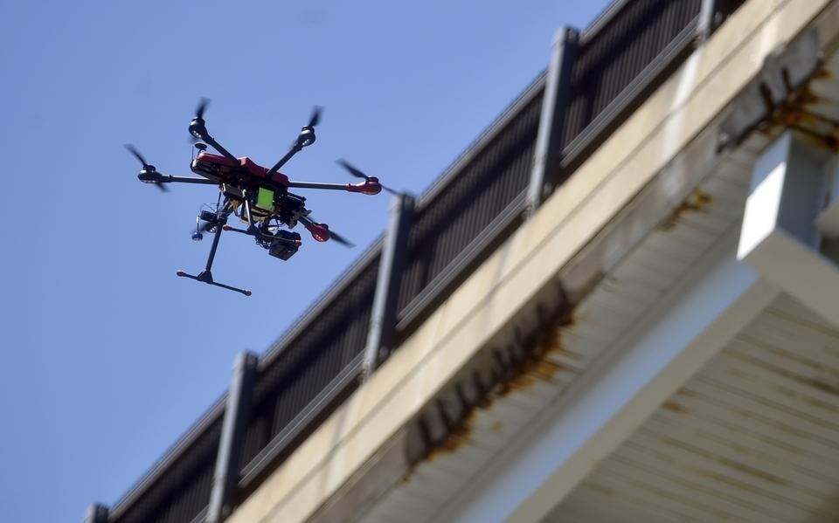
Example: Infrastructure Inspection

Slide 8
Example: Traffic Surveillance
Image source: Elistair/UST

Slide 9
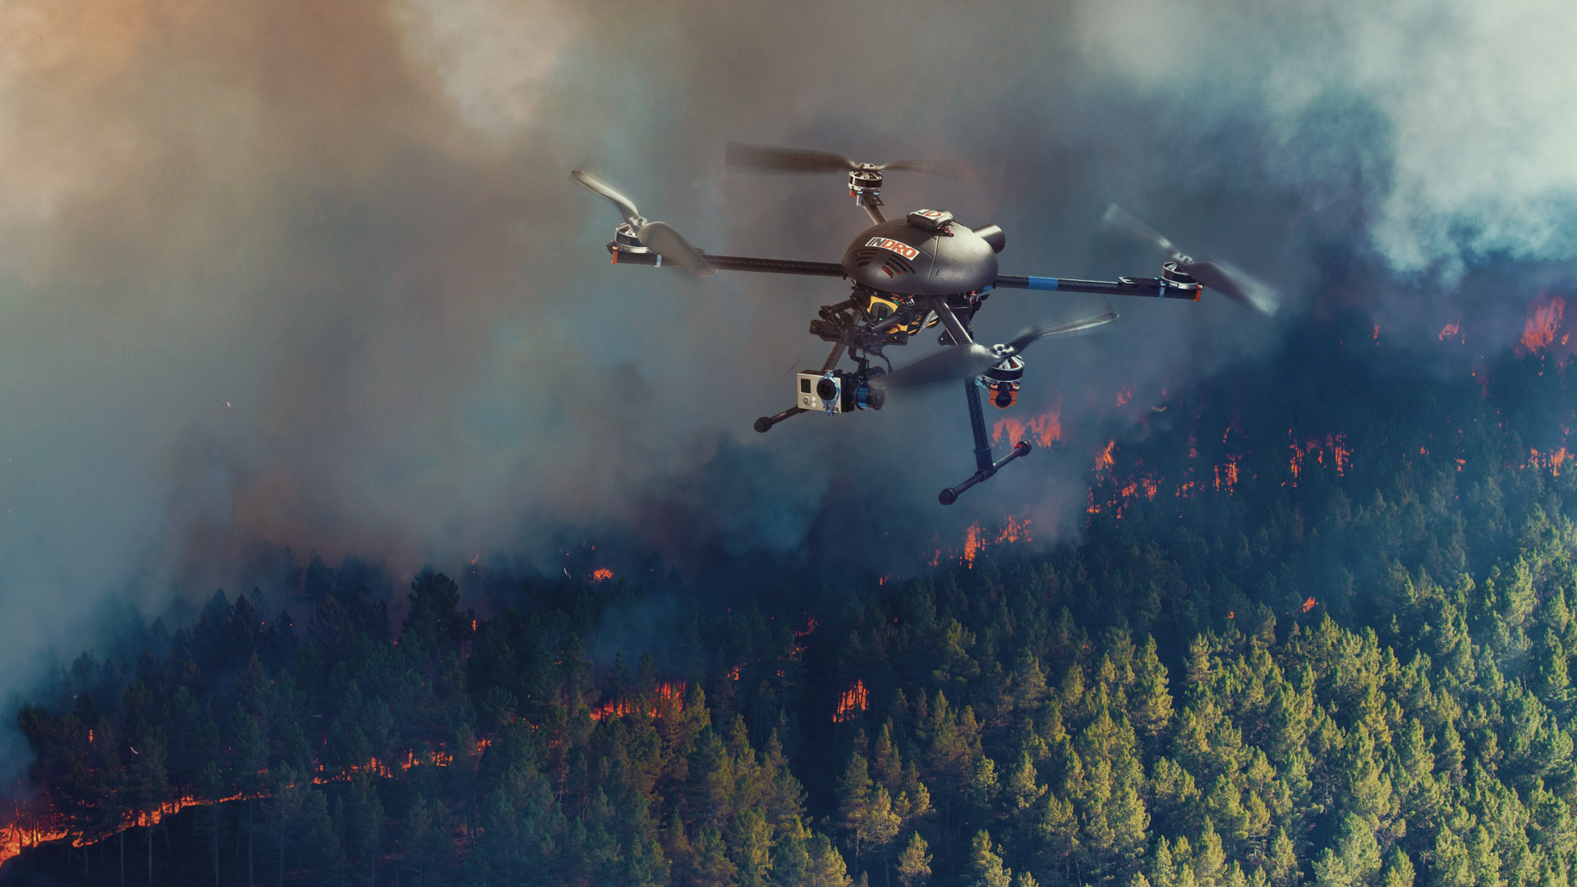
Example: Emergency Response
Image source: PRWeb.com

Slide 10
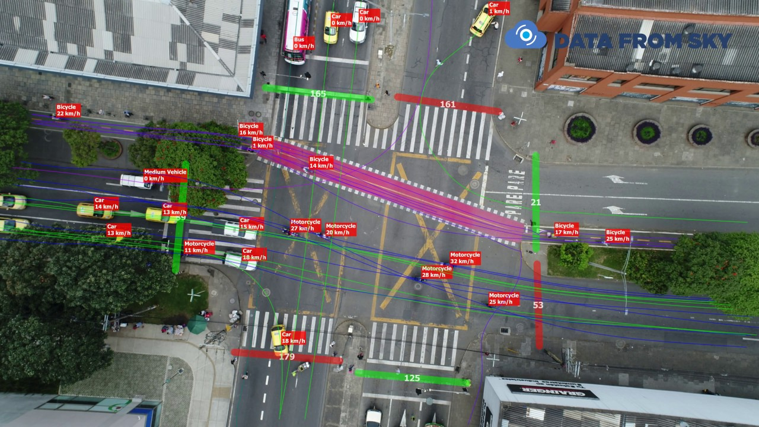
Example: Traffic Pattern Analysis

Slide 11
According to AASHTO…
Certain UAS applications can:
- Cut twice the number of required workers;
- Shrink by four-fold the necessary time to conduct the activity;
- Minimize resulting congestion and need for heavy equipment; and…
- Reduce operating costs sixteen-fold!
Notes:
For example, reports indicated that some UAS applications can cut twice the number of required workers; shrink by four-fold the necessary time to conduct the activity; minimize resulting congestion and need for heavy equipment; and reduce operating costs sixteen-fold

Slide 12
MassDOT sUAS Applications
Bridge Inspection
Construction Site Inspection
Roadway Asset Management
Crash Investigation
Notes:
- UAS technology provides a cost-effective and safe method for bridge inspections and inventory
- UAS platform with different sensors can be used to collect image, video and other data for on-site inspections and to monitor construction projects
- UAS can be used for monitoring roadway surface conditions and proper operation of traffic control devices

Slide 13
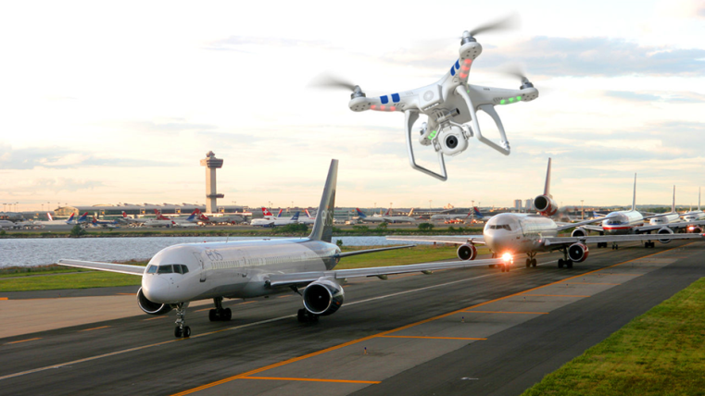
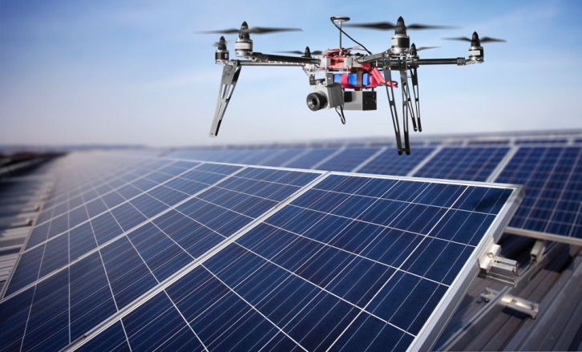
Questions?
Michael Plotnikov, Ph. D.
UMass Transportation Center
mplotnik@engin.umass.edu
Daiheng Ni, Ph. D.
UMass Amherst
ni@engin.umass.edu
John Collura, Ph. D., P.E.
UMass Aviation Center
collura@engin.umass.edu

