Slide 1
ONE MISSION – ONE TEAM

Slide 2
TIM in Massachusetts
4 Hour Responder Program
Massachusetts Goals
Eliminate operational and agency barriers
Improve integrated response
Enhance pre-incident communication and coordination
Notes:
In addition to the overarching goals of the SHRP2 TIM program, Massachusetts has added goals
TIM fundamentals are similar to any emergency or incident response planning
TIM is scalable and adaptable
Should be integrated into other emergency planning efforts (Evacuation,

Slide 3
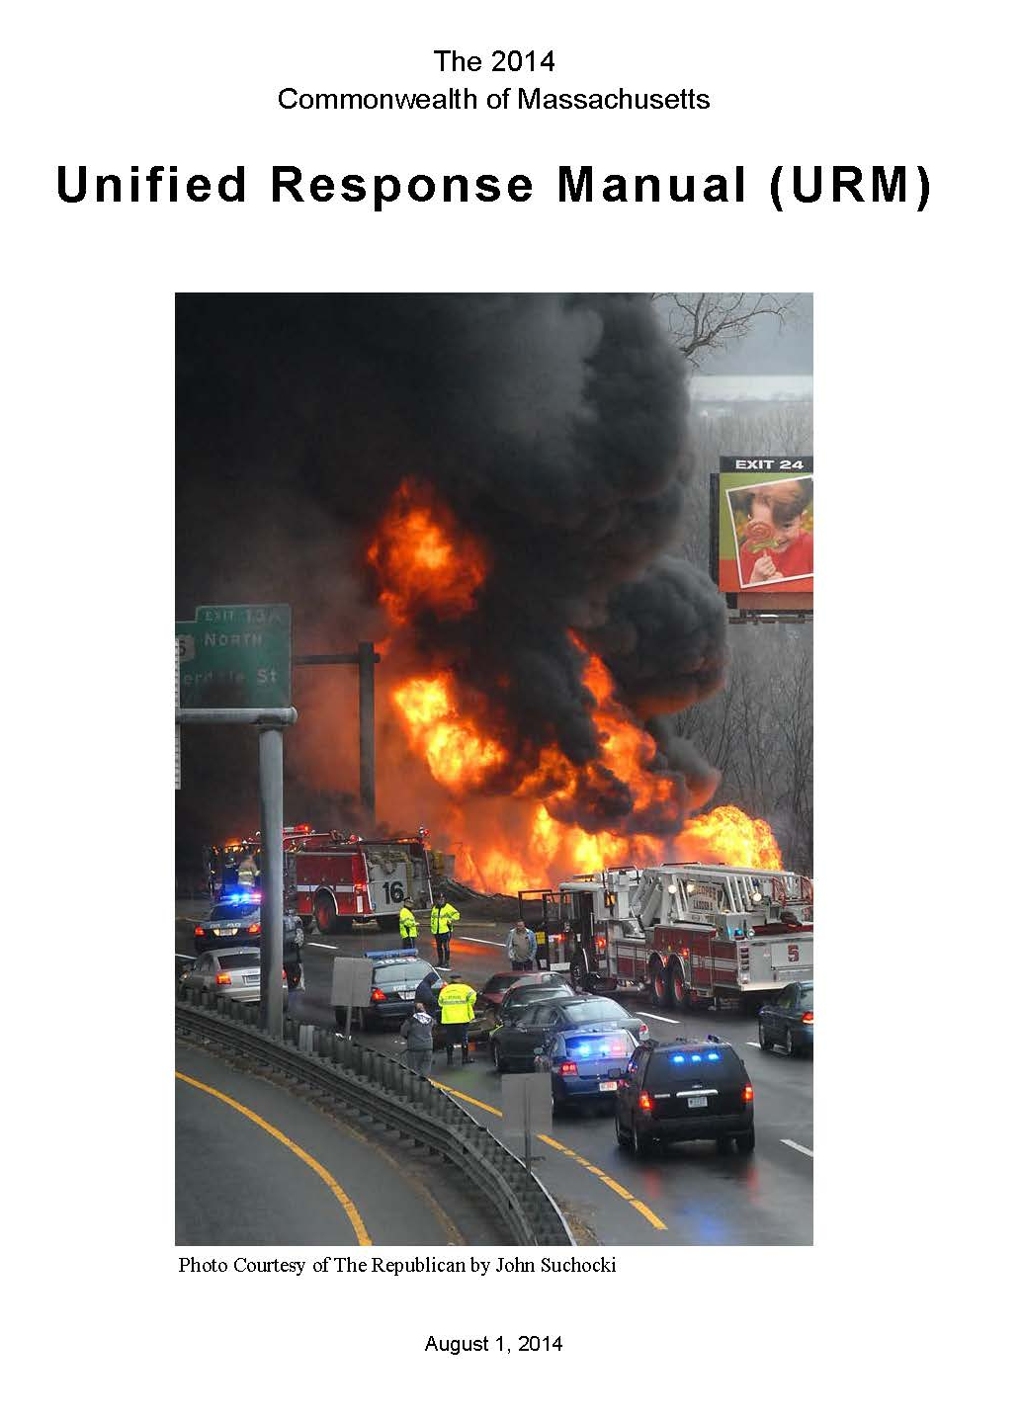
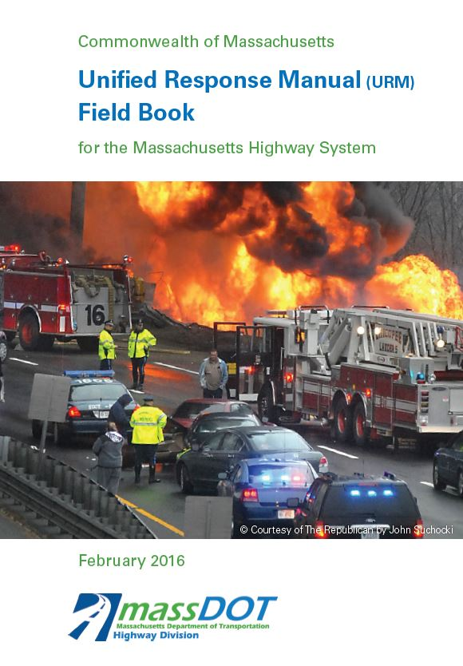
Massachusetts TIM Task Force
4 Hour Responder TIM required in all municipal and state police academies
Authorized to award EMS continuing education credit
Joint full-scale exercises
URM AND URM Field Book
Emergency contacts database
Notes:
The NIMS requirement that ICS be used at traffic incident scenes is emphasized in MUTCD Section 6I.01
Some states have laws that prescribe who is in charge at roadway incidents, while in other states there may be memorandum of understanding (MOU), joint operating procedures/policies, or other agreements that define responsibilities
The National TIM Responder training course assumes that participants have already taken ICS 100, 200, and IS 700
The material in Lesson 6 is intended to simply be a review of the fundamental ICS information presented in these three online courses in the context of traffic incidents
For those who have not completed these courses, they are available online at no charge and are strongly recommended for all responders
https://training.fema.gov/nims/

Slide 4
Vehicle Positioning
Notes:
What are the consequences of self diverting traffic?
What if there is a weight restriction for the bridge?
School getting out?

